Slide 1
Education Safeguarding Refresher 2025
Mark Cowell & Rachel Orwin

Slide 2
Why is Safeguarding so important?
Blackpool is the most deprived district in the Index of Multiple Deprivation against all local authorities
in England. Approximately 32.9% (8,237) of children live in relative low-income families
Crime and Anti-Social Behaviour headlines
Blackpool had the highest rate of all crime per 1000 population across the county in 2024.
Blackpool had the peak volume and rates across Lancashire for robbery, vehicle crime, and violent crime.
Anti-Social Behaviour incidents – Blackpool had the peak volume and rate per 1000 population across Lancashire in 2024.
Domestic abuse :The highest number of offences were reported in the Bloomfield ward, followed by Claremont, Talbot, and Brunswick wards.

Slide 3

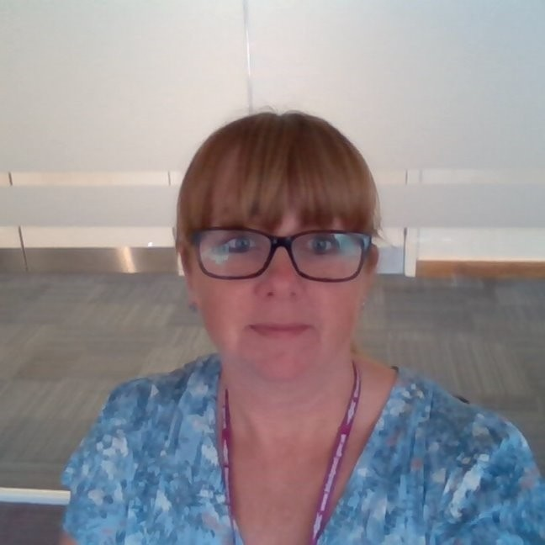

Blackpool Council Team
Mark Cowell
Head of Service
School Standards
Rachel Orwin
Early Intervention and Safeguarding Officer
Faye Weszka
Education Officer
Natasha Armstead
Pupil Welfare and Licensing Service Manager
Helen Piggott
Head of Virtual School
Charlotte Baron
Head of Service for SEND
Ged McNally
Education Inclusion Officer

Slide 4
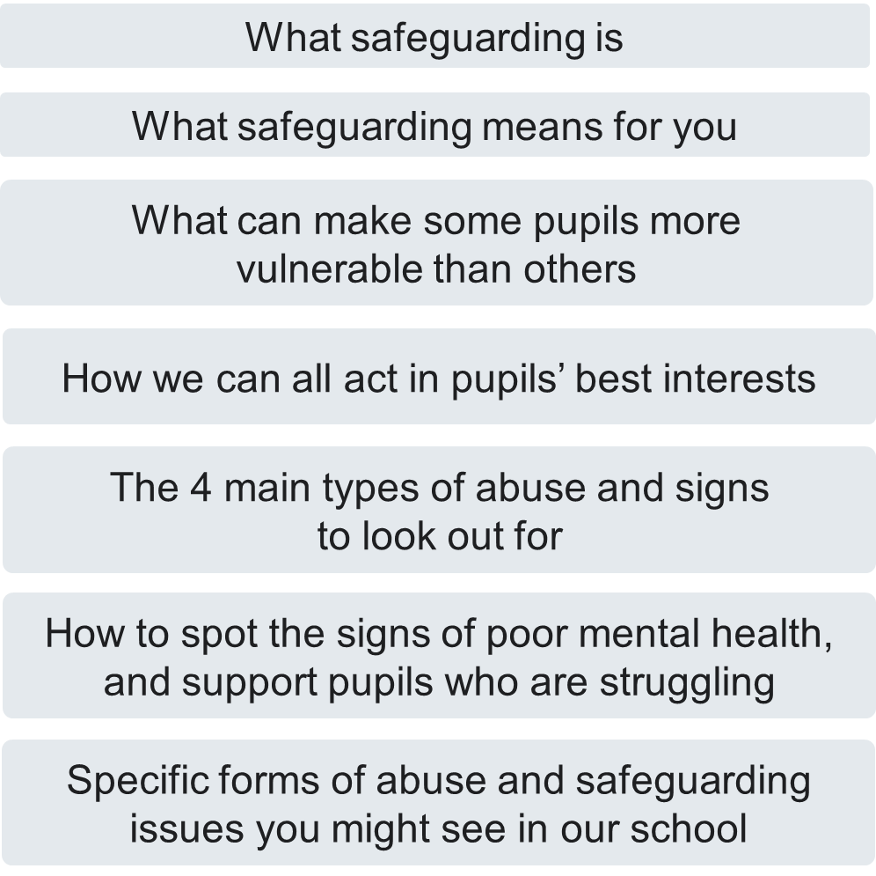
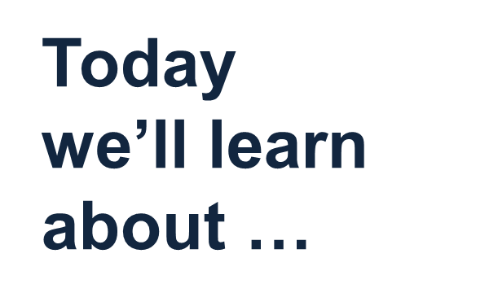

Slide 5
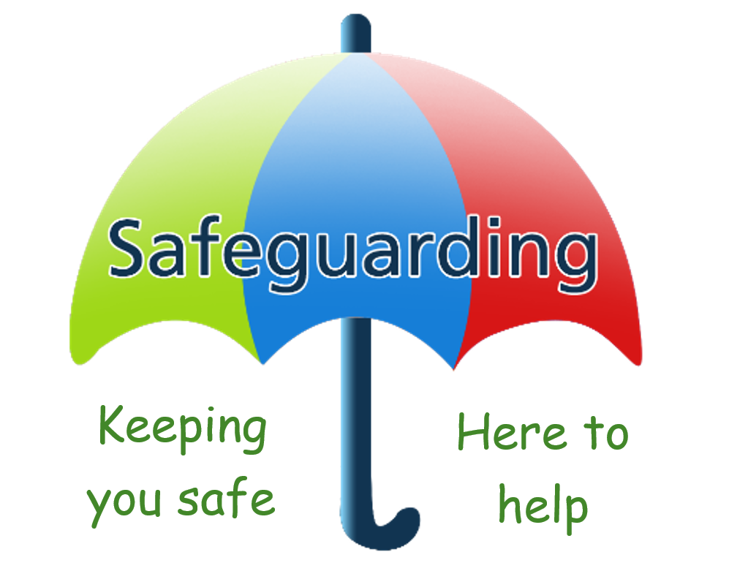
What is Safeguarding?

Slide 6
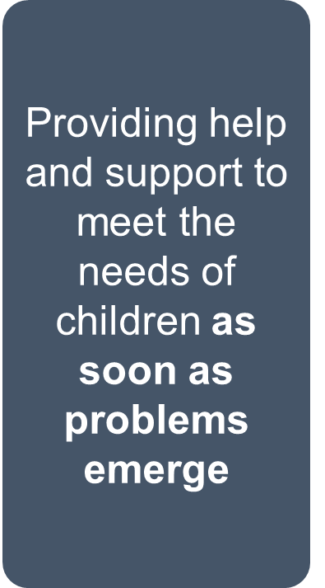
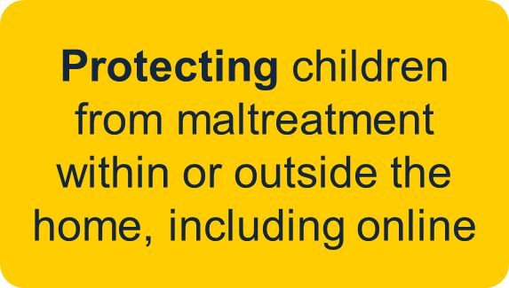
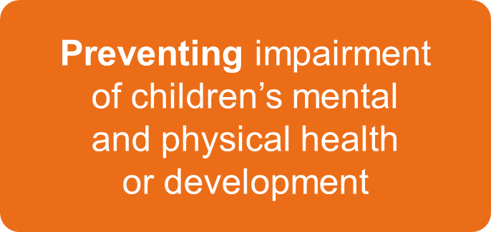
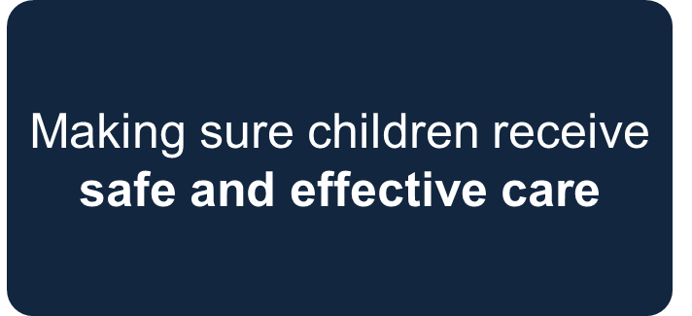
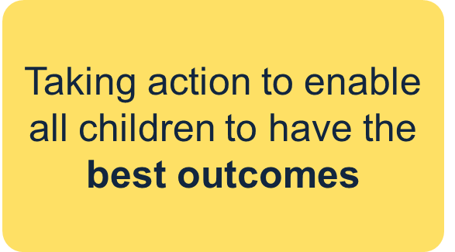
Safeguarding is…..
Notes:
Explain that to effectively safeguard children, we need to know what we mean by the term ‘safeguarding’
Essentially, safeguarding means protecting children from harm, so they can grow up safe, happy and healthy
Remind staff that children are children until they are 18
Select to bring up each element in turn. In more detail, safeguarding means:
Providing help and supporting to meet the needs of children as soon as problems emerge
Protecting children from maltreatment, whether that is within or outside the home, including online
Preventing impairment of children’s mental and physical health or development
Making sure children receive safe and effective care as they grow up
Taking action to enable all children to have the best outcomes
Tell staff that the definition of safeguarding on the slide is set out in Keeping Children Safe in Education (KCSIE) and that you’ll look at other changes to the guidance in later slides
Sources:
GOV.UK – Department for Education (DfE), Keeping Children Safe in Education. https://www.gov.uk/government/publications/keeping-children-safe-in-education--2

Slide 7
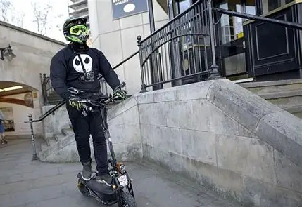
Blackpool Schools Safeguarding Issues
Serious Organised Crime for Blackpool is a huge issue:
County Lines OCGs (Organised Crime Groups) supplying Class A drugs.
Utilisation of E-bikes to deal drugs from. Exploitation of the vulnerable – to deal drugs.
OCG violence including the use of weapons.
Sexual exploitation
Substance misuse
Peer on Peer
Educational Neglect
Mental Health Issues
Notes:
Top few taken from GENGA
https://www.lancashire.gov.uk/media/962034/blackpool-district-profile-2025.pdf

Slide 8
Blackpool Figures
Years | 21-22 | 22-23 | 23-24 | 24-25
Total school contacts | 934 | 1298 | 1197 | 1235
Contacts - Social Care | 260 | 272 | 320 | 355
Contacts - Early Help | 503 | 637 | 536 | 248
Contacts - Universal Services | 141 | 354 | 275 | 219
Contacts - Information or Advice | 14 | 21 | 24 | 348
Contacts - Information Noted | 6 | 5 | 8 | 86
Contacts - NFA (Form Incomplete) | 10 | 7 | 10 | 10
Contacts - Contact Incomplete | 0 | 2 | 0 | 0

Slide 9

What does Safeguarding mean for me?

Slide 10

Changes to Keeping Children Safe in Education and what they mean for you
Clarification that misinformation, disinformation and conspiracy theories are safeguarding harms
Filtering and monitoring and the use of AI
Notes:
Explain that all staff need to read part 1 of Keeping Children Safe in Education OR all staff who work directly with children need to read part 1 of Keeping Children Safe in Education, and staff who don’t work directly with children need to read Annex A of the guidance
Explain that the key changes to the latest version of Keeping Children Safe in Education 2025 are around misinformation, disinformation (including fake news) and conspiracy theories, also filtering and monitoring requirements around AI
Tell staff that you’ll go into more detail on these changes on the next slides
Other changes to KCSIE you might want to highlight to staff, according to your school context:
Clarity that ‘Working together to safeguarding attendance’ is now statutory guidance
The DfE expects to publish revised guidance on Relationships, Sex and Health Education this summer, and will signpost this guidance in KCSIE this September
The DfE expects to publish revised guidance on gender questioning children this summer, and will signpost this guidance in KCSIE this September
A link has been added to the ‘plan technology for your school’ service, which schools can use to assess themselves against the filtering and monitoring standards and receive recommendations on how to meet them
To align with the SEND code of practice, the terms “spectrum” and “disorder” have been replaced with the term “autism” in the paragraph referring to gender questioning children
Clarity that the ‘cybersecurity standards for schools and colleges’ were developed to help schools improve their cyber resilience
Where a school places a pupil with an alternative provision (AP) provider: schools should obtain written information from the AP providers that appropriate safeguarding checks have been carried out on staff working in the setting, including written confirmation from AP provider that they will inform the commissioning school of any arrangements that might put the pupil at risk, (i.e. staff changes) so the commissioning school can itself make sure that safeguarding checks have been carried out on new staff
Source:
GOV.UK – Department for Education (DfE), Keeping Children Safe in Education. https://www.gov.uk/government/publications/keeping-children-safe-in-education--2

Slide 11
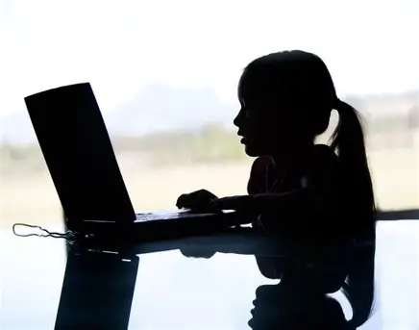
Disinformation, misinformation and conspiracy theories
Disinformation, misinformation and conspiracy theories are online safety risks for children
They refer to the spread of false information or ‘fake news’ online
Children can be more at risk of taking this content at face value
Advanced AI tools can be used to present the information as fact, making it appear realistic, including the use of AI-generated images and videos
As school staff we all have a role to play to ensure pupils are kept safe online from this risk
It’s important that we find opportunities to discuss where pupils get their information from, so they understand the risks
Notes:
Tell staff you’ll now go into more detail about misinformation, disinformation and conspiracy theories:
Explain that KCSIE 2025 clarifies these are safeguarding risks for children
Explain that disinformation, misinformation and conspiracy theories refer to the spread of false information or ‘fake news’ online
Children can be more at risk of taking this potentially harmful and inappropriate content at face value
Explain how advanced AI tools can be used to present the information as fact, making it appear realistic, including the use of AI-generated videos
Remind them that, as school staff, we all have a role to play to ensure pupils are kept safe online
Explain how, as a school, it’s important that we find opportunities to discuss where pupils are getting information from, to protect and educate them, so they understand the risks
If you want to go into more detail on the topic of misinformation online, use slides 88 to 92 of the ‘mix and match’ section of this presentation
Source:
GOV.UK – Department for Education (DfE), Keeping Children Safe in Education. https://www.gov.uk/government/publications/keeping-children-safe-in-education--2

Slide 12
Filtering and monitoring and the use of AI
As a school, the filtering and monitoring procedures also apply to the use of generative AI
We need to make sure pupils are using gen-AI safely, and should monitor any use of AI in the classroom closely
It’s important that any AI products pupils are using in school have the highest standards of filtering possible
We also need to make that if we are asking pupils to use AI in lessons, that they’re not accessing harmful or inappropriate content
If you find that pupils are able to access inappropriate content while using an AI tool, report this to your school’s DSL as soon as possible
Notes:
Tell staff that KCSIE supports schools to use AI safely, and help them understand their filtering and monitoring requirements around AI:
As a school, our filtering and monitoring procedures also apply to the use of generative AI
We need to make sure pupils are using gen-AI safely, and we need to monitor any use of AI in the classroom closely
It’s important that any AI products pupils are using in school have the highest standards of filtering possible
We also need to make sure that if we are asking pupils to use AI in lessons, that they’re not accessing harmful or inappropriate content
If you find that pupils are able to access inappropriate content using an AI tool, report this to you (the DSL)
Explain to staff that as new technology and tools emerge, we will need to keep updating our filtering and monitoring in response
Source:
GOV.UK – Department for Education (DfE), Keeping Children Safe in Education. https://www.gov.uk/government/publications/keeping-children-safe-in-education--2
GOV.UK – Department for Education (DfE), Generative AI: product safety expectations. https://www.gov.uk/government/publications/generative-ai-product-safety-expectations/generative-ai-product-safety-expectations

Slide 13

Safeguarding is everyone’s responsibility
Teaching assistants
Catering staff
Teachers
Office staff
IT technicians
Notes:
Explain that you’re now going to see how every member of staff can play a role in safeguarding children
Select to bring up the different roles one by one
Acknowledge that you can’t cover every role in school in the time you have today, and ask staff to find the role closest to their own on the slide. Ask staff to think about what they, in their role, might notice about a child that could be a cause for concern
Take some feedback from staff. Highlight:
Catering staff will see pupils interacting with each other outside class and overhear conversations. They might notice who’s eating more or less, or children who are stealing food
Office staff might notice high levels of absence, pupils who are often late, and/or parents and carers who are often tricky to get hold of or slow to respond to messages from the school
Teaching assistants might notice changes in behaviour in the pupils they work closely with, in lessons
Teachers might notice children doing less well at school, changes in their behaviour, and other small changes over time
IT technicians will see what pupils are searching for and trying to access
Taken on their own, these things might not seem like much. But, if staff report them, you (the DSL) can start to build a picture. Their piece of information could be the final piece of the puzzle that helps you (the DSL) to make a referral to children’s social care

Slide 14
Look out for changes in a child
Difficulty concentrating or grades dropping
Using drugs or alcohol
Increased absence from school or lessons
Becoming withdrawn
Risk-taking behaviour
Tiredness
Mood or behaviour changes
Mental Health
Self-harming
Notes:
Say that now we've seen that everyone has a role to play and we must always act on concerns, we’re going to look at the common signs that should always be a cause for concern
Ask staff: what have you previously seen that led to you making a report? If you haven’t made a report, what sort of things might you see that should make you worried about a child? Take a few suggestions from staff then select to bring up the signs and talk through them
Select to bring the signs up in turn:
Difficulty concentrating and not doing as well at school
Becoming withdrawn
Mood and behaviour changes – for example, becoming more irritable, angry, aggressive or clingy, attention-seeking behaviour or ‘acting out’
Risk-taking behaviour – this could include behaviour such as stealing, bullying, running away, trespassing or vandalism, fighting or truancy
Mental health needs – this could be signs of depression, anxiety, an eating disorder or post-traumatic stress disorder, for example. Tell staff you’ll cover the common signs of mental health needs to be alert to later in this session
Tiredness
Self-harming – this could include disordered eating
Increased absence from school or lessons, which is also a safeguarding concern because we don’t know where pupils are outside or inside of school
Note these signs are common across multiple different safeguarding issues and types of abuse
Emphasise that:
The key thing to look for is a change in the child. Staff don't need to 'diagnose' an issue or know exactly what it might be, just notice that something might be wrong and act. It’s for others to investigate what the issue might be
Children can try to communicate that something is wrong through their behaviour, either intentionally or unintentionally
Staff should be professionally curious about what might be behind the change they’re seeing
Some of these signs might be innocent – for example, a child might experience mood swings as they go through puberty – but they should always be reported
If there are EYFS staff in this session, you may want to explain how some of the changes on the slide, such as using drugs or alcohol, are less likely to happen with younger children but they should still be on the alert for anything that could indicate a concern
Sources:
NHS, Spotting signs of child sexual abuse. https://www.nhs.uk/live-well/spotting-signs-of-child-sexual-abuse/
NHS, How to spot child sexual exploitation. https://www.nhs.uk/live-well/how-to-spot-child-sexual-exploitation/
NSPCC, Spotting the signs of child abuse. https://www.nspcc.org.uk/what-is-child-abuse/spotting-signs-child-abuse/
GOV.UK – Department for Education (DfE), Keeping Children Safe in Education. https://www.gov.uk/government/publications/keeping-children-safe-in-education--2

Slide 15
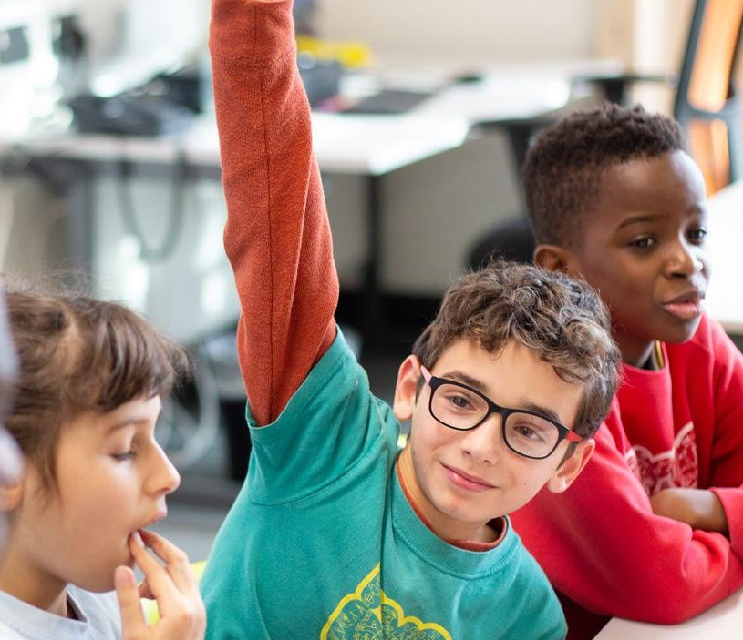
Some children are more vulnerable than others
Live in challenging family circumstances
Are misusing drugs
or alcohol
Are young carers
Have a family member experiencing poor mental health
Are at risk of
abuse linked to
faith or belief
Are being drawn into
antisocial or
criminal behaviour
Are at risk of radicalisation
Are at risk of
modern slavery, trafficking or exploitation
Are educated at home
Notes:
Explain that this slide is a follow-on from the previous slide, listing further groups of pupils who are more vulnerable to abuse
Select to bring up the groups of pupils who are more likely to need early help or may be at greater risk of harm and run through them These include pupils who:
Are in challenging family circumstances – for example, living around drug and alcohol misuse or domestic abuse
Are at risk of abuse linked to faith or belief
Are at risk of radicalisation
Are at risk of modern slavery, trafficking or sexual or criminal exploitation
Are misusing drugs or alcohol
Are young carers
Are involved in a gang
Are showing signs of being drawn into antisocial or criminal behaviour, including gang involvement and association with organised crime or county lines
Are educated at home and therefore less visible to the services that are there to keep them safe and supported in line with their needs
Have a family member experiencing poor mental health
Note that early help means providing support as soon as a problem emerges at any point in a child’s life, from the foundation years through to the teenage years
Sources:
GOV.UK – Department for Education (DfE), Keeping Children Safe in Education. https://www.gov.uk/government/publications/keeping-children-safe-in-education--2

Slide 16
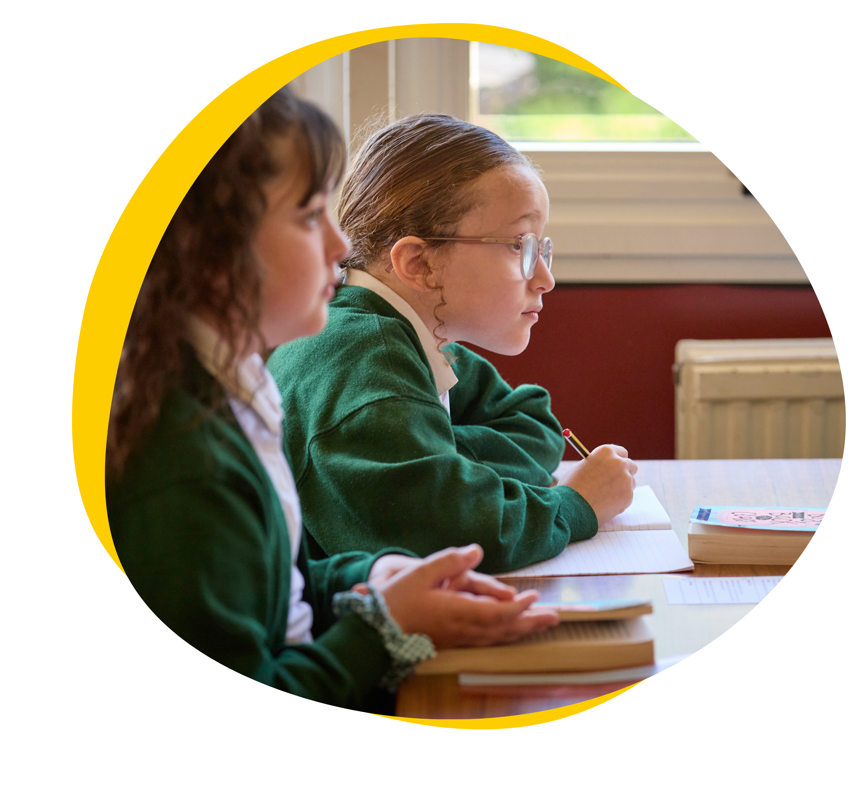
Be even more alert to our Children with SEND and SEMH needs
They can be more vulnerable because they might:
Rely on others more, or be more innocent or trusting
Find it harder to tell someone about their abuse
Be less likely to understand their experiences as abuse
Be more prone to isolation or bullying
Find it harder to communicate their feelings and emotions
Signs of abuse might also be missed or dismissed.
Many forms of SEND are invisible – this doesn’t mean these children are less vulnerable.
Always use professional curiosity: think ‘why?’ or ‘what might be going on here?’
Notes:
Tell staff you're going to look at a particular group in more detail now: pupils with special educational needs and disabilities (SEND) and social, emotional and mental health needs (SEMH)
Highlight that children with disabilities are over 3 times more likely to be abused than other children
Explain they're more vulnerable as they might:
Rely on others for assistance and care, giving abusers more opportunities to abuse them. They might be more prone to trusting others, and/or naïve when it comes to abusive behaviour. For example, they may be more likely to believe lies told to them by strangers on the internet, or more likely to assume that an abusive family situation is normal
Find it harder to communicate their abuse. This could be due to communication barriers caused by their speech, language and communication needs, or because they’re more isolated and have fewer opportunities to tell someone about abuse
Be less likely to understand that what they're experiencing is abuse. This doesn’t mean they aren’t harmed by abuse, though – they’re still experiencing harm
Be more prone to isolation and/or bullying by their peer group due to their SEN or disability
Find it harder to communicate their feelings and emotions
Signs of abuse can also be missed, as they're seen as symptoms of their SEN or disability or caused by their SEN or disability. For example, bruises might be assumed to be caused by disability equipment or problems with mobility. Or, children experiencing abuse or attempting to tell someone about their abuse might self-harm or display inappropriate sexual behaviour, or other repetitive or challenging behaviours, which are misinterpreted as part of their needs or disabilities
Remind staff that:
All forms of SEND are different, and even 2 pupils with the same form of SEND may have different strengths and weaknesses. All these risk factors may or may not be true for any individual
SEND is more than the stereotyped use of wheelchairs and/or blindness or deafness – a lot of SEN and disabilities are invisible, and it can be easy to forget that these children are also vulnerable. For example, neurodivergent pupils can be particularly good at ‘masking’, where they hide their struggles and act as though everything is fine when it’s not
Give staff an example. Either use an (anonymous) example from your context if you have one, or share the example below:
A 15-year-old girl – ‘Maria’ – was the victim of criminal exploitation and sexual exploitation
Maria had SEN and speech and language difficulties, which she received support for at school
Maria was targeted by a gang in her local area on her way to and from school
On one occasion Maria went missing, and was found three hours away from her home by the police
It turned out the gang had used Maria to transport class A drugs, which is known as county lines
Maria’s speech and language issues meant she found it difficult to communicate what had happened to her
The gang also gave her a sense of belonging that she lacked with her peers at school
It later emerged Maria had been sexually assaulted by two different men in the gang
So, what should staff do?
Be even more alert to children with SEND and any signs that something might be wrong
Always use professional curiosity. Think 'why?' or 'what might be going on here?’
Sources:
GOV.UK – Department for Education (DfE), Keeping Children Safe in Education. https://www.gov.uk/government/publications/keeping-children-safe-in-education--2
Safeguarding network, Specific Risks for Children with Additional Needs. https://safeguarding.network/content/safeguarding-resources/specific-risks-children-additional-needs/
GOV.UK – Ofsted, Social care commentary: protecting disabled children. https://www.gov.uk/government/speeches/social-care-commentary-october-2017

Slide 17
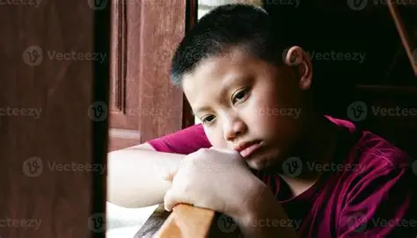
Let’s discuss …
What do we mean by ‘abuse’?
What would you define it as?
Where can abuse take place?
Notes:
[Optional discussion task. Delete this slide if you need a shortened version of this section]
First, ask staff what they think we mean by ‘abuse’
Give them some prompts:
What would they define abuse as?
Where can abuse take place?
Take answers from 1 or 2 members of staff
Sources:
GOV.UK – DfE, Keeping Children Safe in Education. https://www.gov.uk/government/publications/keeping-children-safe-in-education--2

Slide 18
Let’s take a look …
Abuse is a form of maltreatment of a child, where someone inflicts harm on a child, or fails to act to prevent harm
‘Harm’ can include ill treatment that isn’t physical, as well as the impact of witnessing the ill treatment of others
Children can be at risk of abuse in situations both outside and within their families
It can happen online and offline
Notes:
Explain that:
Abuse is a form of maltreatment of a child, where someone inflicts harm on a child, or fails to act to prevent harm
‘Harm’ can include ill treatment that isn’t physical, as well as the impact of witnessing ill treatment of others – for example, witnessing domestic abuse in the household
Children can be at risk of abuse in situations outside, as well as within, their families
It can happen online and offline, and technology can be used to facilitate offline abuse
Sources:
GOV.UK – DfE, Keeping Children Safe in Education. https://www.gov.uk/government/publications/keeping-children-safe-in-education--2

Slide 19
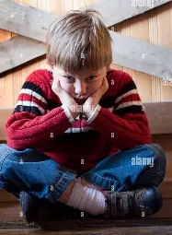
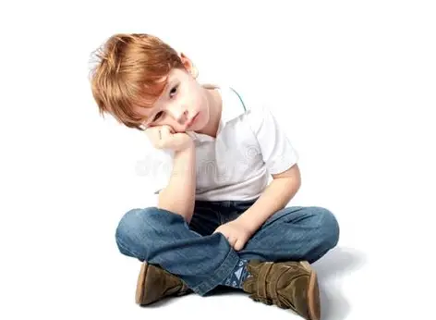
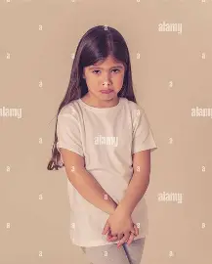
Physical abuse
Neglect
Emotional
abuse
Sexual abuse
Notes:
Explain that you’re going to look at the 4 main types of abuse. These are:
Physical abuse
Sexual abuse
Emotional abuse
Neglect
Emphasise that in most cases, multiple issues will overlap with one another
The critical thing, though, is to be professionally curious and be able to spot that something might be wrong
Sources:
GOV.UK – DfE, Keeping Children Safe in Education. https://www.gov.uk/government/publications/keeping-children-safe-in-education--2

Slide 20
Neglect: what to look out for
Not providing adequate food, clothing and shelter
Failing to protect a child from physical or emotional harm or danger
Not making sure a child has proper supervision
Not getting medical care or treatment for a child
Failing to meet or respond to a child’s basic emotional needs
Notes:
Clarify that it’s very unlikely that 1 child would have all these signs – in reality, a child would most likely only have a few signs. This is why we have to keep a very careful watch, and stay vigilant to the signs
Explain:
Neglect is when a parent or carer doesn’t meet their child’s basic physical and/or psychological needs, to the point that there’s likely to be serious negative effects on the child’s health or development
Neglect is the most common reason for a child protection plan
It could involve:
Not providing adequate food, clothing and shelter (including excluding the child from their home or abandonment)
Failing to protect a child from physical or emotional harm or danger
Not making sure a child has proper supervision
Not getting medical care or treatment for a child
Failing to meet or respond to a child’s basic emotional needs
Explain that there’s also affluent neglect, which is the neglect experienced by children from wealthier families. It can be harder to spot and sometimes overlooked. Affluent parents may work long hours, leaving children unsupervised or with nannies (or other childcare) or grandparents, which can leave children feeling emotionally neglected. Wealthier parents may have a more relaxed attitudes to alcohol, drugs and sexual activity, and colluded boundaries with their children. These parents may also have issues with alcohol or substance abuse, mental ill health, or domestic abuse – these issues can affect any type of family
Explain that it can be hard to distinguish between neglect and material poverty. For example, a parent or carer might not be able to provide sufficient food, clothing or shelter due to poverty
Sources:
GOV.UK – DfE, Keeping Children Safe in Education. https://www.gov.uk/government/publications/keeping-children-safe-in-education--2
GOV.UK, Characteristics of children in need. https://explore-education-statistics.service.gov.uk/find-statistics/characteristics-of-children-in-need
Ann Marie Christian, safeguarding consultant

Slide 21

Neglect and material poverty
More than 1 in 4 children are living in poverty
Families are still struggling to afford food, heating and electricity
Poverty can cause children’s mental and physical health to worsen, and they are more likely to be exposed to crime and violence
Poverty and financial hardship are not the same as neglect – but they do increase the risk of experiencing neglect
Notes:
Highlight the fact that an increase in the number of families living in poverty has made it more difficult to spot signs of poverty vs neglect. Regardless, staff should report any concerns they have, as your school might be able to help the family
Explain:
In the UK, 4.2 million children (more than 1 in 4) children are living in relative poverty
Research from Barnardo’s says that the legacy of the cost-of-living crisis, along with benefit decreases due to inflation, will mean even more families will be living in poverty. As poverty rises, children and young people’s mental and physical health deteriorates and they are more likely to be exposed to crime and violence
Parents and carers may feel shame and embarrassment about their financial difficulties, and may try to hide these issues from the school, so always keep an open mind and don’t assume that a particular family is OK, even if you believe they have an affluent lifestyle
Remind staff again that being in poverty is not a safeguarding issue on its own, but it does increase the risk. It’s important to always report any concerns. The school can provide support for families struggling with the cost of living – but we need to know where to target that support
Sources:
Barnardo’s, Changing childhoods, changing lives https://www.barnardos.org.uk/research/changing-childhoods-changing-lives

Slide 22
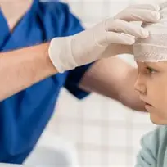
Physical abuse: what to look out for
Bruises, cuts, scratches or scars
Fractures
Bite marks
Burns or scalds
Vomiting, drowsiness or seizures
Breathing problems
Suspicious illnesses
Notes:
So, what might staff see in a child? Staff should note that if a child has regular injuries, there seems to be a pattern to their injuries or their explanations don’t add up, this should be reported. Select to bring up the signs in turn:
Bruises, cuts or scratches
Broken or fractures bones
Bite marks
Burns or scalds
Other injuries or health problems, such as:
Vomiting, drowsiness or seizures, which could be the effects of poisoning
Breathing problems from drowning, suffocating or poisoning
In cases of fabricated or induced illness: illnesses that are regular, doubtful or hard to explain, or only seen when the child is with the same adult(s)
Children might also show changes in behaviour, such as:
Being scared to go home
Using their hair or fringe to cover marks
Not wanting to do PE as they want to keep their skin covered
Being more withdrawn, or having more outbursts
Sources:
GOV.UK – DfE, Keeping Children Safe in Education. https://www.gov.uk/government/publications/keeping-children-safe-in-education--2
NSPCC, Physical abuse. https://www.nspcc.org.uk/what-is-child-abuse/types-of-abuse/physical-abuse/
Ann Marie Christian, safeguarding consultant

Slide 23
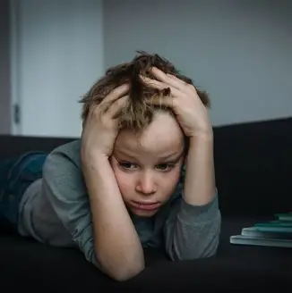
Emotional abuse: what to look out for
Struggling to control their emotions, such as having outbursts or issues with mental health
Lacking social skills or friends
Negative interactions with parents or carers
Trying to make people dislike them, or bullying other children
Language delay
Low self-esteem or self-confidence
Behaviour, language or knowledge you wouldn’t expect for their age
Notes:
Tell staff that emotional abuse is any type of abuse that involves hurting a child emotionally, severely affecting their emotional development. It’s sometimes called psychological abuse
It could involve:
Making a child feel worthless, unloved or inadequate
Silencing or making fun of what a child says
Having inappropriate age or developmental expectations of a child. For example:
Pushing them too hard or not recognising their limitations
Limiting their learning
Being overprotective
Limiting their social interactions
Exploiting or corrupting a child
Serious bullying, including cyber-bullying
Exposing a child to the ill treatment of another person – for example, domestic abuse
Emotional abuse can be hard to spot, especially when it happens as part of other kinds of abuse
Note that some level of emotional abuse is involved in all types of maltreatment
Sources:
GOV.UK – DfE, Keeping Children Safe in Education. https://www.gov.uk/government/publications/keeping-children-safe-in-education--2
NSPCC, Protecting children from emotional abuse. https://learning.nspcc.org.uk/child-abuse-and-neglect/emotional-abuse/
Ann Marie Christian, safeguarding consultant

Slide 24
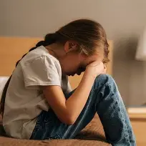
Sexual abuse: what to look out for
Changes in behaviour
Avoiding a particular person
Sexually inappropriate behaviour
Difficulty concentrating at school
Needing the toilet a lot
Difficulty sitting
Dropping hints or mentioning ‘secrets’
Pregnancy and STIs
Secretive online behaviour
Notes:
Explain that sexual abuse is the fourth main type of abuse, and it’s when someone forces or entices a child to take part in sexual activities, whether or not the child is aware of what is happening. This could be:
Physical contact – for example, kissing, touching, rubbing (including outside clothes), or rape
Non-contact abuse – for example, involving a child in looking at or producing sexual images, encouraging sexually inappropriate behaviour and grooming in preparation for child abuse
Note:
Adult males aren’t the only perpetrators of sexual abuse. Women can also commit sexual abuse, as can other children (you’ll look at abuse of children by other children in more detail later)
It can happen online, offline, or both
Select to bring up the signs as you go through them. Signs that staff might see are:
Changes in behaviour, such as being aggressive, withdrawn or being tired in class due to sleeping difficulties and nightmares
Avoiding their abuser(s) – they might seem afraid of a particular person and try to avoid spending time with them, or having poor personal hygiene to make themselves less attractive to their abuser
Sexually inappropriate behaviour, such as using sexually explicit language or knowing things you wouldn’t expect them to
Difficulty concentrating at school
A pupil needing the toilet a lot, due to urinary tract infections (UTIs)
Difficulty sitting, caused by soreness in the genital and anal areas
Dropping hints or clues that the abuse is happening, without explicitly revealing it
Pregnancy and STIs
Being secretive online, or seeming distant, upset or angry after using their phone or the internet
Sources:
GOV.UK – DfE, Keeping Children Safe in Education. https://www.gov.uk/government/publications/keeping-children-safe-in-education--2
NHS, Spotting signs of child sexual abuse. https://www.nhs.uk/live-well/spotting-signs-of-child-sexual-abuse

Slide 25
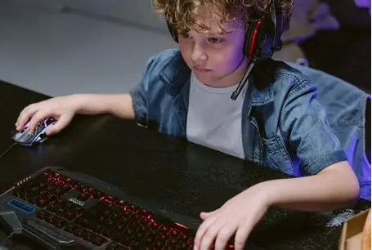
Remember: abuse happens online, too
Texts and messaging apps (e.g. WhatsApp)
Social media (e.g. Snapchat, TikTok)
Email
Online chatrooms
AI (e.g. text-to-image systems)
Online gaming
Streaming sites
(e.g. Twitch)
Notes:
[Before presenting, if you’re in an EYFS setting, you might want to remove slides 58-61, as they’re more relevant to older children]
Explain it can be very easy to assume that abuse happens in a physical space like the home or the classroom, but it’s important to remember that emotional and sexual abuse can also happen virtually. This can include:
Social media sites, such as Snapchat, TikTok, X, Facebook and Instagram as well as any other website where comments can be left on content a child has created, like YouTube
Via email
Using AI to generate harmful imagery, such as indecent images or images to make fun of someone
In online chatrooms, where children talk to each other virtually
Texts and messaging apps, such as WhatsApp
Streaming sites, where someone records themselves doing something live and can receive comments (for example, gaming streaming on Twitch)
Online gaming sites such as Roblox or Fortnite, where players can talk to each other while they play
If you want to go into more depth with staff about online safety, use our staff briefing and/or eLearning course:
https://safeguarding.thekeysupport.com/factsheets-and-briefings/online-safety-briefing/
https://safeguarding.thekeysupport.com/online-safety-the-essentials/

Slide 26
Online grooming
Grooming involves someone building a relationship with a child
and gaining their trust, in preparation for abuse
Online platforms make it easier for groomers to target several
children at once, which can make the grooming process quicker
After making contact online, a groomer may convince a child to meet in person or persuade them to take part in online sexual activity
What is it?
Who is at risk?
Grooming can affect any child, regardless of age, gender, race or socio-economic background
However, some children are more vulnerable than others
© The Key Support Services Ltd | For terms of use, visit thekeysupport.com/terms
Notes:
Safeguarding issue 1: online safety (grooming)
Tell staff that you’re now going to look at the issue of online grooming
Select ‘What is it?’ to reveal each bullet point 1 at a time
Explain that groomers can:
Use online platforms like social media, gaming platforms or instant messaging apps to connect with a child
Learn about a child’s interests from their online profiles, then use this knowledge to help build a relationship with them
Easily hide their true identity online
Select ‘Who is at risk?’ to reveal the bullet points 1 at a time
Tell staff that while grooming can affect any child, some children are more vulnerable than others. These include:
Looked after children
Children with SEND
Children with low self-esteem
Children who are experiencing mental health issues
Children whose online activity isn’t monitored or supervised
Remind staff it’s wrong to assume that primary school-age children aren’t vulnerable to online grooming because they won’t have access to certain online platforms. In fact, Ofcom data from 2024 revealed that 1 in 3 children aged 5 to 7 use social media unsupervised
Remember: grooming can happen to any child who spends time online
Source:
Ofcom, A window into young children’s online worlds, 2024: https://www.ofcom.org.uk/media-use-and-attitudes/media-habits-children/a-window-into-young-childrens-online-worlds

Slide 27

Online grooming: what to look out for …
“He was really nice to me when no one else was. I thought he was my friend ... I didn’t think I needed to tell anyone because I didn’t think he was doing anything wrong, at first anyway.
“I didn’t tell anyone because I thought I’d
get in trouble. He said no one would believe me, and I didn’t want my mum to be angry with me.”
Spending less time with friends
Unexplained gifts, or having more money than usual
Spending more or less time online than usual
Being secretive about their devices, or what they do online
Signs of sexual abuse
Notes:
Safeguarding issue 1: online safety (grooming)
Explain that staff may notice the following signs that grooming is being carried out online:
The child may suddenly have more money than usual or new things like clothes, jewellery or electronics that they can’t explain
The child may be spending more time online, or offline (this might be reported by their parents or carers). They might also complain of being tired, because they were online all night
The child is secretive about their use of the internet or a device – they may refuse to hand their phone in if that’s school policy, or refuse to tell you what they get up to online
If a pupil tells you that they often use their device unsupervised – for example, they play on their iPad when they go to bed – this could also be a red flag
Explain how the more general signs of sexual abuse could also indicate a child is being sexually abused online, including:
Changes in behaviour, such as being aggressive, withdrawn or being tired in class due to sleeping difficulties and nightmares
Sexually inappropriate behaviour, such as using sexually explicit language or knowing things you wouldn’t expect them to at their age
Difficulty concentrating at school
Dropping hints or clues that the abuse is happening, without explicitly revealing it
Remind staff that, as with all safeguarding issues, they should always be alert to changes in a child. Although the signs above might not mean a child is being abused online, the key is to notice something might be wrong, and act on those concerns. It’s your (the DSL’s) job to investigate those concerns further
Read the quote on the slide to staff:
Explain that it can be difficult to spot the signs that a child is being groomed online
Also highlight that children may not seek help because they:
Are unaware they’re being groomed
Genuinely believe they’re in a caring relationship, and don’t want to risk losing that relationship
Are scared about what will happen if they speak out
Feel ashamed about what’s happened
Sources:
Elizabeth Rose, safeguarding consultant
NHS, Spotting signs of child sexual abuse. https://www.nhs.uk/live-well/spotting-signs-of-child-sexual-abuse

Slide 28
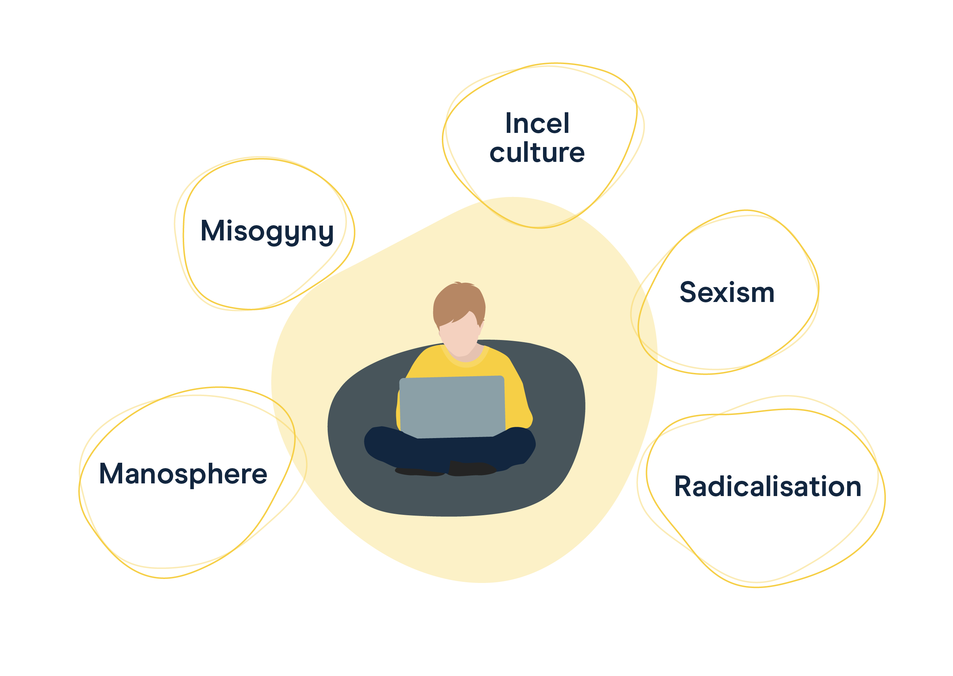
Misinformation online and toxic masculinity
Notes:
Safeguarding issue 2: misinformation online and online toxic masculinity
Misinformation online
Tell staff that you’re now going to look at the issues of misinformation online, including toxic masculinity
Explain to staff that children might be exposed to fake news or misinformation online
AI is sometimes used to alter images and videos, or create completely fake images and videos, and it’s often difficult to spot what’s real and what’s not
This is a safeguarding risk because:
Reading or hearing misinformation can upset and worry children
Misinformation has been linked to radicalisation by extremists
Remind staff that younger children might hear misinformation from older children and other adults, and share it without realising that it’s false
Online toxic masculinity
Explain how online toxic masculinity exposes children to harmful ideologies that could influence their attitudes, behaviour and relationships
Online toxic masculinity can often appear to ‘normalise’ abuse and harassment
Explain that the ‘manosphere’ is the name for a collection of online communities where misogynistic views are shared
These groups discuss ‘masculinity’ and promote sexist beliefs, but they also discuss everyday topics such as gaming, and health and fitness
A lot of groups in the manosphere use jokes and memes to share their views, so it might not be obvious at first that they’re spreading hateful content
Children (and especially boys) might get involved in these online communities as it gives them a sense of worth, belonging and security. They can be strongly influenced, and even radicalised, by what they see
Source:
Ofcom, A window into young children’s online worlds, 2024: https://www.ofcom.org.uk/media-use-and-attitudes/media-habits-children/a-window-into-young-childrens-online-worlds

Slide 29
What signs of radicalisation should I be alert to?
Becoming more isolated from friends and family
Not being willing or able to talk about their views
Becoming more angry
Talking as if from a script, or using new phrases
A sudden disrespectful attitude towards women and girls
Being more secretive, especially about their internet use
Notes:
Safeguarding issue 2: misinformation online and online toxic masculinity
[In advance: use KeyGPT to generate a scenario on radicalisation for staff or delete this from the slide]
Explain to staff that you’re going to look at the signs of radicalisation by misinformation online and online toxic masculinity
Ask for suggestions on possible signs of radicalisation before going through the list on the slide
Select to bring up the signs in turn:
Becoming more isolated from friends and family
Not being willing or able to talk about their views
Becoming more angry
Talking as if from a script, or using new phrases
A sudden disrespectful attitude towards women and girls
Becoming more secretive, especially about their internet use

Slide 30
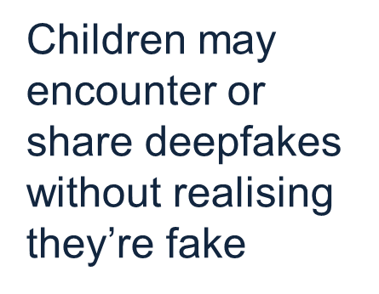
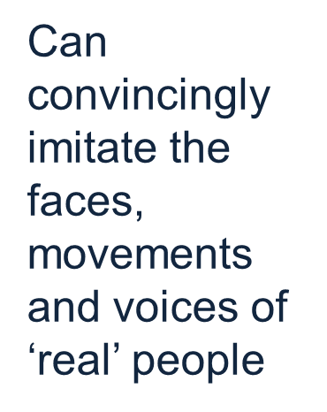
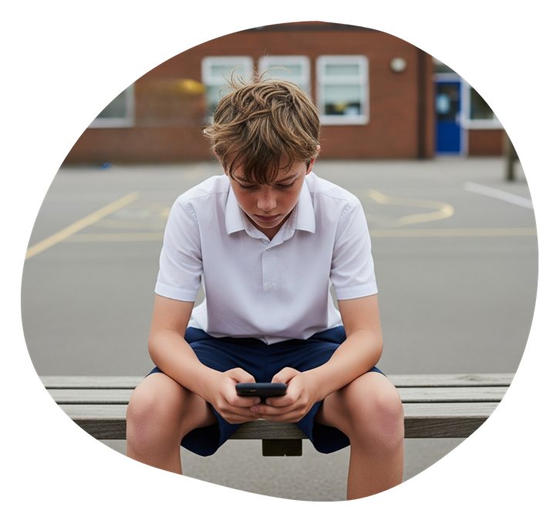
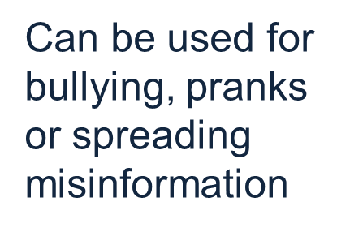
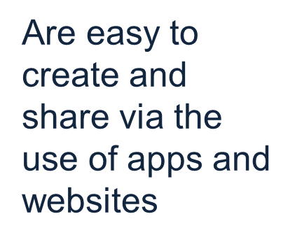
Deep fake Images and Videos
Notes:
Explain to staff that the use of deepfake images to blackmail or humiliate others, including children and teachers, is on the rise
Deepfake creation technology is moving fast, and images created are extremely realistic
Children may struggle to identify when images and videos are fake. Children who are the victim of deepfakes (even if it’s intended as a silly ‘joke’) might be humiliated and traumatised
Remind staff not to assume that young children wouldn’t be capable of creating these images/videos – tools to create deepfakes are increasingly accessible to them. There are plenty of apps that make it easy for anyone to generate realistic images, and share them

Slide 31
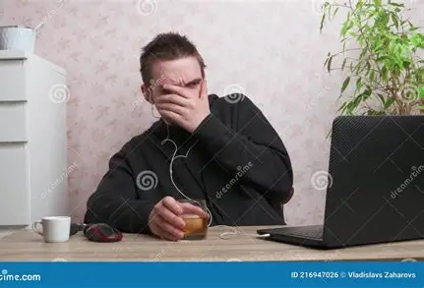
Sextortion
What is it?
Sextortion is a form of online blackmail where someone threatens to share sexual images or information unless the victim complies with their demands.
It might begin with grooming, where an offender has built up a relationship of trust with the victim first.
Notes:
Safeguarding issue 4: sextortion
Tell staff that you’re now going to look at the issue of sextortion
Give staff a couple of minutes to read the information on the slide
Explain to staff that
Financially motivated sexual extortion is commonly referred to as ‘sextortion’
It’s when an adult threatens to release nudes or semi-nudes of a child unless they pay money, or do something to benefit them
It’s often carried out by organised crime groups, motivated by profit
These groups tend to:
Coerce the child into sending nudes/semi-nudes to blackmail them
Use images stolen from the child through hacking their account
Use digitally manipulated images, such as AI-generated images
Source:
Department for Science, Innovation and Technology and UK Council for Internet Safety, Sharing nudes and semi-nudes: advice for education settings working with children and young people. https://www.gov.uk/government/publications/sharing-nudes-and-semi-nudes-advice-for-education-settings-working-with-children-and-young-people

Slide 32
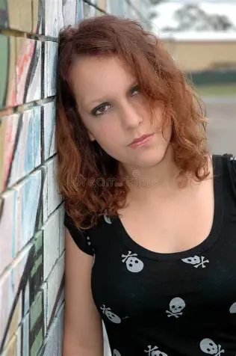
Sextortion: what are the warning signs?
Sudden changes in mood
Signs of being distracted, upset or afraid after being online
Excessive secrecy about online activity
Notes:
Safeguarding issue 4: (sextortion)
Explain to staff that the warning signs of sextortion might include:
Sudden changes in mood
They could have stronger emotional responses or outbursts – for example, the child may get unusually angry, upset or distant after checking their phone or using their computer/tablet
Being secretive about their use of the internet or a device – they may refuse to hand their phone in if that’s school policy, or refuse to tell you what they get up to online
The child may be spending more time online, or more time offline. They might complain of being tired because they were online all night, or have their phone going off a lot
Being distracted, upset or afraid after being online
If a pupil tells you that they often use their device unsupervised – for example, they play on their iPad when they go to bed – this could also be a red flag
The more general signs of sexual abuse could indicate a child is being sexually abused online
Tell staff:
Make sure you take any disclosures of sextortion seriously, as the child is likely to be embarrassed and worried about the consequences
Remember: do not intentionally view any images or ask to see them
If you’re aware of an incident, report it to you (the DSL) as soon as possible
Remind staff that, as with other safeguarding issues, they should always look for changes in behaviour or mood. Although a change might not suggest a child is being abused online, the DSL can look into the situation further
You might want to share or signpost our financially-motivated sextortion parent/staff factsheet: https://safeguarding.thekeysupport.com/factsheets-and-briefings/financially-motivated-sexual-extortion-sextortion-parent-and-staff-factsheets/

Slide 33
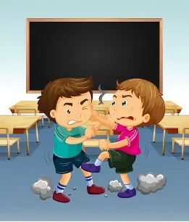
Child-on-child abuse
Child-on-child abuse is abuse between children.
It can happen in and outside of school, and online.
Notes:
Safeguarding issue 5: child-on-child abuse
Tell staff that you’re now going to look at the issue of child-on-child abuse
Read through the key points on the slide

Slide 34
Child-on-child abuse can include:
Bullying
Abuse in intimate personal relationships
Physical abuse
Sexual violence
Sexual harassment
Sexual activity without consent
Initiating or hazing-type violence and rituals
Sharing nudes or semi-nude images
Notes:
Safeguarding issue 5: child-on-child abuse
Select to reveal each example and briefly talk through them in turn:
Bullying can include online (cyber) bullying, prejudice-based and discriminatory bullying – for example, bullying because of a child’s sexuality or perceived sexuality
Abuse in intimate personal relationships between children. This is sometimes referred to as ‘teenage relationship abuse’, but younger children are also vulnerable to this type of abuse
Physical abuse, such as hitting, kicking, shaking biting, hair pulling
Children might also use technology to encourage physical abuse, or threaten it
Sexual violence, such as rape, assault by penetration and sexual assault
Again, children might use technology to encourage this type of abuse, or threaten it
Sexual harassment can include sexual comments or ‘jokes’, or online sexual harassment which is standalone or part of a wider pattern of abuse
Abusive messages could include misogynistic or misandrist (strongly prejudiced against men) content
Causing another child to engage in sexual activity without consent, such as forcing them to strip, touch themselves sexually or engage in sexual activity with someone else
Upskirting – where someone takes a picture under a person’s clothing without their permission, for sexual gratification or to cause the victim humiliation, distress or alarm
Sharing nude or semi-nude images and/or videos (including AI-generated images)
Abuse could also include sharing images and pornography with those who don’t want to receive this content
Initiation or hazing-type violence and rituals could involve using harassment, abuse and/or humiliation as a way of initiating someone into a group, and may also include an online element
Gender violence, including:
Sexualised language or behaviour (such as inappropriate touching, comments about bodies)
Gender-based bullying (such as teasing, or excluding others for not conforming to gender ‘norms’)
Use of gender-based power dynamics (such as boys asserting dominance over girls through control or intimidation)
Tell staff other examples of gender violence could include (read through all the examples below, or 1 or 2 depending on the time you have):
During lunch break, a group of year 5 boys dare each other to touch the backsides of girls in the playground and laugh about it. One girl reports feeling uncomfortable and upset, but the boys say, “It’s just a joke.” Explain: this is harmful sexualised behaviour that may stem from peer pressure or exposure to inappropriate content. Even if meant as a ‘joke’, it crosses boundaries.
A year 4 boy is regularly teased and excluded by his peers for playing with dolls and joining in games with girls. He’s called names like “baby” or “girl-boy” and starts to avoid playtime. Explain: this is bullying based on non-conformity to gender norms. It reinforces harmful stereotypes and can impact a child’s confidence and sense of identity.
In a group activity, a boy in year 6 repeatedly talks over the girls in his team, dismisses their ideas, and tells them to “just do the writing” while he “leads” the project. The girls comply but look frustrated and disengaged. Explain: this behaviour may seem subtle, but it can reflect ingrained beliefs about male dominance or leadership. It’s important to challenge these dynamics early to promote equality and respect.

Slide 35



Child-on-child abuse
Act immediately on any concerns or disclosures
Reassure the child they’ll be supported and kept safe
Don’t dismiss or downplay any reports
Report via your Safeguarding Systems
Notes:
Safeguarding issue 5: child-on-child abuse
[In advance, edit this slide to briefly summarise your procedures for reporting possible child-on-child abuse, including who to report to and how]
Explain that staff might witness child-on-child abuse between pupils, or a pupil might tell them they’ve been a victim of child-on-child abuse
Staff might also see signs that something is wrong, such as the common behavioural signs we looked at earlier. They should always be alert to changes in a child, such as in their mood, behaviour or school performance
While anyone can be affected, staff should be aware that:
It’s more likely to be girls as the victim of sexual violence and sexual harassment, and boys more likely to be the perpetrators
Children with SEN are 3 times more likely to be abused by their peers
Whether a child makes an allegation of child-on-child abuse, or staff see something that’s a cause for concern, staff should always take immediate action, following your school’s reporting
If a child does make an allegation, staff should reassure the child that they’ll be supported and kept safe. Don’t make the child feel like they’re causing trouble by speaking up
Staff shouldn’t dismiss an allegation as “banter”, “part of growing up” or “having a laugh”. This can create a culture of unacceptable behaviours, and an unsafe environment for children. It can ‘normalise’ abuse, leading to children accepting and not reporting it
Explain that while the alleged victim must always be the priority in any case of child-on-child abuse, schools must still balance providing appropriate support and taking disciplinary action of the alleged perpetrator – they aren’t mutually exclusive
Sources:
GOV.UK – DfE, Keeping Children Safe in Education. https://www.gov.uk/government/publications/keeping-children-safe-in-education--2

Slide 36
Report your concerns
You should always report any concerns you have, even if you’re not sure what the problem is.
Your DSL is here to help you and will decide what the next course of action will be….

Slide 37

What happens after you make a report
You have a concern or
a child tells you about abuse
You report it to the DSL or deputy DSL
The DSL decides what to do next
Further support within school
Early help
Referral to
children’s social care
Notes:
[In advance, edit this slide to include the contact details for your local children’s social care team, and your local police force]
Talk through what happens when staff report concerns. Select to reveal each point as you make it
A member of staff has a safeguarding concern about a child, or a child tells them about abuse that’s happened to them
If they think a child is in immediate danger and you (the DSL) or deputy DSL, or another member of the senior leadership team, isn’t available, they can make a referral to the local authority’s children’s social services themselves, and contact the police if appropriate
Immediate danger means that a child is suffering harm or is likely to suffer harm
To decide whether a child is in immediate danger, staff should ask themselves: if I don’t do something now, will he come to harm? (Note that this will always be subjective)
Staff should still tell you (the DSL) or deputy DSL as soon as possible after making a referral
In most cases though, staff will make a report to you (the DSL) first
Reiterate that their job isn’t to investigate, just to report
You (the DSL) will then decide what to do next
The child might receive support within school, using your school’s own pastoral support processes
The child and their family might receive early help
You (the DSL) might make a referral to your local children’s social care team. If the LA makes a statutory assessment for a child in need plan or child protection plan, staff might be involved in the assessment. If so, you (the DSL) will support the staff member with this
If staff don’t hear about what happened next, they should follow up with you (the DSL)
Sources:
GOV.UK – DfE, Keeping Children Safe in Education. https://www.gov.uk/government/publications/keeping-children-safe-in-education--2

Slide 38
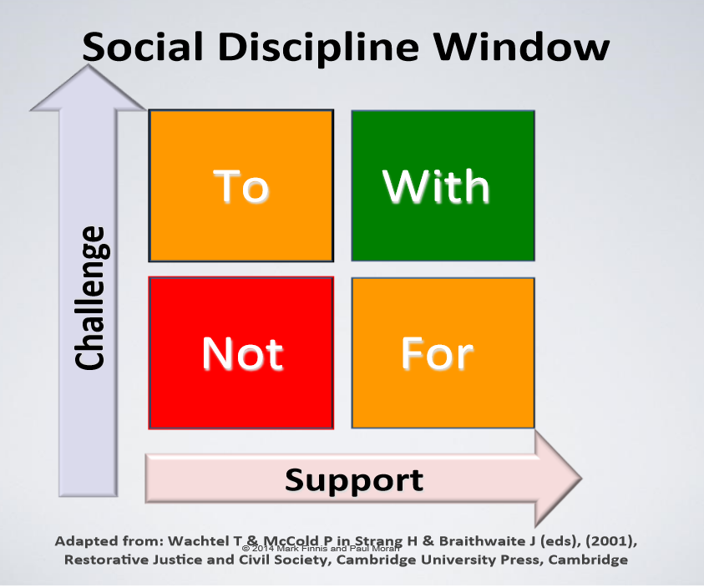
Restorative Practice: Relationships & Working ‘WITH’
Notes:
Discuss how important consent is for referrals and we should obtain it for all referrals unless it meets the statutory requirement :
There may be some circumstances where it is not appropriate to seek consent, either because the individual cannot give consent; it is not reasonable to obtain consent; or because to gain consent would put a child or young person's safety or well-being at risk. Where a decision to share information without consent is made, a record of what has been shared and with whom should be kept.
We should work WITH families, not do things to them.
Children are the heart of what we do, and we should never lose sight of the impact.
We should seek to support children within their family network wherever possible.
Children with additional needs or who are vulnerable because of family circumstance should be supported to have equity of aspiration and outcomes with their peers.
The anchors in a families life, the school they choose for their children, the community the choose to live in and the people around them can help to build assets, capacity and resilience when problems are identified early and addressed with honesty and collaborative working.

Slide 39
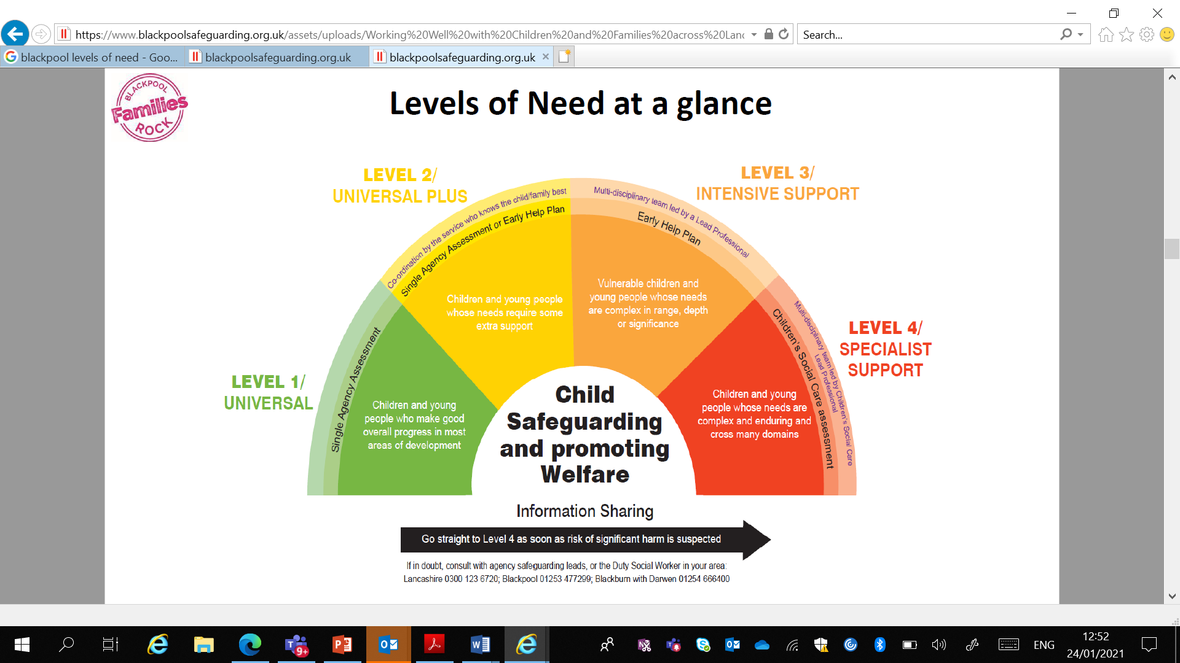
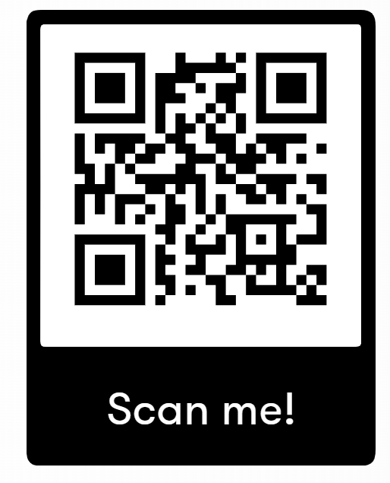
Working Well With Children And Families
Online request for support form
Notes:
Across the local authority areas, what we call Pan Lancashire, we have agreed the levels of need and the broad description of how services can and should respond this is set out within ‘Working Well with Children and Families in Lancashire’ where the model illustrates how agencies should respond to the requirements of children and families across four levels of need (Universal, Universal Plus, Intensive and Specialist).
This guidance seeks to give clear advice to all professionals and the public on the levels of need and thresholds for different responses in Lancashire. However, we recognise that each child and family member is an individual, and each family is unique in its make-up, so reaching decisions about levels of needs and the best intervention requires discussion, reflection and professional judgement applied in the context of the lived experience of the children and family.
The Levels of Need illustrate how Early Help operates across Lancashire and clarifies the threshold between each level.
In this model, all services and interventions seek to work openly with the family (or with young people on their own where it is age appropriate) in order to support them to identify, talk honestly about and address their needs at the lowest possible level. Where as a partnership we agree to actively work with children and families to prevent their needs escalating to a higher level. We will only request services at a higher level after we have exhausted the resources and expertise at the earliest level of intervention.

Slide 40
Quiz time

