Slide 1


Public Health Briefing: HPV Vaccine
This briefing has been created by the Blackpool Council Public Health team. All information is accurate as of June 2025.
Click the Blackpool Council image on the right of this slide to visit the Healthier Blackpool webpage.
If you have any questions about anything in this briefing, please contact publichealth@blackpool.gov.uk.
Notes:
Lindsay, it may be worth putting an email address here for someone or a generic service email address that people can contact with any further questions rather than our Public Health email address.

Slide 2
Human Papillomavirus (HPV)

Slide 3
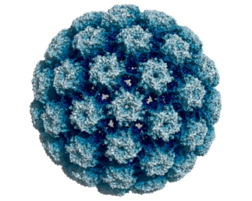
What is HPV?
HPV is the name for a very common group of viruses
Some types can cause genital warts or cancer
HPV affects the skin and there are over 100 types
HPV does not usually cause any symptoms meaning it can go unnoticed
Sometimes, HPV can cause painless growths around your vagina, penis or anus (genital warts)
Many types of HPV affect the mouth, throat and genital area, and are easy to catch

Slide 4
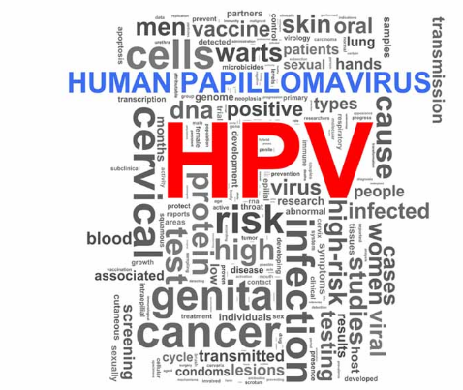
How can you get HPV?
Any skin-to-skin contact of the genital area
Vaginal, Anal or Oral sex
Sharing Sex Toys
HPV is very common, has no symptoms and most people will get some type of HPV in their lifetime.

Slide 5
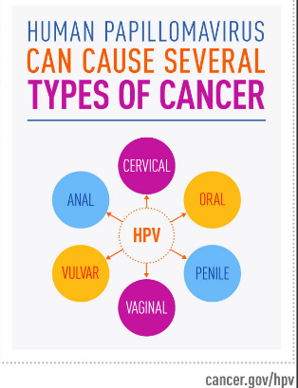
Why is the HPV vaccine important?
For some people, some types of HPV can cause:
Cervical cancer
Anal cancer
Penile cancer
Vulval cancer
Vaginal cancer
Some types of head and neck cancers
The HPV vaccine protects against the types of HPV that cause most cases of genital warts and some cancers.

Slide 6
Who is eligible for the HPV vaccine?
All boys and girls in school year 8 (aged 12 to 13) across England , are offered the vaccine.
If you have missed out on receiving the vaccine you can still receive the vaccine up to the age of 25.
When it was first introduced in 2008, the vaccine was only offered to girls.
However, due to clear evidence that being vaccinated protects both sexes, the vaccine has been offered to boys since 2019.

Slide 7
Is the HPV vaccine safe?
Yes!
More than 280 million doses of the HPV vaccine have been given worldwide, including 120 million doses in the US and 10 million across the United Kingdom.
Since the HPV vaccination programme was introduced in September 2008, there has been a decline in HPV infections and genital warts.
It is expected that the HPV vaccine will save hundreds of lives every year across the United Kingdom.

Slide 8
The HPV vaccine and side effects
The HPV vaccine is called Gradasil 9 as it protects against 9 types of HPV that can cause cancer and genital warts.
Side effects are often mild, if there are any.
Soreness and/or swelling to the arm where the vaccine was injected can occur. This is usually gone within a couple of days.
More serious side effects are rare but can be explore on the NHS website under the HPV Vaccine section.

Slide 9
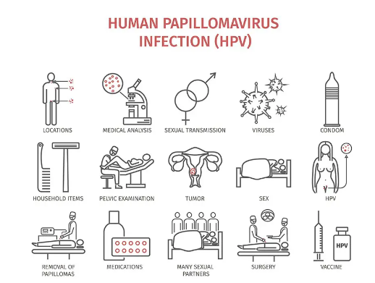
It is important to remember…
To get your HPV vaccine to protect yourself
The vaccine is saving hundreds of lives in the United Kingdom every year
The HPV vaccine will prevent over 90% of cervical cancers
Even if you have received your HPV vaccine, those invited to a cervical smear test must still attend any future appointments

Slide 10
Thank you
Information on the HPV vaccination from September 2023 - GOV.UK (www.gov.uk)
Human papillomavirus (HPV) - NHS (www.nhs.uk) https://pshe-association.org.uk/resource/educate-hpv-vaccine

