Slide 1
Public Health Briefing: PrEP & PEP
This briefing has been created by the Blackpool Council Public Health team and is accurate as of February 2025.
Click the Blackpool Council image on the right of this slide to visit the Healthier Blackpool webpage. Click on the PSHE image to be directed to the PSHE section of the Healthier Blackpool website.
If you have any questions about anything in the slide, please contact publichealth@blackpool.gov.uk.
Notes:
This guidance has been created in collaboration with the Blackpool Council Public Health Team & colleagues from the ADASH team within Blackpool Adolescent Services.
The ADASH team focuses on Adolescent Alcohol, Drug and Sexual Health support and later in the briefing there is a slide that provides further information about the ADASH team and referrals to relevant services.
This presentation has been created to give you an overview of the drug Ketamine and is correct as of March 2024.

Slide 2
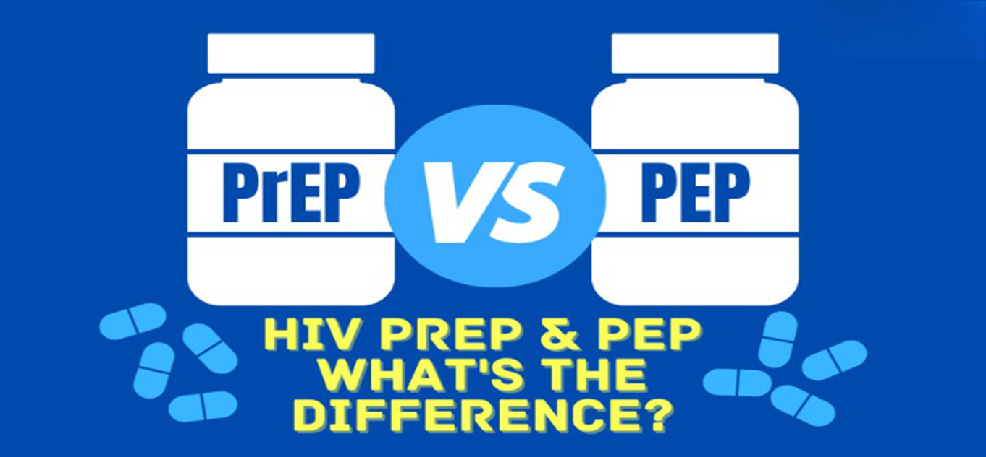

Slide 3
What we will cover
How is HIV transmitted?
What is PrEP?
Who can take it?
How it works
How to get it
PEP

Slide 4
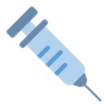
How is HIV Transmitted?
If you are having sex, you should understand how HIV is transmitted then you know how to keep yourself safe.
HIV is sexually transmitted mainly through condom-less anal or vaginal sex. It can also be transmitted through sharing infected needles. The risk is increased by:
Prescence of semen or blood
Longer or more traumatic sex
Having multiple sexual partners
It is not transmitted through skin-to-skin contact, kissing, sharing household equipment or spaces (e.g. Cutlery & toilets)

Slide 5
Did you know…..
Most people who are aware they have HIV, take medication
The medication reduces the amount of HIV virus in their body
The medication reduces the amount of virus to such an extent
that it becomes UNDETECTABLE
Undetectable=Untransmittable. It cannot be transmitted to someone else

Slide 6
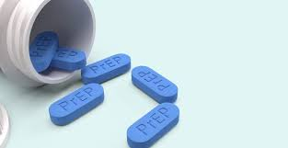
What is PREP??
PREP is short for Pre-Exposure Prophylaxis which involves taking tablets BEFORE having sex
Its one of the most effective ways of reducing the risk of acquiring HIV
There are two ways of taking it – DAILY, one tablet per day or EVENT BASED, this is where you only take tablets where you are planning to have sex - two tablets prior to the sex and then two further single doses over two days.
It’s a very safe medicine & most people can take it
It only protects against HIV. It doesn’t give any protection against STI’s such as Chlamydia, gonorrhoea and Syphilis.

Slide 7
Who can take it
PrEP can be taken by anyone who is at a higher risk of acquiring HIV
Men who have sex with men
Transmen and transwomen
People who have a partner with HIV who does not have an undetectable viral load
People who have sexual partners from parts of the world where the rate of HIV is much higher

Slide 8
How does it work?
HIV targets CD4 cells which are crucial for maintaining a healthy immune system
PrEP medication come in tablet form and are swallowed and absorbed into the bloodstream
PrEP travels to the CD4 cells and forms a protective barrier around them, stopping the HIV entering and establishing infection
PrEP is highly effective at prevent HIV– 99% in clinical trials

Slide 9
How to get PrEP
If you are in a high-risk group for acquiring HIV, you can get PrEP free of charge from the local Sexual Health service.
In Blackpool, this is at Whitegate Health Centre.
You will be seen by a Nurse who will take your medical and sexual history to assess if you are eligible for PrEP.
Before starting PrEP you need to have some tests done for Sexually Transmitted Infections, including HIV and also a Kidney Function Test, these need to be done every 3 months whilst you are taking PrEP.
The nurse will discuss with you your individual circumstances and agree the best way for you to take it.

Slide 10
So what is PEP??
PEP = Post Exposure Prophylaxis is an emergency measure medication as it reduces the risk of acquiring HIV AFTER you have been exposed to it.
It is recommended if the risk of HIV is >1:1000
This usually includes having anal or vaginal sex without a condom with someone known to be HIV positive and not on treatment or someone from a high-risk group for HIV .eg MSM or a person from a country with high rates of HIV

Slide 11
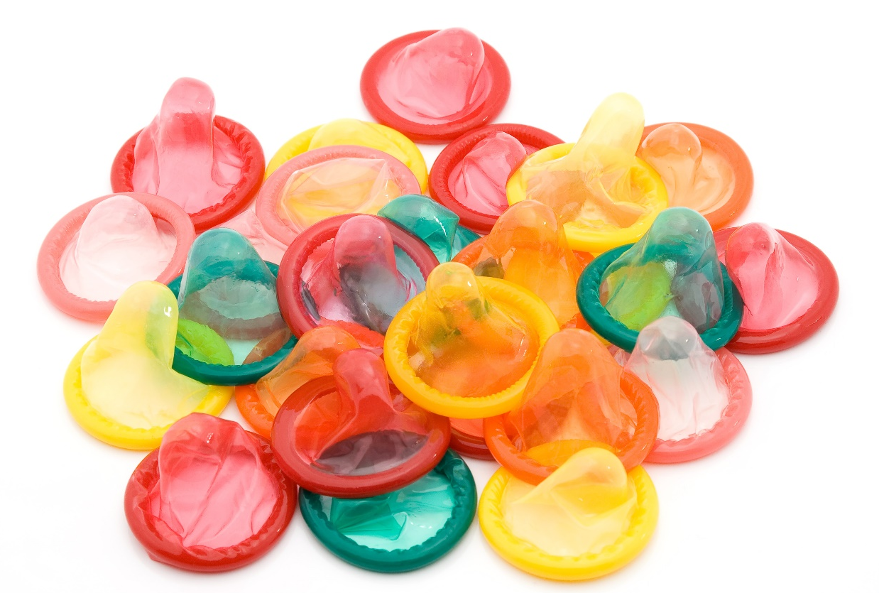
How to take PEP
PEP involves taking 2 different tablets once a day for 28 days
It ideally needs to be started within 24 hours of when the risk has happened, but it must be started within 72 hours at the latest to still be effective.
Its thought to be more than 80% effective if it is taken correctly and no doses are missed
If someone has been at risk of HIV, they should contact the local sexual health clinic to discuss if PEP is recommended . It can also be started by the A&E dept if the clinic is closed.
Although PEP can be very useful in emergency situations, using condoms during sex is the most effective way of preventing HIV.

Slide 12
Local Services
Blackpool and Lancashire Sexual Health Services
Telephone: 0300 1234 154 option 4
Whitegate Health Centre 150 Whitegate Drive Blackpool FY3 9ES
Specifically for Under 25’s: Connect Young Peoples Centre 26 Talbot Road Blackpool FY1 1LF

Slide 13
Useful Links
PrEP:
PrEP - Info Sheets - My Meds, My Health (online)
UK guide to PrEP | Guides | HIV i-Base
| Prepster
PEP:
PEP (post-exposure prophylaxis for HIV) | Terrence Higgins Trust

