Slide 1
Tobacco Lesson
September 2024
Notes:
This lesson has been created by the Public Health team in Blackpool Council to be used by colleagues in Education to support those in Key Stage Three to learn about tobacco, the history of its cultivation and its use in cigarettes. While this lesson is primarily for a Key Stage Three audience, the facts are applicable to all ages and should therefore hopefully make adapting and tailoring this lesson achievable for colleagues in KS1 & KS2.
This lesson can be used and adapted by PSHE colleagues as they wish but should be viewed and engaged with after viewing the Public Health Briefing on Tobacco.
Foundations for a great lesson – 5 Minutes
Learning Objectives – 1 Minute
Starter Activity – 5 Minutes
Tobacco Timeline – 4 Minutes
What’s in your cig? Part I – 5 Minutes
What’s in your cig? Part II – 5 Minutes
Nicotine Video – 3 Minutes
Impacts of smoking on the body – 5 Minutes
Tobacco & The Law – 2 Minutes
The Great Debate – 20 Minutes
Takeaway From Today! – 5 Minutes

Slide 2
Foundations for a great lesson!
Challenge the point, not the person
Be Respectful
Do not judge others
Notes:
Boundaries and ground rules keep us safe.
Setting these out and revisiting them before we talk about PSHE topics is important.
Think about building something, you need solid foundations to do this. Draw a brick wall and write a ground rule that will keep everyone safe.
Ensure there is agreement among the pupils and re-visit at the beginning of every lesson.

Slide 3
Starter Activity Pack of facts?!
Notes:
The purpose of this starter activity is to understand what pupils may already know about tobacco. This can be delivered in one of two ways as outlined below.
Teacher led version:
Teacher has a range of facts and figures about tobacco/cigarettes and asks the class if the statement is true or false. If the statement is false it is discarded. (Facts and figures more generally, as well as figures relating to Blackpool can be found in the Tobacco briefing).
Pupil led version:
Pupils can work as individuals, as a pair or in small groups to discuss what they know about tobacco/cigarettes/smoking. If there is limited knowledge around tobacco, this could be done as a class discussion.
Encourage pupils to share what they have discussed and note any key points made.
Additionally, to encourage discussion you could prompt the class to think about:
What tobacco is
Why it is harmful/what the impact is
Law around buying and consuming tobacco
If resources allow and this is done in pairs or small groups, print a copy of the outline of a Tik Tok warning and ask pupils to draw in one colour what they know about cigarettes. Sticking to one colour is important as students will be asked to add to this at the end of the lesson in a different colour, anything they have learned in the lesson.

Slide 4
Learning Objectives
By the end of this lesson, pupils should be able to:
Explain the history of tobacco
Identify and recognise some of the chemicals produced when smoking
Know the current age of consent and understand potential future changes
Respectfully explore attitudes and opinions of others around smoking

Slide 5
Tobacco Timeline
6,000 BC
2024
Notes:
For this activity, create a timeline of the history of tobacco from its discovery to current use in cigarettes – as well as this pupils can include information relating to cigarettes/vapes/smoking more broadly.
This activity could once again be done on an individual basis, in pairs or in small groups. In addition, small groups could be given specific topics to research or a range of years to focus their research on to make the activity more focused/manageable.
Staff Led Version:
Staff can access information about the history/chronology of tobacco from its cultivation up to its current day use using the following websites:
https://tobaccofreelife.org/tobacco/tobacco-history/
6,000 BC – Native Americans first start cultivating the tobacco plant.
1492 – Christopher Columbus first encounters dried tobacco leaves. They were given to him as a gift by the American Indians.
1600 – Tobacco used as cash-crop – a monetary standard that lasts twice as long as the gold standard.
1826 – Nicotine isolated for the first time
1970 – Tobacco manufacturers legally obliged to print a warning on the labels that smoking is a health hazard.
1990 – 2000 – Bans on public smoking come into effect in most states in America, as well as in other countries in the world.
2024 – Tobacco & Vapes bill included in King’s Speech – “Smoke free Generation”
Staff can access information relating to tobacco regulation/policy from a UK perspective using the following website: https://ash.org.uk/uploads/Key-Dates_2022-04-21-101255_ajre.pdf
From this, staff can create a timeline with a number of dates/events and ask pupils to match the dates and events before plotting these on a timeline from the earliest event to the most recent.
Pupil Led Version:
Pupils can do their own research into tobacco and cigarettes and present their own timeline.

Slide 6
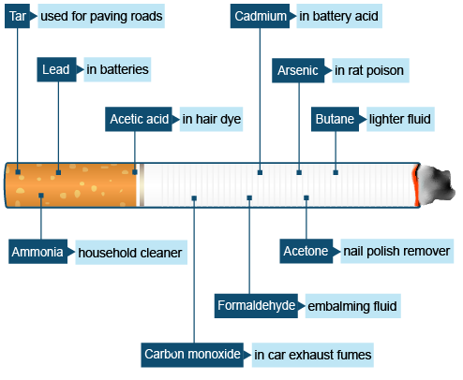
What’s in your Cig?
Notes:
Slides 7 & 8 are related to the same activity! What’s in your cig encourages pupils to think about what is in a cigarette.
For this activity, ask pupils to think about what is in a cigarette in addition to Nicotine.
They can use the blank spaces to write in different things that make-up a cigarette or they could make a list to the side.
Staff are welcome to take this diagram and print onto A4 paper or have on an interactive whiteboard.
This image and the answers on the next slide are from: https://www.bbc.co.uk/bitesize/articles/zb62jsg#zqq3vwx

Slide 7
What’s in your Cig?
Notes:
Refer back to the list created by the pupils and ask them to take some time to consider all of the chemicals that are used in the creation of a cigarette.
Ask them if they are surprised/shocked by any of the chemicals/elements that make-up a cigarette.
Key Learning: It is important here to explain to the pupils that cigarette smoke contains over 4,000 chemicals and the ones on the diagram have been selected as pupils may recognise some of the chemicals highlighted.
This information has been taken from: https://www.bbc.co.uk/bitesize/articles/zb62jsg#zqq3vwx

Slide 8
Nicotine in Tobacco Video

Slide 9
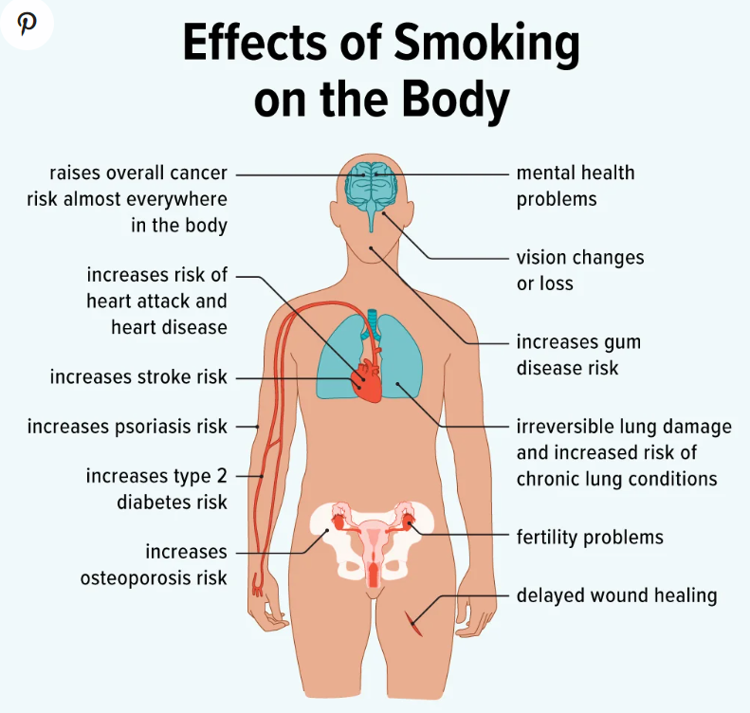
The impact of smoking on the body
Notes:
This activity could be done in small groups where someone lies down on a large piece of flipchart paper and is drawn around. Alternatively, print a template of a human body and give to individual pupils or to pairs.
Discuss the short and long term effects that smoking tobacco could have on the human body and label the parts of the body that smoking could impact.
Discuss: Why might smoking underage be even more harmful?
In relation to the discussion point – encourage pupils to think about the fact that if young people are smoking under the age of 18, their bodies are still developing physically and mentally their brains are still developing too.
You can access information about the impact on smoking here:
https://www.nhs.uk/better-health/quit-smoking/benefits-of-quitting-smoking/
https://www.bbc.co.uk/bitesize/articles/zb62jsg#zqq3vwx
Image from: https://www.healthline.com/health/smoking/effects-on-body

Slide 10
Tobacco & The Law
At what age can young people purchase and consume tobacco, cigarettes and/or vapes now?
Has this changed over the years?
Could it be due to change again in the neat future?
Notes:
For this discussion, encourage pupils to return to their timelines if they have featured information about when changes were made to the age at which young people can purchase and consume tobacco/vape products.
If they do not have this information from the previous activities or discussions, they can visit the following website. https://lawstuff.org.uk/ (if pupils do not have access to technology as part of the session, the teacher should encourage discussion and provide the corrects answers accordingly.
– It is currently 18 years of age.
Yes – Children and young people used to be able to purchase tobacco and cigarettes from a much younger age. It only increased to 18 from 16 in 2007!
Yes – Smoke free generation legislation and the Tobacco & Vapes bill is currently being explored by Members of Parlaiment.

Slide 11
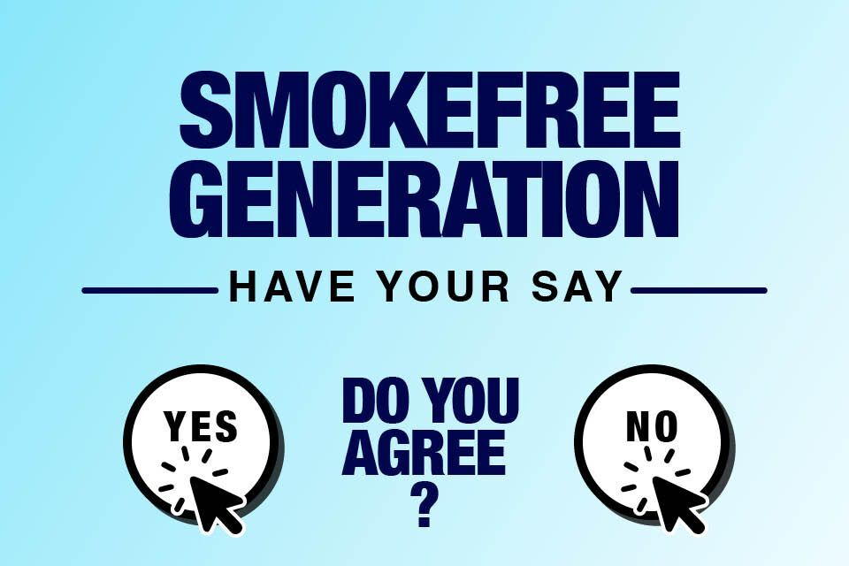
The Great Debate!
Thinking about everything you know already & everything you have learned about tobacco, cigarettes and smoking today, you will now have a debate about plans by the Government to create a smoke free generation.
Notes:
More information about what the proposed smoke free generation pledge by the Government could look like, as well as further details on the Tobacco and Vapes Bill can be found here - https://healthmedia.blog.gov.uk/2024/04/15/creating-a-smokefree-generation-and-tackling-youth-vaping-what-you-need-to-know/
Pupil Led Version:
The class can be split into teams of agree/disagree and be given a set amount of time to fact-find and consider their argument either in favour of, or against the idea of a smoke free generation. Setting out a clear structure for the debate so pupils can prepare their contributions is advisable.
Teacher Led Version:
The class teacher can ask pupils to raise their hand to vote as to whether or not they agree/disagree with the plans to create a smoke free generation and can ask pupils to validate their statement by sharing why they agree/disagree.
Approximate timings – 10 minutes to research and decide your key arguments. 2 minutes per team to make an opening argument – 2 minutes for each team to challenge/debate – raise of hands to vote on if the class agree/disagree.
Agree/Disagree – Debating points as a class before finally voting on an issue could be a fantastic way to capture learning across the year with a series of Agree/Disagree statements about the class

Slide 12
Your Takeaway from Today! ☺
Notes:
To bring the lesson to an end, encourage pupils to re-visit the pack of facts that they created earlier in the lesson. Using a different colour, encourage the pupils to add any additional information they now know about tobacco/smoking. Writing using two different colours will allow the teacher to identify new learning that has come about as a result of the lesson.

Slide 13
Smoking cessation support services
There is support available for people of all ages for those under the age of 18, those aged between 18 – 24 & for adults and we believe it is never too late to get support to stop smoking.
You can find a full list of services by visiting the Healthier Blackpool website’s Smoke Free section.
Blackpool Tobacco Addiction Service Free Helpline:
0808 1964324
Notes:
When a conversation arises with a young person who is vaping or smoking, there are a number of services you can make them and their parent/carer aware of.
Encourage a referral into the specialist tobacco addiction service.
They will support any young person over the age 12 if they are smoking AND vaping.
Nicotine Replacement Therapy (NRT) is available for over 12s.
There is also a self-referral form.
If a young person is using tobacco alongside another substance such as Cannabis, you can refer them to the ADASH team – follow the QR code in the poster to find out more information about the service and how to refer/self-refer.

