Slide 1
Public Health Briefing: Tobacco
This briefing has been created by the Blackpool Council Public Health team and is accurate as of September 2024.
Click the Blackpool Council image on the right of this slide to visit the Healthier Blackpool webpage. Click on the PSHE image to be directed to the PSHE section of the Healthier Blackpool website.
If you have any questions about anything in the slide, please contact publichealth@blackpool.gov.uk.
Notes:
This is a Public Health briefing on Tobacco and Smoking.
This briefing has been created for those working across Education in Blackpool to ensure that tobacco and smoking remains on the agenda from a prevention and harm reduction perspective.
All of the information in this slide is accurate as of September 2024.
You can access the Smoke Free section of the Healthier Blackpool website by clicking on the Blackpool Council Public Health image on screen.
You can access our PSHE offer to those working in Education by clicking on the PSHE image on screen.
If you have any question as a result of this briefing, please do not hesitate to contact the Public Health team using the email address on screen.

Slide 2
This briefing will cover:
What is tobacco?
Tobacco and Smoking
Nicotine in Tobacco
The make-up of cigarettes
The cost of smoking
Tobacco & the law
Tobacco & the impact
Harm Reduction Advice
Smoking Cessation Support
Notes:
This briefing will cover a range of topics as you can see on the slide.

Slide 3
What is Tobacco?
Tobacco is derived from the genus Nicotiana, a plant from the night-shade family, which is indigenous to (from) North & South America.
The plant where Tobacco comes from has existed for millennia and was first smoked by native Americans for ceremonial purposes and for its purported positive health benefits!
There is recorded use of tobacco being used recreationally as a cigarette as early as the 1500’s, until this time it was chewed or smoked in a pipe.
From the late 1800’s the most common way to consume tobacco has become smoking cigarettes.
As well as many other chemicals, tobacco contains Nicotine. Nicotine is such a powerful drug that the Royal College of Physicians has confirmed that Nicotine causes addiction similar to drugs such as Cocaine and Heroin.
Nicotine is absorbed by the body extremely quickly and reaches the brain between 10 – 19 seconds after being inhaled.
Notes:
Read from slide:
Tobacco is derived from the genus Nicotiana, a plant from the night-shade family, which is indigenous to (from) North & South America.
While it has existed as a plant for centuries and was originally used by native Americans for ceremonial purposes and many initially believed tobacco could have positive health benefits!
There is recorded use of tobacco being used recreationally as a cigarette as early as the 1500’s. At this time it was chewed or smoked in a pipe.
However, the most common way to consume tobacco is now through smoking cigarettes.
As well as many other chemicals, tobacco contains Nicotine.
Nicotine is such a powerful drug that the Royal College of Physicians has confirmed that Nicotine causes addiction is similar to drugs such as Cocaine and Heroin.
Nicotine is absorbed by the body extremely quickly and reaches the brain between 10 – 19 seconds after being inhaled.

Slide 4
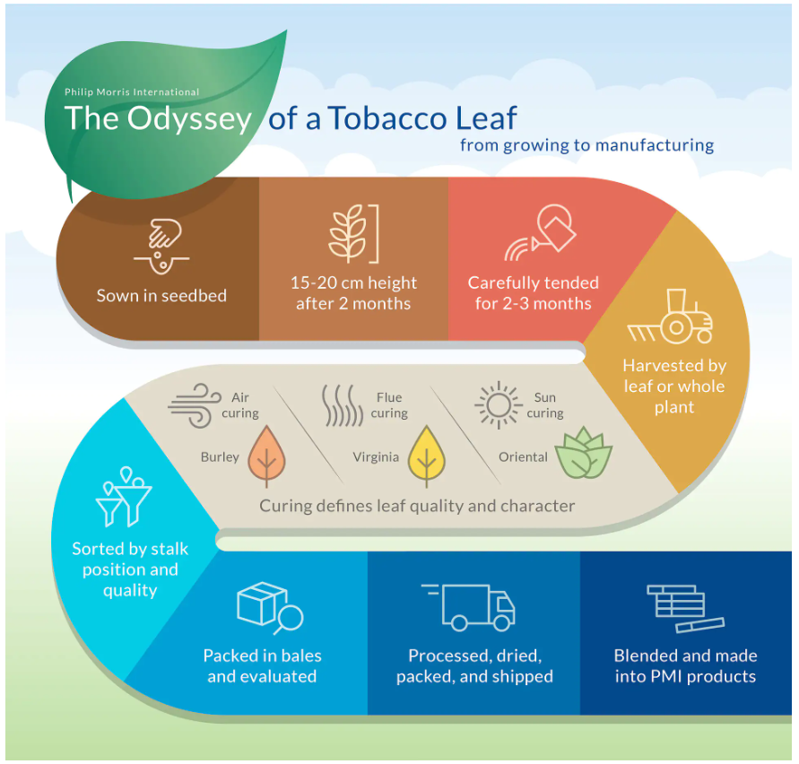
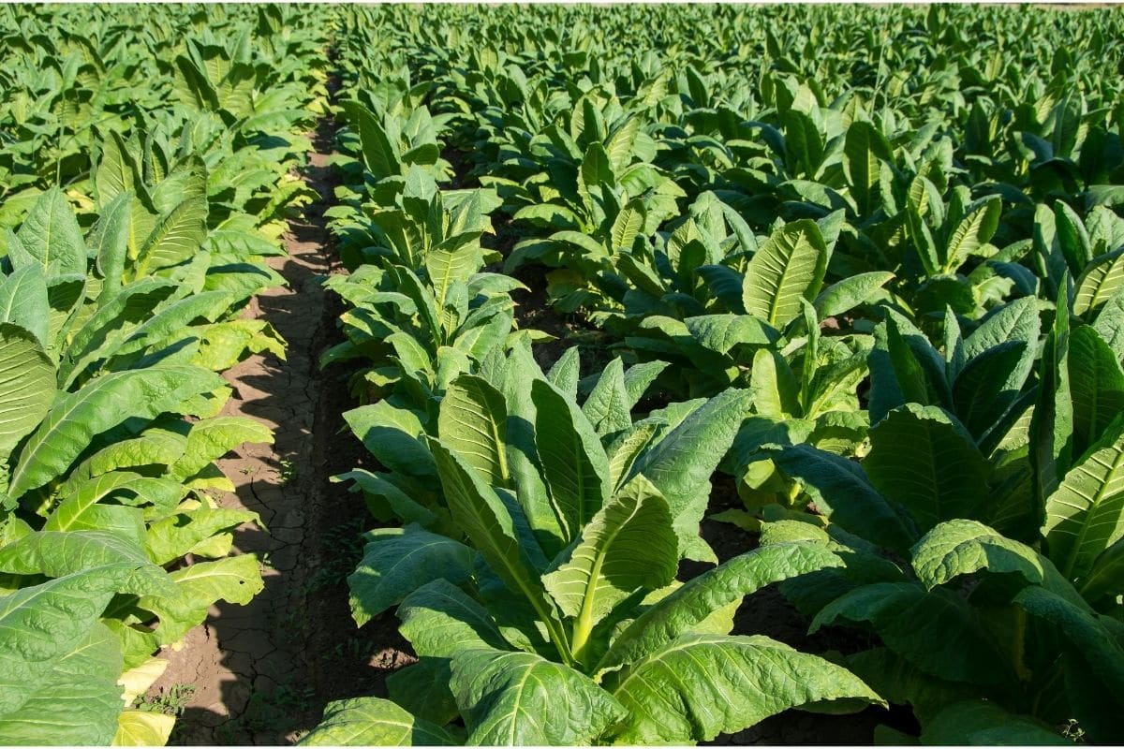
Tobacco: From plant to pouch
The diagram on the right of this slide offers a breakdown of the process from the growing of the tobacco plant, through to its treatment so that it can be used as intended as tobacco to be smoked in cigarettes.
Notes:
As you can see from the image on screen, from the plant, tobacco is cultivated and goes through many different stages to become the tobacco that we see most commonly in cigarettes or as pouches of rolling tobacco.
https://www.pmi.com/tobacco-economics/tobacco-farming-and-curing

Slide 5
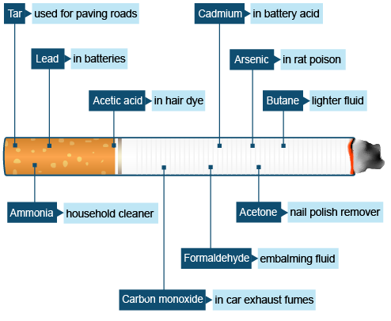
The make-up of cigarettes
Nicotine, which is found in tobacco, is not the only component of a cigarette. Cigarettes are made up of a number of ingredients and chemicals as this image shows.
As seen, many of the elements of a cigarette are made up of chemicals that are harmful and are used in many other products that are not fit for human consumption.
Notes:
As you can now see on screen, in addition to nicotine which is naturally found in tobacco, there are a number of other chemicals contained within a cigarette.
The next slide will not contain any audio and will instead feature a short video that explains the impact that nicotine has on the brain. Once you have watched this, please move the slide on yourself to get to the next slide.
https://www.bbc.co.uk/bitesize/articles/zb62jsg

Slide 6
Nicotine in Tobacco Video

Slide 7
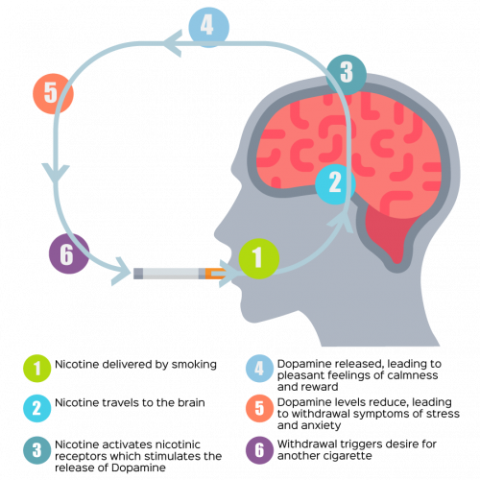
The impact of nicotine
Notes:
If you would like further details on how nicotine affects the brain you can view the notes in this briefing.
In short, Nicotine affects the brain in several ways:
It interferes with the blood-brain barrier function, raising the risk of brain edema and neuroinflammation.
It activates structures in the brain called receptors, which release dopamine, making you feel good.
It is harmful to developing brains and can disrupt the formation of brain circuits that control attention, learning, and susceptibility to addiction.
It increases the release of neurotransmitters in the brain, which help regulate mood and behavior.
It affects the area of the brain responsible for attention, memory, learning, and brain plasticity, which essentially means the brain has the ability to rewire itself and nicotine can disrupt the ability for the brain to do this and stop it from creating new connections.
These new connections include being able to recover from traumatic injuries, learning new skills, restoration of lost functions in your body and management of depression and anxiety.
Nicotine is a highly addictive stimulant. It is most popularly known for its use in tobacco products and vapes.
When nicotine binds to receptors in your brain, it communicates to neurotransmitters to be released that enable biological responses. These include dopamine and serotonin – that regulate pleasure, mood, emotion, and pain relief. The dopamine release, for instance, is what causes one to feel pleasure after smoking a cigarette or using a vape.
Using nicotine can be complicated. In the short-term, smoking may feel good by creating feelings of pleasure and relaxation and it can also create social opportunities to connect with other people and provides a distraction from stressful situations. These are powerful drivers for continuing to vape or smoke.
However, because of the way nicotine works in the body, those feel-good chemicals don’t last long. Within just a few minutes, the effect of nicotine in the body wears off and can lead to a desire to smoke or vape again. This is nicotine withdrawal, and it includes:
cravings or urges to smoke or vape
feeling irritated or upset
feeling jumpy and restless
a hard time concentrating
changes in sleep and eating habits
And feeling anxious or depressed.
Over time, it takes frequent use of nicotine to create that same good feeling and deal with these symptoms of withdrawal. This is called nicotine dependence. Eventually, what started out as a pleasurable experience, vaping or smoking can lead to a nicotine addiction cycle that only addresses controlling withdrawal symptoms.
Due to nicotine's addictive nature, vaping and/or smoking can easily become a habit. An individual may develop a routine surrounding the act of it that looks like regular breaks or only smoking or vaping after meals, certain locations or under certain levels of stress. If someone is to overcome the addiction to nicotine, they will likely have to change the behaviors they associate with smoking or vaping as well as start a reduction regime of nicotine.
This makes it hard to stop using these products even when you know it’s bad for you.
Nicotine replacement therapy such as gum and patches are licensed by the Medicines and Healthcare products Regulatory Agency for smoking cessation, not just by adults but also for children from age 12 upwards.
A Public Health Engald report from 2022 found that
Nearly half (43.0%) of the 11 to 18 year olds who were current and former vapers, reported always using vaping products that contained nicotine
And only 17.3% reported always using nicotine-free products.
Addiction is a form of learning, and young people can get addicted more easily than adults.
YP can do it to address other needs such as relief from boredom and to cope with anxiety and stress.

Slide 8
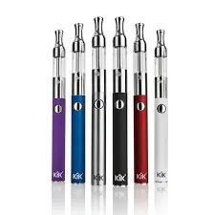
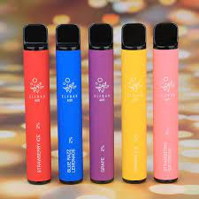
A new wave of Nicotine consumption…
While we understand the impact on the individual and to wider society of consuming tobacco and smoking, and there is also evidence that people smoking cigarettes is on the decline, the alternative methods many people are opting to use are also causing concern.
While there are many approved Nicotine Replacement Therapy (NRT), stop smoking options, which includes patches, gum and inhalators, many smokers have transitioned to use E-cigarettes and Vapes.
Many of the vapes that people are currently using are unregulated and the long-term implications of using these is still largely unknown.
Notes:
While this briefing focuses primarily on tobacco and smoking, it is important to acknowledge here the concerns that are growing around the use of vapes, particularly among young people that have not previously smoked tobacco.
They are relevant to the story of smoking cessation due to the fact that vapes were originally positioned and presented as a tool to support smoking cessation and were broadly welcomed to be used as such. However, we have seen a growing number of young people who have never consumed tobacco turning to vapes as an introduction to nicotine.
With that, concerns have grown over how vapes are marketed including the make-up of the machines being colourful, producing lots of smoke and having a number of flavours that would appeal to young people.
Vapes have not been in circulation long enough to be able to conclusively determine the risks and the potential impact and therefore, the advice is clear that using vapes as a temporary measure to aid smoking cessation is the only way they should be used and with that, they should not replace smoking tobacco, but instead be part of a process of reducing nicotine intake and completely eradicating nicotine consumption.
For more information on vaping you can access the vaping resources including a briefing that was created earlier in 2024.

Slide 9
Tobacco & the law
Over many decades, legislation on tobacco and smoking has changed considerably. For many years, those aged 16 and above were allowed to purchase tobacco until 2007.
From 2007, the legal age for purchasing tobacco was increased to 18 and earlier in 2024, a policy paper signifying the Government’s intention to legislate for a smoke free generation was published.
Plans include making it an offence to sell tobacco products to those born on or after the 1st of January 2009.
Notes:
Read from screen:
Information about changes to legislation over the years can be found at: https://ash.org.uk/uploads/Key-Dates_2022-04-21-101255_ajre.pdf
Information about the Tobacco and Vapes bill that was https://www.gov.uk/government/publications/tobacco-and-vapes-bill-factsheets/tobacco-and-vapes-bill-smokefree-generation-factsheet

Slide 10
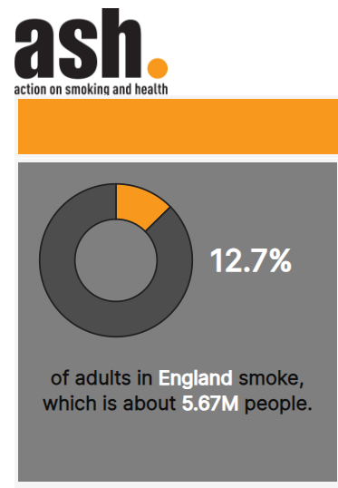
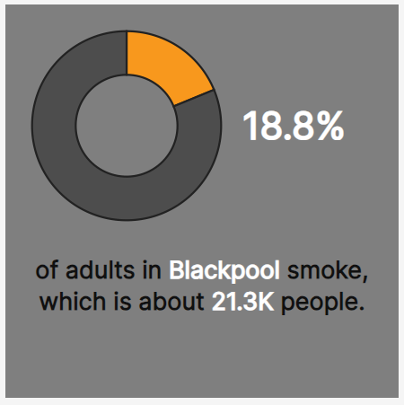
Smoking in Blackpool
Smoking is the cause of many preventable diseases and premature deaths across the world and in addition to the tragic impact that smoking can have on an individual and their friends and family, there is also cause for concern around the cost of smoking to society.
Notes:
As you can see from the images on screen courtesy of data from Action on Smoking & Health, rates of those smoking in Blackpool are higher than the national average, with 18.8% of people, accounting for around 21,300 adults, smoking in Blackpool. This compares with 12.7% of adults across England.

Slide 11
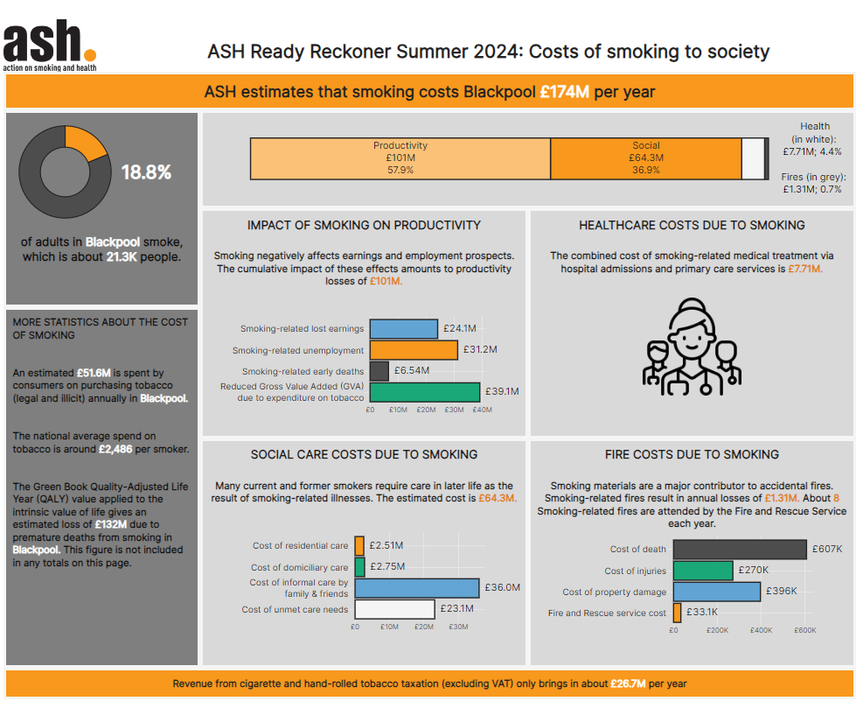
The cost of smoking…
The cost of smoking Tobacco goes well beyond the price of a pouch of tobacco or a packet of cigarettes.
This tool by ASH on the costs of smoking to society covers:
Impact of smoking on productivity
Healthcare cost due to smoking
Social Care cost due to smoking
Fire costs due to smoking
Notes:
Smoking is one of the leading causes of preventable deaths across the world and Action on Smoking and Health (ASH, 2024), report that smoking costs England approximately £46 billion pounds per year.
ASH have a Ready Reckoner tool that allows you to see how smoking is impacting on your Town or City. The estimated cost for Blackpool is £174 Million pounds per year.
As well as the health implications for individuals that smoke and those that are impacted by second hand smoking, we now turn our attention to the cost to society.
While some revenue is brought in through the taxation applied to tobacco products, meaning the Government will receive some money, this is far outweighed by the cost to the NHS and Social Care that smoking causes due to the causal link that exists between smoking and disease and the impact on life expectancy.

Slide 12
Harm Reduction Advice
The fundamental of harm reduction advice is always that the best way to reduce harm in the first instance is not to start. This is certainly the case with using tobacco and any other nicotine based products.
Engaging with smoking cessation services is the best form of harm reduction for those already consuming tobacco, as even when reducing the number of cigarettes smoked, there is still significant harm caused to the human body.
However, in cases where people are already smoking or vaping, the advice is as follows:
Seek support from smoking cessation services
Buy products from reputable businesses
Aim to reduce the number of cigarettes you smoke
Avoid smoking around babies and children to reduce the impact of Second-hand smoking
Notes:
Harm reduction advice and guidance is always really clear that if someone is not already engaging in the activity, in this instance smoking, the best way to reduce harm is to continue not to smoke.
However, it is acknowledged that many people may already be consuming tobacco and as a result nicotine and the harm reduction messaging for those already consuming nicotine is as follows:
Firstly, make sure that you are receiving the product that you ask for. Often, counter-fit cigarettes and tobacco can be more harmful and especially in instances with vapes, can contain substances

Slide 13
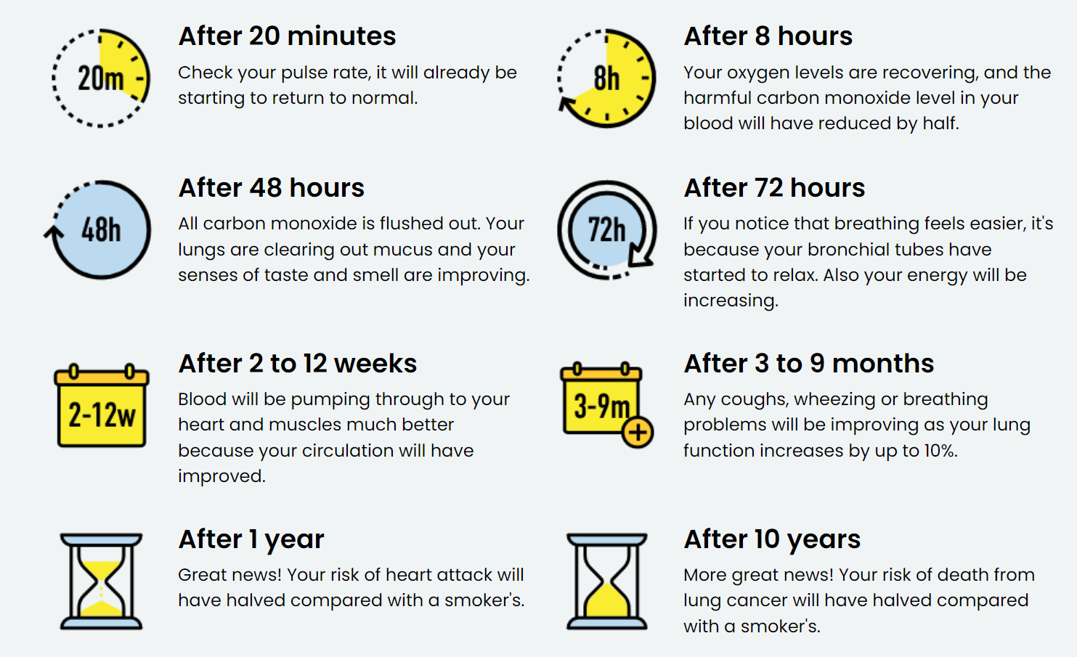
What happens when we quit?!
Notes:
From the NHS’s Better Health Quit Smoking website, you can now see on screen the many short-term and long-term effects of going on your own smoking cessation journey.
After just 20 minutes, this has a positive impact on the human body, all the way to after 10 years, at which point someone who has successfully quit smoking would face a significantly reduced risk of cancer.
As well as the many health benefits, it would also have a positive impact on an individual’s finances due to the cost of smoking.

Slide 14
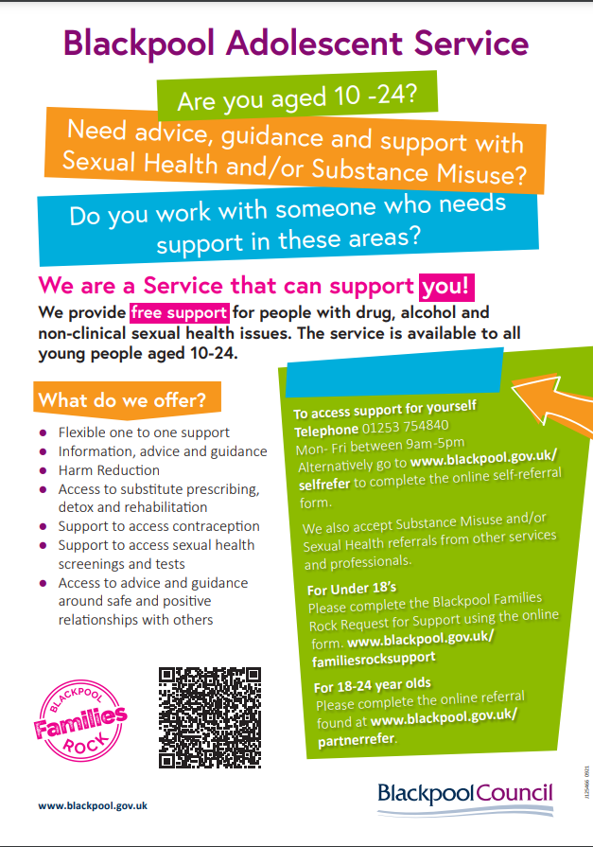
Smoking cessation support services
There is support available for people of all ages for those under the age of 18, those aged between 18 – 24 & for adults and we believe it is never too late to get support to stop smoking.
You can find a full list of services by visiting the Healthier Blackpool website’s Smoke Free section.
Blackpool Tobacco Addiction Service Free Helpline:
0808 1964324
Notes:
When a conversation arises with a young person who is vaping or smoking, there are a number of services you can make them and their parent/carer aware of.
Encourage a referral into the specialist tobacco addiction service.
They will support any young person over the age 12 if they are smoking AND vaping.
Nicotine Replacement Therapy (NRT) is available for over 12s.
There is also a self-referral form.
If a young person is using tobacco alongside another substance such as Cannabis, you can refer them to the ADASH team – follow the QR code in the poster to find out more information about the service and how to refer/self-refer.

Slide 15
Thank you.
E-mail: publichealth@blackpool.gov.uk
Website: www.healthierblackpool.co.uk

