Slide 1
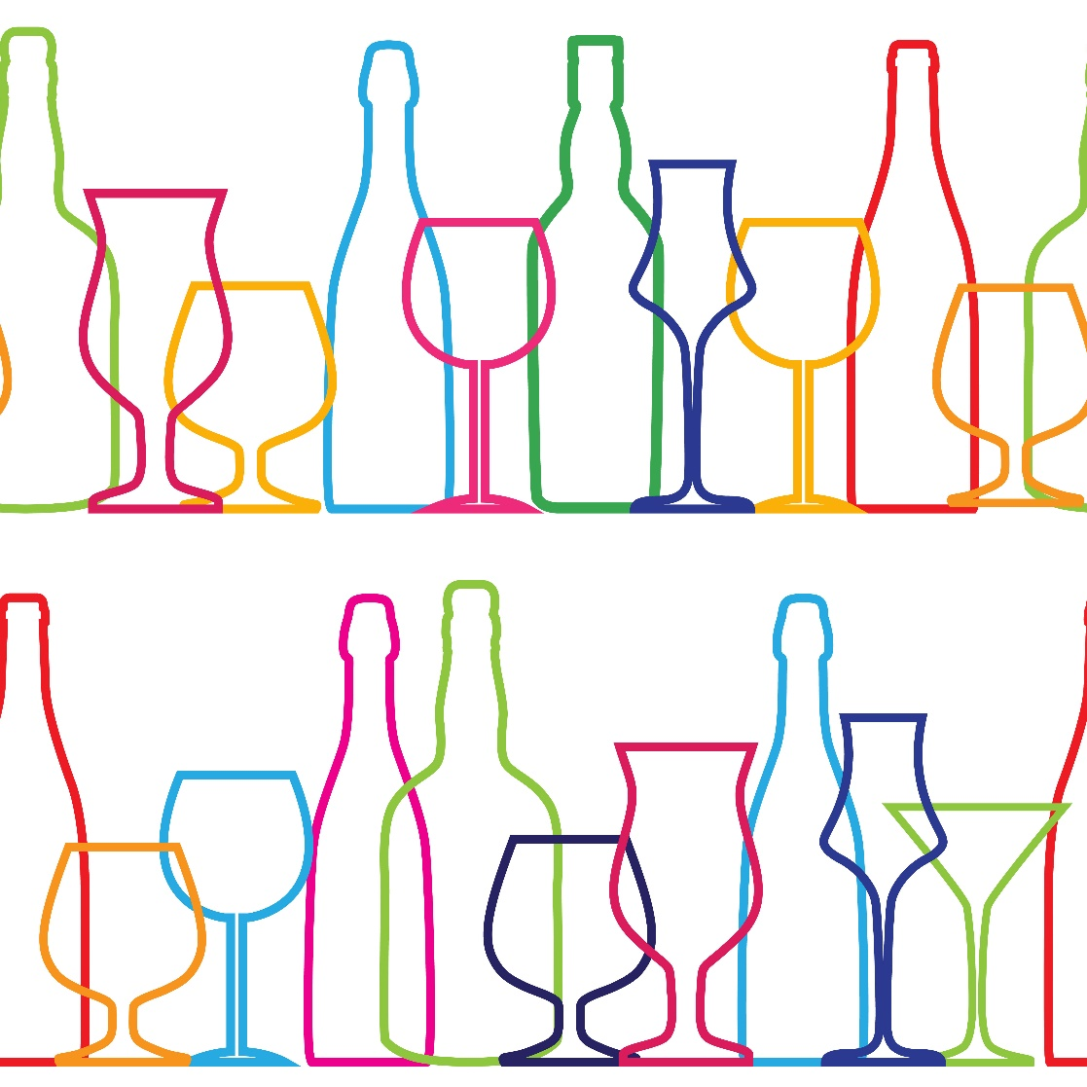
Alcohol Lesson
September 2024
Notes:
This lesson has been created by the Public Health team in Blackpool Council to be used by colleagues in Education to support those in Key Stage Three to learn about alcohol.
While this lesson is primarily for a Key Stage Three audience, the facts are applicable to all ages and should therefore hopefully make adapting and tailoring this lesson achievable for colleagues in KS1 & KS2.
This lesson can be used and adapted by PSHE colleagues as they wish but should be viewed and engaged with after viewing the Public Health Briefing on Alcohol.
Foundations for a great lesson – 5 minutes
Starter Activity – 5 Minutes
Learning Objectives – 1 Minute
What is alcohol? – 10 Minutes
Higher or Lower – 4 Minutes
ABV – 3 Minutes
Risks of alcohol – 2 Minutes
Alcohol Units Video – 5 Minutes
Drinking Diary Activity – 5 Minutes
Make a game of it – Main Activity – 15 Minutes
Takeaway From Today! – 5 Minutes

Slide 2
Foundations for a great lesson!
Be respectful
Use appropriate language
Notes:
Boundaries and ground rules keep us safe.
Setting these out and revisiting them before we talk about PSHE topics is important.
Think about building something, you need solid foundations to do this. Draw a brick wall and write a ground rule that will keep everyone safe.
Ensure there is agreement among the pupils and re-visit at the beginning of every lesson.
Note for teachers: Please approach this session and discussions sensitively, particularly when talking about recommended units as some young people will have relatives that drink excessive amounts of alcohol, so emphasise the importance of accessing services/support, which you can find in the briefing or at the end of these slides.

Slide 3
Starter Activity: All About Alcohol
Write down everything you know about alcohol.
Include as much detail as possible as we will look back over this at the end of the lesson to compare what we have learned in the lesson today.
Notes:
Encourage pupils to write down everything they know about alcohol as a starter activity before any new knowledge is shared as part of the lesson.
Differentiation:
This can be done individually, in pairs or as small groups. If there is limited knowledge around alcohol this could be done as a class discussion with bullet points made about to reflect back on at the end of the lesson.
Additionally, to encourage discussion you could prompt the class to think about:
The different types of alcohol
How else alcohol is used – in medicine etc…
Recommended drinking guidelines
Different strengths
Law around alcohol – to consume, to purchase etc…
Facts around Alcohol and Blackpool are available within the Blackpool JSNA - https://www.blackpooljsna.org.uk/Living-and-Working-Well/Healthy-Lifestyles/Alcohol.aspx
Alcohol is the third leading risk factor for death and disability after smoking and obesity. Alcohol has been identified as a causal factor in more than 60 medical conditions including cirrhosis of the liver, heart disease, depression, strokes and a number of cancers.
Blackpool has high levels of alcohol-related harm (health, disorder, violence) for the size of its population.

Slide 4
Learning Objectives
By the end of this lesson, pupils should be able to:
Explain what alcohol is
Understand and be able to explain the relationship between ABV and Units
Have knowledge of the law around purchasing and consuming alcohol
Explain the risk of excessive drinking and the harm to young people

Slide 5
What is alcohol?
Sort the statement cards about alcohol into two piles, one that is true and one that is false.
Notes:
This activity can be done as a whole class to save time/resources. Each statement could be displayed on screen or introduced by the teacher to the group. The class can vote on if they think the statement is true or false:
True statements:
Alcohol comes from the chemical Ethanol.
Ethanol is also be used in medicines and domestic cleaning products.
It is illegal to give a child alcohol if they are under the age of 5.
If you are aged 16 or 17 and are accompanied by an adult, you can drink (but not buy) beer, wine or cider with a meal.
Alcohol was banned across America (Prohibition) from 1920 – 1933.
False statements:
Alcohol affects everyone in the same way.
All alcoholic drinks are the same strength.
It is legal for someone to buy alcohol for anyone under the age of 18 in England.
Every country has the same laws relating to alcohol.
Recommended units per week in the UK are different for men and women – False now, although it used to vary for men and women.

Slide 6
Notes:
Use the images and explanation of ABV% and Units in slide 7 to develop this slide – ask the young people to say which drink and portion size is higher or lower than the previous drink.

Slide 7
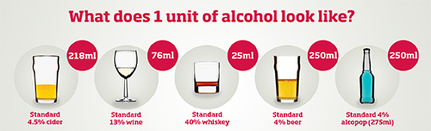
Alcohol By Volume (ABV) – Alcohol Strength
Notes:
Alcohol varies in its strength. This means that having the same measurement of an alcoholic drink does not mean that it has the same amount of alcohol within it.
Staff should explore this with pupils to support them to understand the different strengths of the various types of alcohol available.

Slide 8
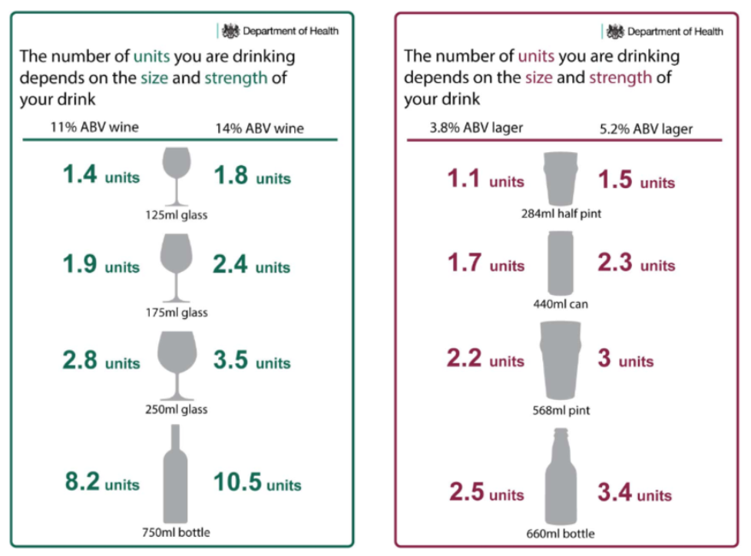
Watch & learn: Alcohol units
Now we have learned that alcohol has different strengths (ABV), we can take this learning to start to appreciate that the higher the strength of the alcohol, the percentage of the Alcohol By Volume, the less of it is needed to make up one unit.
Notes:
Load this video from the NHS on alcohol units - https://www.youtube.com/watch?v=OeX0Fz0Xza4
Once the group have watched the video, introduce them to the following website - https://alcoholchange.org.uk/alcohol-facts/interactive-tools/unit-calculator. Explore this with the pupils to support their understanding as they will use this later.

Slide 9
Watch & learn: Risks of alcohol
After watching the video, discuss why young people may be at even greater risk if drinking alcohol underage.
Notes:
Ask pupils to watch this video to inform learning for the main activity later in the lesson.
Link to YouTube video: https://www.youtube.com/watch?v=g1Ecg6N1jks
Use this opportunity to promote Blackpool ADASH team to young people if they had any concerns around their own, or alcohol use of peers and friends.

Slide 10
Create Your Own Diary
 | Alcohol consumed
Day of the week
Monday | Alcohol Free Day | 4 pints of beer
Tuesday | 1 pint of cider 1 Double Whiskey and Mixer | 1 bottle of red wine 2 x Vodka and Mixer
Create two versions of a weekly drinking diary.
One version is of someone who stays within the recommended 14 units per week, including having several drink-free days.
The other is of someone who drinks more than the recommended weekly number of units in a week.
Include what they have to drink on each day in both examples.
Notes:
This can be done as an individual task, as a pair or in small groups.
To factor in differentiation, the teacher could provide a diary template and a case study and ask pupils to complete the diary.
As an extension of this task, ask students to consider different factors that could influence someone’s diary in terms of where/when/ they drink alcohol.
Ask the group to discuss if they think people living or visiting Blackpool may drink more or less and ask them to explain why they think that is the case. The purpose of this is to encourage learners to unpick the fact that many Towns/Cities have more vibrant Night Time Economies and how

Slide 11
Make a game of it!
Take all of your learning from today as well as knowledge you already have relating to alcohol and in pairs/small groups, create a game for younger people to learn about alcohol.
Notes:
The teacher can be more specific about the age range if that is deemed more helpful for the class.
Prompt the group to be as creative as they like.
The game could be a form of Alcohol Top Trumps with metrics such as cost, strength, number of units in a bottle etc…
It could be a board game that encourages safe levels of drinking with different scenarios resulting in someone either drinking appropriately or drinking excessive amounts – if the player reaches over 14 units in the game they have to go back to the start.
It could be developing the script/scenes for a VR game about alcohol.

Slide 12
Your Takeaway from Today! ☺
Notes:
To bring the lesson to an end, invite each group to share their game ideas to assess the learning and their understanding of alcohol.

Slide 13
Harm Reduction Advice
As with any harm reduction, the advice remains that if you do not currently drink excessive amounts of alcohol, the best form of harm reduction is not to start.
When drinking, there are things that can reduce the risk of harm, these include:
Drinking in line with recommended daily amounts
Having several alcohol free days to factor in enough recovery time
Alternate between water or a soft drink after an alcoholic drink
Avoid caffeine when drinking or after alcohol
Remember, it takes your body approximately an hour per unit of alcohol to recover and process the alcohol
Do not mix alcohol with other drugs.
Stay safe and with people you know and trust if you have drank too much
If you are worried about yourself or a friend, call 111 or 999 if it is an emergency
Notes:
All information included in this slide including the narration is https://www.drinkaware.co.uk/advice-and-support/underage-drinking/know-the-risks-of-drinking-alcohol-underage
If someone has symptoms of alcohol poisoning, here are some things you can do to help them and some things you should avoid doing.
First, things you should do:
1. Try to keep them awake and sitting up
2. Give them some water (and nothing else), if they can drink it
3. Lie them on their side in the recovery position if they’ve passed out, and check they’re breathing properly
4. Keep them warm
5. Stay with them and monitor their symptoms
What not to do:
Never leave someone alone to sleep it off The amount of alcohol in someone’s blood continues to rise even when they’ve stopped drinking because the digestive system carries on absorbing alcohol into the bloodstream
Never give them a coffee Alcohol dehydrates the body. Coffee will make someone who is already dehydrated even more so – in severe cases this can even cause permanent brain damage
Never make them sick Their gag reflex may not be working properly which means they could choke on their vomit
Never walk them around Alcohol is a depressant which slows down your brain’s functions and affects your sense of balance. Walking them around might cause accidents
Never put them under a cold shower Because moving a person with alcohol poisoning risks causing injury, it’s not a good idea to give them a shower. A cold shower is even worse - alcohol lowers your body temperature, which could lead to hypothermia. The best advice is to put them in the recovery position in the nearest safe place.
Never let them drink more alcohol The amount of alcohol in their bloodstream could become dangerously high

Slide 14
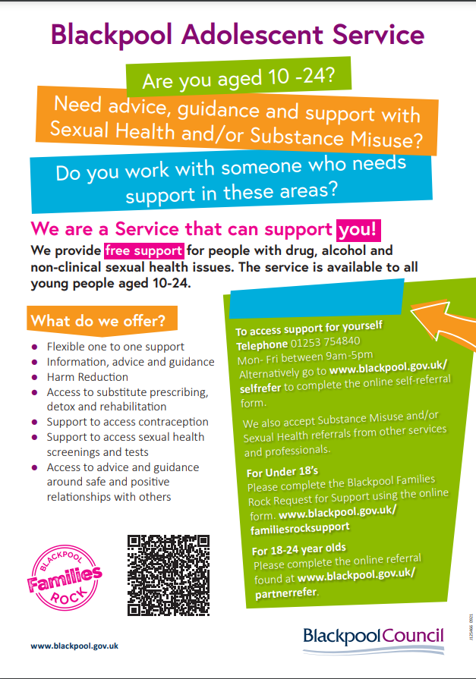
Alcohol support services
There is support available for people of all ages for those under the age of 18, those aged between 18 – 24 & for adults.
Under 25:
Blackpool Families Rock – Request for support
Adolescent Services Partner Referral
Adolescent Services Young Person Self Referral
Over 25:
Advice and service information - Healthier Blackpool
LIGHTHOUSE Horizon
Notes:
There is a new Online referral pathway for under 18s and 18-24 year olds and self-referrals. For more information please review the Adolescent Services image on screen for under 25’s.
Partner under 18's
Link to Blackpool Families Rock Request for Support Hub should be made using the online form -
Partner referrals 18-24 years
www.blackpool.gov.uk/partnerrefer
self-refer via
www.blackpool.gov.uk/selfrefer
Horizon
Referrals get triaged and allocated a key worker – important that you complete comprehensively!
That key worker will make contact over the phone to arrange a convenient time for an assessment.
This assessment can now be done over the phone or F2F if requested
1:1 sessions
Brief intervention sessions ( 5 ways to wellbeing)

