Slide 1
Public Health Briefing: Alcohol
This briefing has been created by the Blackpool Council Public Health team and is accurate as of September 2024.
Click the Blackpool Council image on the right of this slide to visit the Healthier Blackpool webpage. Click on the PSHE image to be directed to the PSHE section of the Healthier Blackpool website.
If you have any questions about anything following on from listening to this briefing, please contact publichealth@blackpool.gov.uk.
Notes:
This is a Public Health briefing on Alcohol.
This briefing has been created for those working across Education in Blackpool to ensure congruency with key public health messaging in relation to alcohol, and the messages delivered as part of PSHE education across education providers in Blackpool.
All of the information in this briefing is accurate as of September 2024.
You can access Drink Less section of the Healthier Blackpool website by clicking on the Blackpool Council Public Health image on screen.
You can access our PSHE offer for those working in Education by clicking on the PSHE image on screen.
If you have any question as a result of this briefing, please do not hesitate to contact the Public Health team using the email address on screen.
https://www.gov.uk/alcohol-young-people-law

Slide 2
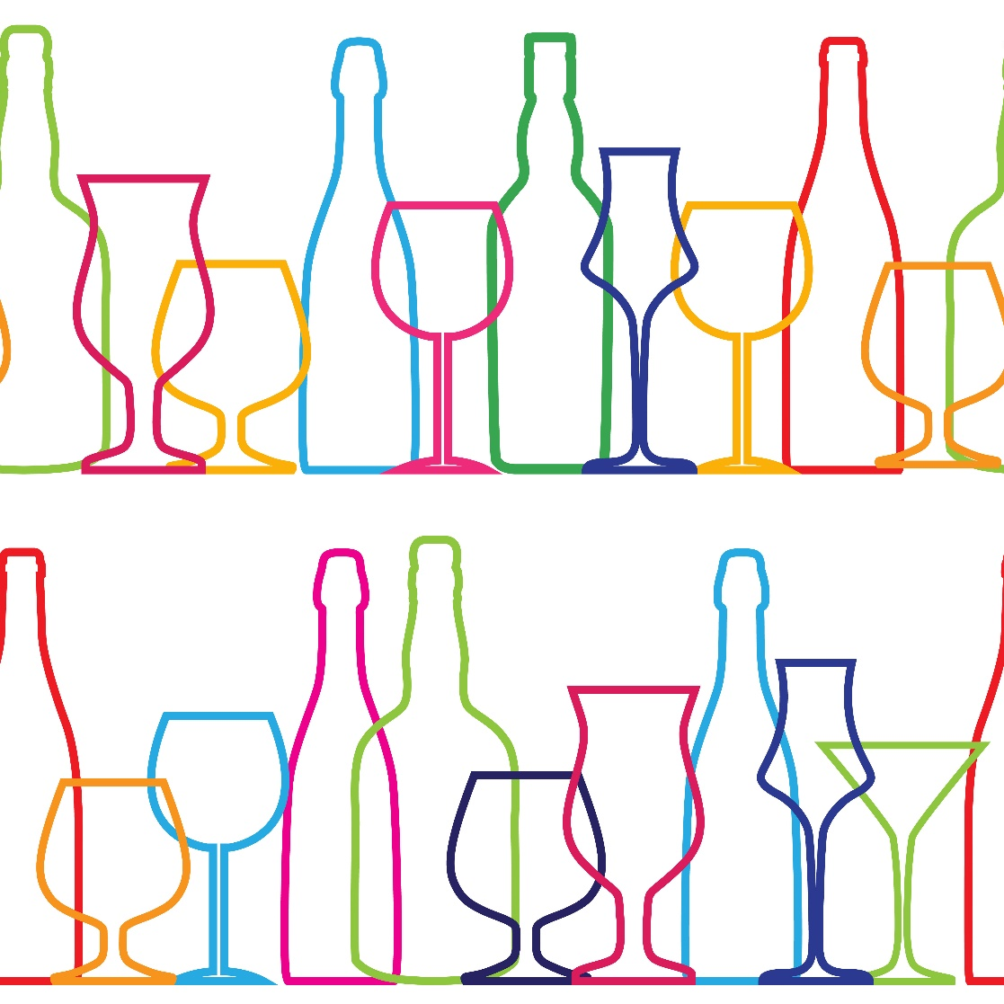
This briefing will cover
What is alcohol?
Alcohol strength & recommended amount
The true cost of alcohol
Alcohol Harm Paradox
Alcohol & Young People
Alcohol & the law
Alcohol & the impact
Harm reduction
Alcohol support services
Notes:
This briefing will cover a range of topics including the strength of alcohol and recommended amounts, the impact of consuming alcohol and harm reduction messaging.

Slide 3
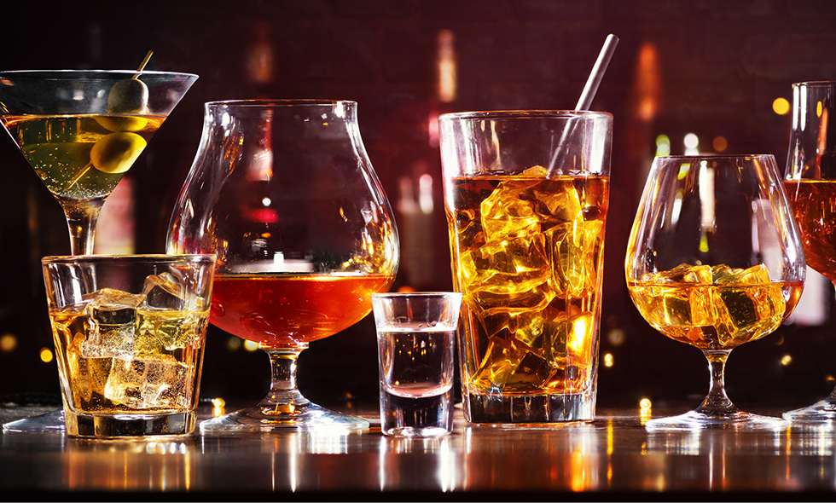
What is alcohol?
Alcohol comes from the chemical Ethanol. Ethanol is a psychoactive & toxic substance that can cause dependence. Despite some people describing feeling positive after a couple of drinks, alcohol is a depressant.
The WHO says that most alcohol related harms are caused by heavy episodic drinking (binge drinking), or heavy continuous drinking.
Even at low levels, alcohol can present health risks. The more alcohol that is consumed, the greater the risk.
Notes:
Read from screen

Slide 4
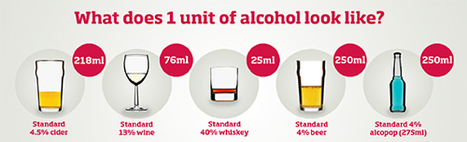
Alcohol strength & recommended amount
Notes:
Alcohol comes in different types flavours, colours and strengths! The strength of alcohol is measured as a percentage of ABV which stands for Alcohol By Volume.
Interestingly though, while the strength of alcohol is measured in ABV, the amount of alcohol people consume is measured in units.
The link between the two is simple – the higher the ABV%, the more units the drink contains and therefore the higher the ABV%, a lower amount of that alcohol would be needed to reach the recommended units of alcohol that people should have.
There are lots of really useful websites that explain what a unit is in more detail and there are tools on there for people to gain a better understanding of their own drinking habits and what this means for the amount of units they drink.
https://alcoholchange.org.uk/alcohol-facts/interactive-tools/check-your-drinking/alcohol-units
https://www.nhs.uk/live-well/alcohol-advice/calculating-alcohol-units/
https://www.healthforteens.co.uk/lifestyle/alcohol/how-much-is-safe-to-drink/

Slide 5
Alcohol harm paradox
Notes:
It is important to understand the relationship between the harms of alcohol and the disproportionate impact the harms of alcohol has in deprived communities.
More alcohol-related health problems are found among people with a low social class (service employees, low-level manual laborers, and the unemployed)
compared to those with a high social class status (upper class), even though these two groups drink similar amounts of alcohol.
This is known as the Alcohol harm paradox
An individual’s economic and social standing can be measured in different ways, but usually through a combination of education, income and occupation.
Generally, the higher someone’s socio-economic status, the more affluent they are.
In the UK, less affluent people experience a higher rate of alcohol-related health problems, despite people in different socio-economic groups having similar alcohol consumption levels.
It is quite a significant difference too.
There are a few different explanations for the Reasons for the Alcohol Harm Paradox
One being drinking and other unhealthy behaviours - Drinking combined with other health-challenging behaviours, such as smoking or having a poor diet, has been found to multiply your risk of developing conditions like alcoholic liver disease and some cancers, compared to doing them separately or not at all.
And Research shows how less affluent drinkers are more likely to do more health-challenging behaviours at the same time, compared to their more affluent counterparts.
This multiplied risk might explain the difference in harm, despite the different groups drinking similar amounts
It could be Consumption patterns - people living in less well-off areas drink alcohol in more harmful ways - for example, binge drinking.
(binge drinking, defined as 8 units or more for men and 6 units or more for women)
Less affluent people tend to be more likely to drink lots of alcohol in one session compared to lighter drinking over several sessions.
This might explain the findings that they suffer more injury from alcohol than more affluent people.
It could also be Access to health-care resources
People with a lower socio-economic status have to deal with more barriers in accessing health services than people with a higher socio-economic status - for example transport costs and being on waiting lists (not affording quick access through private healthcare).
There is also the thinking that socio-economic deprivation increases the probability of exposure to aversive experience, which promotes internalising symptoms (depression and anxiety), which promotes drinking alcohol to cope with negative affect, which in turn accelerates the transition from alcohol use to dependence.
On top of that, stigma around alcohol dependence seems to be particularly high for less affluent people.
Together, these barriers mean that less affluent drinkers are less likely to receive, or look for, professional help with alcohol-related diseases and disorders.

Slide 6
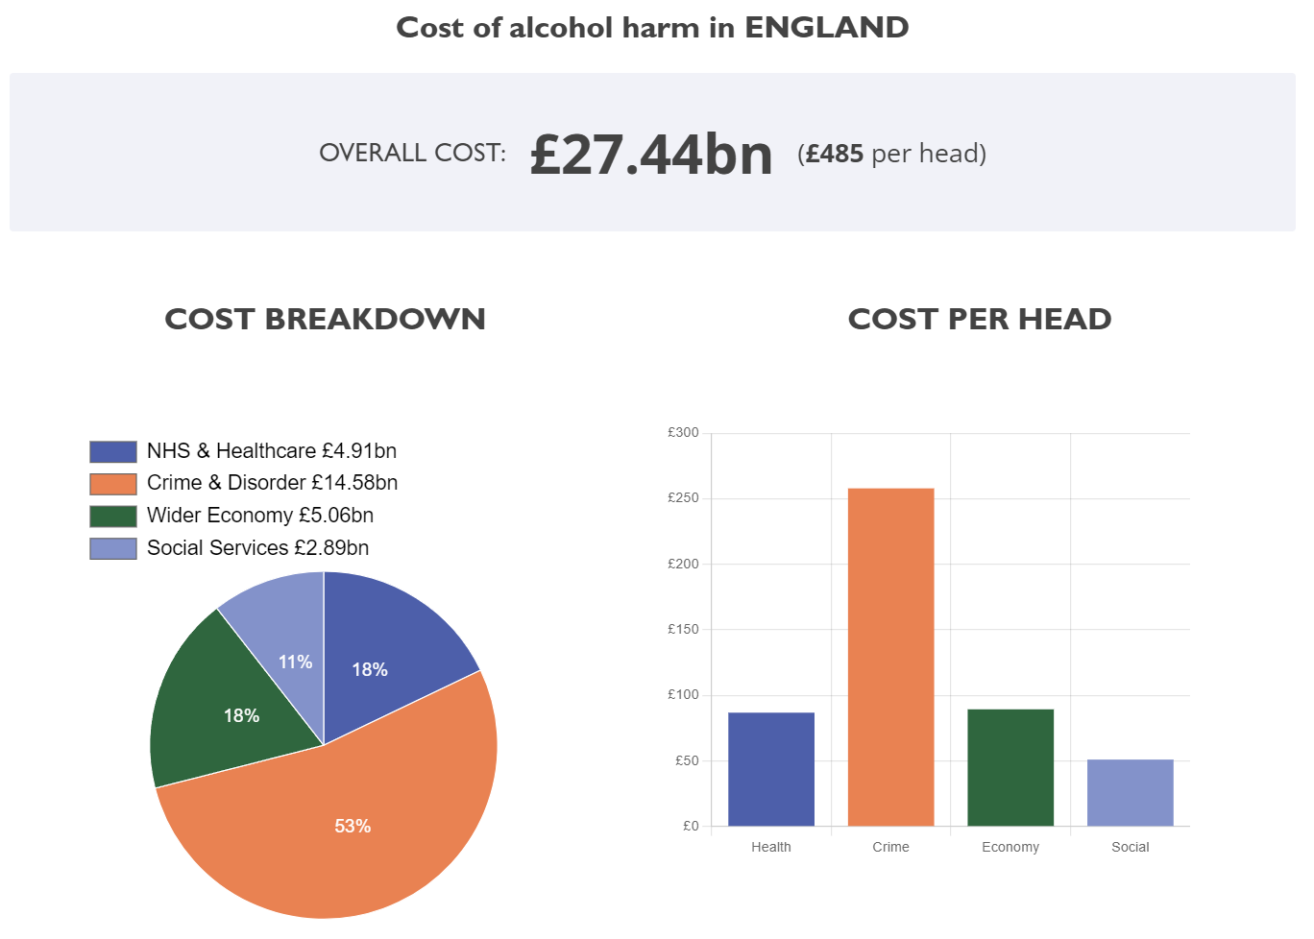
The cost of alcohol…
Notes:
Alcohol harm across the UK has a significant cost associated with it. And due to the extensive impact it has across many aspects of our society, calculating the cost accurately is difficult. Yet there are clear direct costs: to health services, the criminal justice system, and paramedic and police time. These have a direct impact on government finances. And there are also clear indirect costs: from lost productivity due to premature death, the loss of quality of life for the drinker, and drink driving collisions leading to higher insurance rates.
You can see from the graph on screen that while there are costs to Social Services and the NHS and wider healthcare system, the biggest cost of alcohol to wider systems is felt due to crime and disorder associated with alcohol consumption.
Again, according to data from the IAS, in England, Blackpool suffers the third largest cost of alcohol per person, with only Westminster and the City of London having higher costs per person. https://www.ias.org.uk/factsheet/economy/

Slide 7
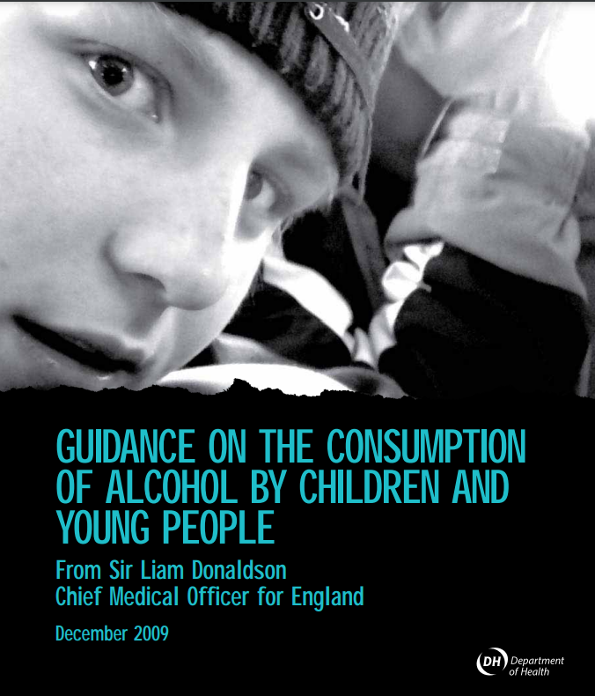
Alcohol and Young People
Notes:
It is important to engage with research and evidence when trying to understand the different experiences and relationships young people have with alcohol. More focus has been given to this public health area since the end of the 2009 when the CMO for England published guidance on the consumption of alcohol and young people.
In a report published by the World Health Organisation in 2024, it was found that a third of 11 year olds and more than half of the 13 years olds in England who took part in the survey had drunk alcohol, putting England top out of 44 countries who took part.
In addition, research indicates that experimenting with alcohol becomes more common as children get older. In England in a study in 2021, it was found that 13% of 11 year-olds said they had tried alcohol, compared to 65% of 15 year-olds.
Research is useful because as well as finding out information on if young people have drank alcohol, some research has also explored reasons why young people said they drink alcohol, this is also known as exploring attitudes where we can learn not only why young people drink but also learn what they think about other people the same age are doing when it comes to drinking,
In a 2018 study, young people aged 11 – 15 across England, reasons for drinking included:
To look cool in front of their friends (74% of 11-15s)
Their friends pressure them into it (62% of 11-15s)
To be more sociable with friends (61% of 11-15s)
It gives them a rush or a buzz (60% of 11-15s)
It helps them forget their problems (53% of 11-15s)
Other people they live with drink (52% of 11-15s)-

Slide 8
Alcohol & the law
Unlike other substances that can be addictive, alcohol is not an illegal substance and can therefore be sold to and bought by those who are over the age of 18 in the United Kingdom.
However, if you are under the age of 18, it is against the law:
For someone to sell you alcohol
To buy or try to buy alcohol
For an adult to buy or try to buy alcohol for you
To drink alcohol in licensed premises
Notes:
Alcohol and young people
You can be stopped, fined or arrested by police if you’re under 18 and drinking alcohol in public.
If you’re under 18, it’s against the law:
for someone to sell you alcohol
to buy or try to buy alcohol
for an adult to buy or try to buy alcohol for you
to drink alcohol in licensed premises (such as a pub or restaurant)
However, if you’re 16 or 17 and accompanied by an adult, you can drink (but not buy) beer, wine or cider with a meal.
If you’re 16 or under, you may be able to go to a pub (or premises primarily used to sell alcohol) if you’re accompanied by an adult. However, this isn’t always the case. It can also depend on the specific conditions for that premises.
Working in a restaurant or bar under 18
You can serve alcohol in a restaurant if you’re 16 or 17 as long as the licence holder or bar manager has approved the sale.
You may be restricted to selling alcohol in sealed containers (such as cans or bottles) in some areas.
Retail – Someone over 18 to authorize the sale.
Blackpool best practice – Challenge 25.

Slide 9
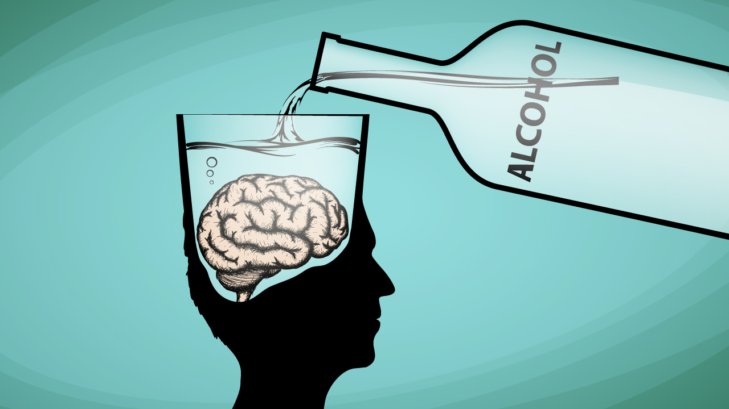
Alcohol & the impact
Some of the risks associated with drinking are short-term and more long term, they include:
Alcohol poisoning
Increased likelihood of accidents/injuries
Liver damage
Impact on brain development in adolescence
Mental Health
Increased likelihood of engaging in other risk taking behaviours
Fetal Alcohol Syndrome Disorder
Notes:
All information included in this slide including the narration has been informed by the following information: https://www.drinkaware.co.uk/advice-and-support/underage-drinking/know-the-risks-of-drinking-alcohol-underage
Due to young people typically having a lower body weight and a limited ability to process alcohol can make them more susceptible to becoming more dangerously intoxicated very quickly. This is also known as ‘acute intoxication’. This puts young people at increased risk of alcohol poisoning.
Alcohol poisoning can be extremely dangerous as it affects the part of the brain that controls balance and speech, as well as the nerves that control breathing and your heartbeat. It can also stop your gag reflect from working and can increase the risk of choking to death, especially if you vomit as a result of drinking too much.
Some long term effects include:
A range of cancers
Liver Disease – Cirrohsis
Heart disease
Increased blood pressure
Fertility
FASD – Brain damage to an unborn child

Slide 10
Alcohol & Cocaine - Cocaethylene
Notes:
When a person uses both alcohol and cocaine, the substances form a very unique highly toxic substance known as coca-ethylene as result of the substances being metabolized in the liver.
Researchers believe that coca-ethylene is produced in the liver about two hours after an individual has used the two drugs.
The addition of coca-ethylene to the alcohol and cocaine already in the system can produce effects that are much more powerful than the effects that alcohol or cocaine alone produce, increasing the risk of heart attacks, fits, strokes and even sudden death.
Mixing alcohol and cocaine can be fatal up to 12 hours after consumption.
Coca-ethylene takes longer to leave the body than either alcohol or cocaine, subjecting the heart and liver to a longer period of stress.
It can increase the depressive effects of alcohol, making reaction to the cocaine stronger.
Using coca-ethylene is likely to increase aggression.

Slide 11
Harm Reduction Advice
As with any harm reduction, the advice remains that if you do not currently drink excessive amounts of alcohol, the best form of harm reduction is not to start.
When drinking, there are things that can reduce the risk of harm, these include:
Drinking in line with recommended daily amounts
Having several alcohol free days to factor in enough recovery time
Alternate between water or a soft drink after an alcoholic drink
Avoid caffeine when drinking or after alcohol
Remember, it takes your body approximately an hour per unit of alcohol to recover and process the alcohol
Do not mix alcohol with other drugs.
Stay safe and with people you know and trust if you have drank too much
If you are worried about yourself or a friend, call 111 or 999 if it is an emergency
Notes:
All information included in this slide including the narration is https://www.drinkaware.co.uk/advice-and-support/underage-drinking/know-the-risks-of-drinking-alcohol-underage
If someone has symptoms of alcohol poisoning, here are some things you can do to help them and some things you should avoid doing.
First, things you should do:
1. Try to keep them awake and sitting up
2. Give them some water (and nothing else), if they can drink it
3. Lie them on their side in the recovery position if they’ve passed out, and check they’re breathing properly
4. Keep them warm
5. Stay with them and monitor their symptoms
What not to do:
Never leave someone alone to sleep it off The amount of alcohol in someone’s blood continues to rise even when they’ve stopped drinking because the digestive system carries on absorbing alcohol into the bloodstream
Never give them a coffee Alcohol dehydrates the body. Coffee will make someone who is already dehydrated even more so – in severe cases this can even cause permanent brain damage
Never make them sick Their gag reflex may not be working properly which means they could choke on their vomit
Never walk them around Alcohol is a depressant which slows down your brain’s functions and affects your sense of balance. Walking them around might cause accidents
Never put them under a cold shower Because moving a person with alcohol poisoning risks causing injury, it’s not a good idea to give them a shower. A cold shower is even worse - alcohol lowers your body temperature, which could lead to hypothermia. The best advice is to put them in the recovery position in the nearest safe place.
Never let them drink more alcohol The amount of alcohol in their bloodstream could become dangerously high

Slide 12
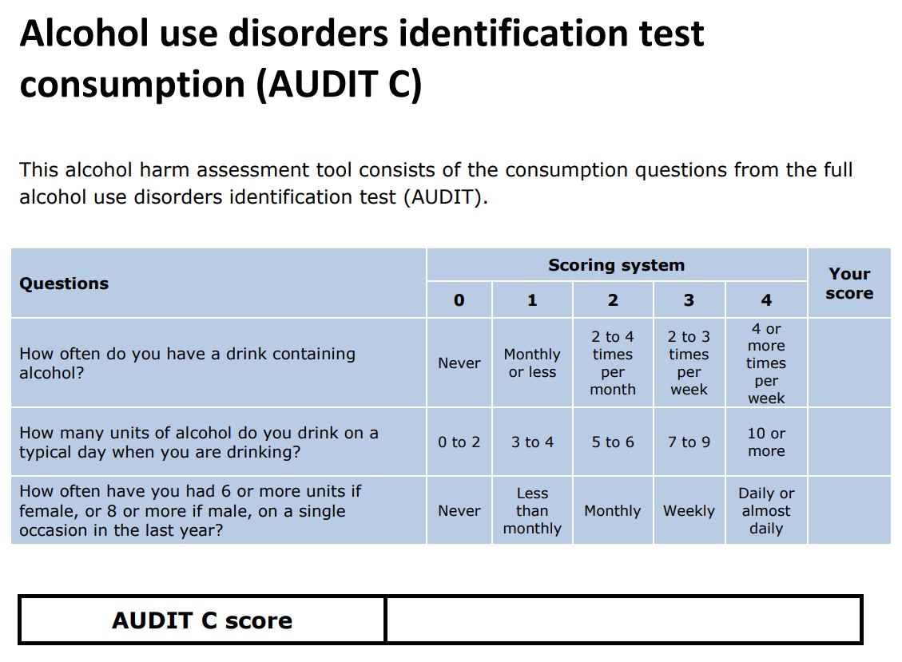
AUDIT-C Tool
Notes:
AUDIT in this instance stands for, Alcohol Use Disorders Identification Test with the C focusing specifically on Consumption – how much someone drinks.
The Audit C tool is used by services to understand if someone could be at risk of harm due to the amounts that they drink - it focuses specifically on consumption
While this tool is used by medical professionals and services relating to alcohol use, it is useful for those working with children, young people & their families to have an awareness of it.
A link to the full AUDIT screening tool can be found following the link in the notes. https://assets.publishing.service.gov.uk/media/6357a7d7e90e0777a45a9caa/Alcohol-use-disorders-identification-test-for-consumption-AUDIT-C_for-print.pdf

Slide 13
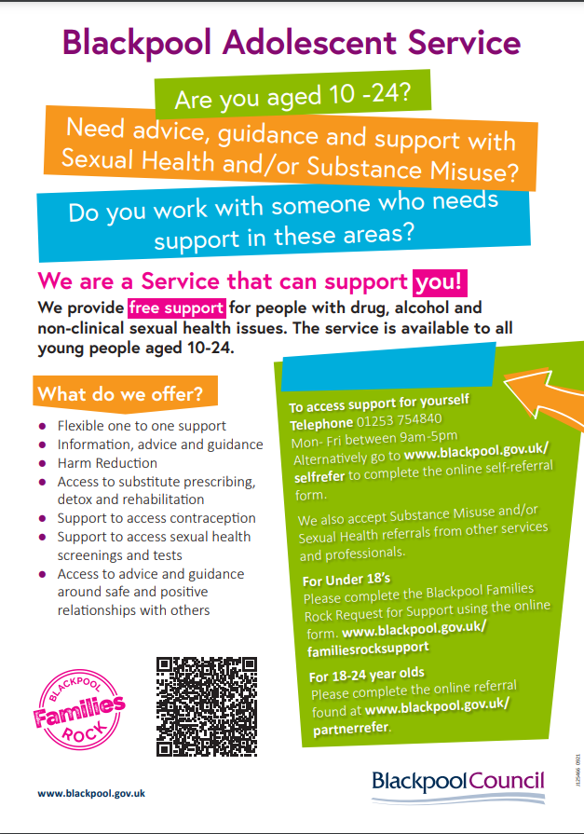
Alcohol support services
There is support available for people of all ages for those under the age of 18, those aged between 18 – 24 & for adults.
Under 25:
Blackpool Families Rock – Request for support
Adolescent Services Partner Referral
Adolescent Services Young Person Self Referral
Over 25:
Advice and service information - Healthier Blackpool
LIGHTHOUSE Horizon
Notes:
There is a new Online referral pathway for under 18s and 18-24 year olds and self-referrals. For more information please review the Adolescent Services image on screen for under 25’s.
Partner under 18's
Link to Blackpool Families Rock Request for Support Hub should be made using the online form -
Partner referrals 18-24 years
www.blackpool.gov.uk/partnerrefer
self-refer via
www.blackpool.gov.uk/selfrefer
Horizon
Referrals get triaged and allocated a key worker – important that you complete comprehensively!
That key worker will make contact over the phone to arrange a convenient time for an assessment.
This assessment can now be done over the phone or F2F if requested
1:1 sessions
Brief intervention sessions ( 5 ways to wellbeing)

Slide 14
Thank you.
E-mail: publichealth@blackpool.gov.uk
Website: www.healthierblackpool.co.uk

