Slide 1
Thresholds, Duties
and Family Rights
Getting Back to the Children Act 1989
Notes:
Title Slide
2 mins
Introductions take place across the trainers, and advice given in terms of keeping cameras on, participating and using the reaction and chat functions.
All slides will be sent at the end of the training along with the mentimeter activities that we will complete during the session.

Slide 2
The case for change
What are thresholds, where do they come from?
What are our duties in law?
What rights do children & families have?
Notes:
Aim of slide:
To introduce the theme of the workshop.
2 mins
Narrative:
We are not looking to change Thresholds, but thing about the application of this within our work, what is the case for change with practice and why.
We are considering what practice looks like currently nationally, and the implications of this upon practice with families, what is happening operationally and what is driving this.
We will consider our duties in law, what legislation and policy tells us about our role and how we should undertake our role with families
We are considering families rights, parents' consent and what this looks like
And how does family Safeguarding support this practice across your service

Slide 3
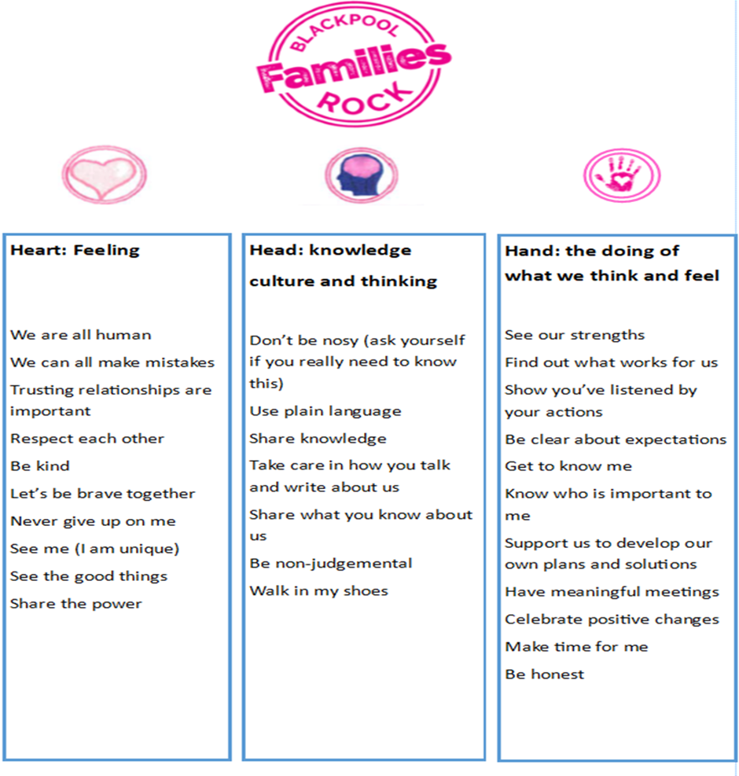
Blackpool Families Rock
‘Blackpool Families Rock’ Model of Practice: Blackpool’s families, children and young people are at the heart of everything we do. Our ‘Blackpool Families Rock’ Model of Practice has been co-produced with children, young people, families and foster carers who have experienced our services. The Co-Production Group developed a set of Practice Principles, using a Social Pedagogy methodology; Head, Heart and Hands. The Practice Principals describe how our families and communities want Blackpool’s partnership agencies to ‘work with them,’ in terms of our core beliefs (head), the values we hold (heart) and the way we practice and behave (hands).

Slide 4
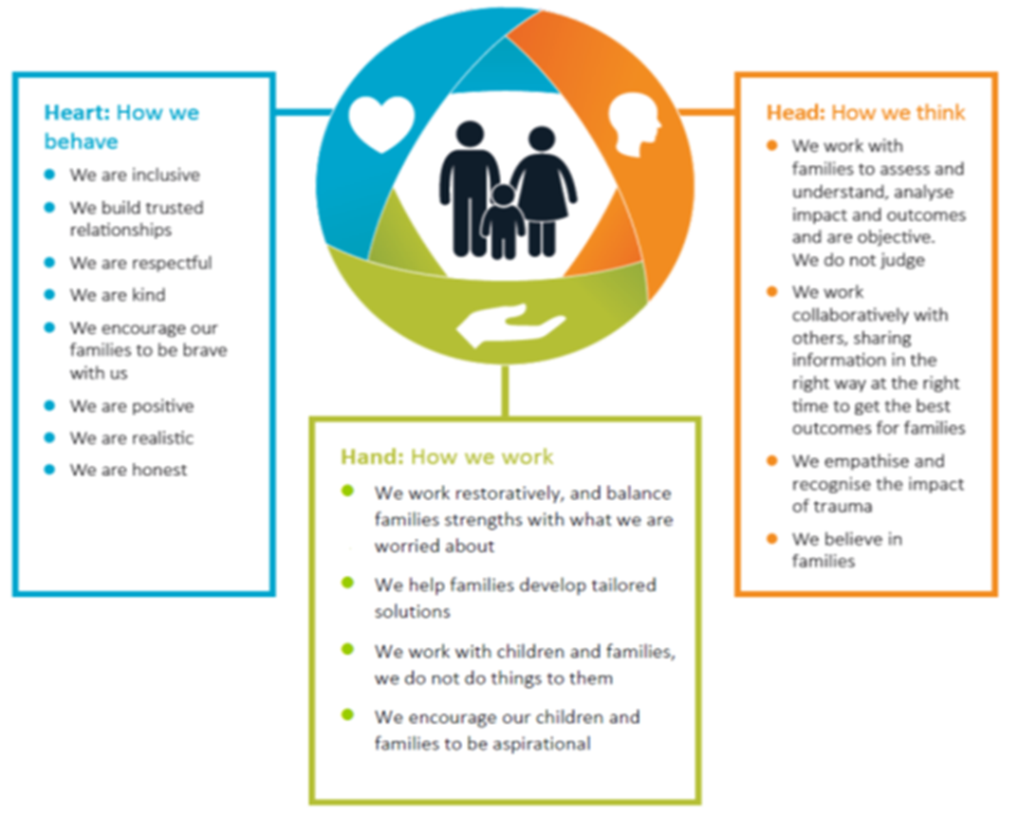
Blackpool Families Rock
Our approach when we work with children and families is:
Relationship Based practice: creating trusting and honest relationships with families, which provide opportunities for them to change. Support families to understand our concerns for their children. Be respectfully clear with families regarding the impact of concerns on their child’s daily life and their outcomes if changes in their life do not happen. Work in partnership with families to develop a Plan for their family, which has their children as a central focus.
Restorative practice: to improve and repair relationships within families and communities. The purpose is to build healthy families and communities, increase social capital, reduce crime and anti-social behaviour, and repair(ing) harm.
Systemic Solution Focused Practice: Working as a ‘Systemic solution focused family’ at 3 levels;
Support families to develop a wider eco support system, which enables them to make the changes they need to thrive and succeed.
Partnership staff across Blackpool work as a solution focused system, a ‘jigsaw of support’ which fits together & nurtures family led sustainable change.
Strategic leaders across Blackpool operate as a Strategic Solution Focused Family, creating an environment which enables their workforce to implement ‘Blackpool Families Rock’ Practice Guidance Principles, which supports families and communities to be resilient and achieve positive sustainable change.
Balancing ‘Harm’ and the impact on the child’s life with ‘Strengths’ within the family and local community network. It is a way of viewing adults and children as resourceful and resilient in the face of their worries. Support family led Plans, which focus on children’s aspirations and outcomes, whilst balancing this approach with a good understanding of the worries we share about the children’s daily lived experience.

Slide 5
National Picture
82,710 children looked after in England as of March 2023 (67,080 in 2012)
Number of children in care has risen by 35,000 over the last 30 years
Number of babies removed from parents at birth has doubled last 10 years
20% of children in care proceedings remain with or return to their parents
We know very little about the impact of care proceedings on children and families
The average time for proceedings is currently 46 weeks in the UK, compared to 30 weeks in 14/15
Notes:
Aim of slide:
To consider what the national picture looks like across social care services across the UK currently and how this impacts upon social care practice and to provide some data to the narrative.
3-5 minutes
Narrative:
There are currently 82’710 children that are looked after across England as of March this year, data shows that this number rises on average of 1000 per year – this is taking into account children that are entering and leaving the system each year
This is up from 67080 in 2012
26% children go to extended family members
24% children remain/are returned home on supervision orders
If the rates of CIC are rising – on average a 1000 per year as discussed so an additional 10000 in the next 10 years, data shows that providers are down 16% in the last year, where will all these children go ?
CAFCASS data shows that the number of children entering care has doubled in the last 20 years and the number of babies removed from parents ‘at risk of harm’ has doubled in the last 10 years
-NUFJ7756-Mason-Cover-191209.indd (nuffieldfoundation.org) Pre-birth assessment and infant removal at birth: experiences and challenges.
Newborn Babies in Care Proceedings - Nuffield Family Justice Observatory (nuffieldfjo.org.uk)
Mothers in recurrent care proceedings: New evidence for England and Wales - Nuffield Family Justice Observatory (nuffieldfjo.org.uk)
How many mothers are in recurrent proceedings?
Of the 96,457 mothers who appeared in care proceedings in England and
20% of children in care proceeding remain with or return to their parents without any order or SO which we know are in effect CIN plans (Harwin et al, 2019)- study contribution of supervision Orders and Special Guardianship Order
Wales between 2011/12 and 2020/21:
In England, 17,205 mothers (18.9% of the total in care proceedings) returned to court following an initial (index) appearance
12,772 (14.1%) mothers returned to court with at least one new child
4,433 (4.9%) mothers returned to court with the same child
In Wales, 920 mothers (16.3% of the total in care proceedings) returned to court following an index appearance.
777 (13.8%) mothers returned to court with at least one new child
143 (2.5%) mothers returned to court with the same child
Key findings
• In England and Wales approximately 1 in 4 women are at risk of returning to court for subsequent care proceedings within 10 years of their first appearance in care proceedings. This finding is consistent with findings reported in 2015 for England and 2017 for Wales.
• Approximately 1 in 5 mothers who return to court with a new child (as opposed to the child who was the subject of previous proceedings) are at risk of returning to court within 10 years. ii Mothers in recurrent care proceedings: New evidence for England and Wales
• The risk of returning to court is highest within the first three years of the initial proceedings. Following a first return to court, risk of further returns, increases.
• The risk of returning to court is higher for mothers who first gave birth when young and if the child in the first set of proceedings is subject to a placement order (plan for adoption). In both England and Wales, a high proportion of mothers in recurrent care proceedings (more than 40%) are estimated to be aged 14–19 at the birth of their first child.
• There are marked regional differences between rates of recurrence in London and the South West on the one hand, and other areas of England on the other. There are particularly high rates in the North East, the Midlands, Yorkshire and the Humber, and the North West.
The average time for care proceedings stands at 46 weeks, this is up by 16 weeks compared to 14/15 and the new PLO guidance is restricting care proceedings to 26 weeks where ever possible
What is the impact of all of this ?
Research tells us a lot about children in the care system and their likely outcomes, there is no research about the impact of this though , what did being taken through all of that achieve for the family 5, 10 years later ?
Average weekly time for proceeding June 2023- is currently 46 weeks (DFE data,2023)
Of the 25000 children subject to proceedings at any one time, only 50% are removed from their parents at the point of interim application – a further 25% of these are never removed from their family or extended network – therefore raising the question as to whether proceedings were necessary in the first place ? (Cafcass,2018)

Slide 6
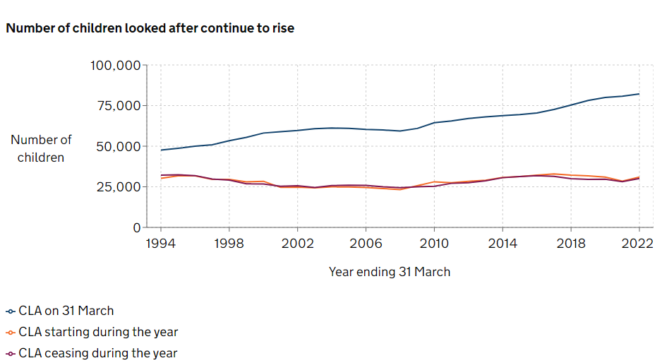
Notes:
Aim of slide: A visual representation of the number of children in care currently
2 minutes
Narrative:
1994 – number of children in care 47,590
2022 – current number of children in care – 82,710
The number remaining in care has risen significantly, however the rates of entry and leaving remain largely the same
Other interesting data that feeds into the narrative possibly –
52 days longer in care-
Are care plans being reviewed to consider if thresholds still apply
Are we still maintaining contact with parents supporting them to make changes so that they can at some point their children can return home
The current numbers of children subject to statutory services:
403,090 CIN as at March 2023
50,780 children were on a CP plan as of March 2023
Children looked after in England including adoptions, Reporting year 2022 – Explore education statistics – GOV.UK (explore-education-statistics.service.gov.uk)
Safeguarding Pressures | ADCS

Slide 7
Blackpool data
Number of children being supported by a child in need plan 1,649
Number of children being supported by a child protection plan 278
Number of children who are looked after by the Local Authority 529

Slide 8
Chat box activity
What do you think are the reasons for the increases in CP Plans and children becoming looked after?
Notes:
Activity slide : this is an activity slide where a code (mentimeter) is added to the chat function if online, or the screen if in person and attendees are invited to add their thoughts in relation the above question.
This usually takes place 15 minutes into the training

Slide 9
What does data and research tell us?
Regional rates of children becoming looked after & subject of CP Plan vary hugely
The category of Neglect remains the most common category for CP plans
Families entering Court are predominantly neglect and emotional abuse
Increasing evidence that professionals have reduced levels of tolerance - Hedley J., Clear Blue Water, Byfield et al
Notes:
Aim of slide:
This usually leads on from the conversation and is a recap slide for what research is telling us about families.
4 mins
Narrative:
As we have seen there are huge variations for the rates of child protection and children in care across the UK
There were 50,780 children on a CPP at 31st March 2023 and Neglect remains the most common category of abuse for child protection plans (CPPs) in England (25,050 children at 31 March 2023) - At 31 March 2023, 3630 children in England were the subject of a child protection plan (CPP) due to physical abuse, 19,000 for emotional abuse and 1890 for sexual abuse (Office of National Statistics ONS).
Blackpool CP plans 64% neglect
There is a wealth of research that suggests that there is an increasing lack of tolerance amongst professionals in terms of acceptable parenting, thinking about the things that we have discussed already and the variances in our discussion it is easy to see why this would be the case.
The ‘Clear Blue Water research’ by Isabelle Trowler in 2018 for example found too many marginal cases involving children at risk of significant harm were entering the family justice system.
The study argued that a focus on early help in recent years has meant too little resource being directed towards “sophisticated” services to support families facing complex and longstanding, sometimes cross-generational issues.
Meanwhile social workers had become “far less tolerant of multiple attempts at generating adequate change”, the report said – sometimes placing them at odds with courts and fuelling the sharp national increase in supervision orders.
There are links to reading at the end of the slide deck also so that you can read up on this further.

Slide 10
Why did you come into your job?
What are our main objectives?
Reflection
Notes:
Activity slides: this is a chat activity where we invite attendees to add their thoughts about connecting with what social work is for – people generally add common things such as to help people, to advocate for people, to support people, give people a couple of minutes to add their thoughts before reading some out.
If you are in person, you will invite people to offer their thoughts to the group.
2-4 minutes

Slide 11
What is our primary duty in law and where is this laid out?
Where are
thresholds laid out?
Notes:
Activity slide: if online you will ask attendees to offer their thoughts as to where social work duties are laid out in law and give people a minute or two to add their thoughts.
You will then ask where thresholds are laid out and again give people the opportunity to respond.
If in person, you will invite them to offer their views.
The aim is to get to the Children Act 1989 and this leads into slide 10.
2 -4 minutes

Slide 12
Provision of services for children in need & their families:
(1) It shall be the general duty of every local authority
(a) to safeguard and promote the welfare of children within their area who are in need; and
(b) so far as is consistent with that duty, to promote the upbringing of such children by their families, by providing a range and level of services appropriate to those children’s needs
Any service provided by an authority may be provided for any member of his family, if it is provided with a view to safeguarding or promoting the child’s welfare
Part Three Children Act 1989
Notes:
Aim of slide:
To revisit the children, act specifically the section relating to the provisions of services
3 minutes
Narrative:
Read slide as it is written, paying particular focus on section b and the specific language written:
Any service provided by an authority may be provided for any member of his family, if it is provided with a view to safeguarding or promoting the child’s welfare
This suggests that any service may be provided – this connects back to the mentimeter activity where resources will have been raised as a reason for the numbers of children coming into care, and any other conversation that took place that is relevant.

Slide 13
A child shall be taken to be in need if:
Legal Definition
Child in Need
(Threshold) s17 (10)
(a) s/he is unlikely to achieve or maintain, or to have the opportunity of achieving or maintaining, a reasonable standard of health or development;
(b) her/his health or development is likely to be significantly impaired, or further impaired, without the provision for her/him of such services; or
(c) s/he is disabled
So if s17b is CiN, what is s47?
Notes:
Aim of slide:
To revisit the children, act specifically the section relating to child in need
3 minutes
Narrative:
Read slide as it is written, paying particular focus on section b and the specific language written:
(b) her/his health or development is likely to be significantly impaired, or further impaired, without the provision for her/him of such services; or
The specific issues here is the choice of word – impairment
Link this back to the conversation earlier in terms of poverty, cost of living crisis etc and that it would be reasonable to suggest therefore that there is going to be a level of impairment potentially where parents and families are struggling as an example

Slide 14
Parents views…
Child in Need A child who is unlikely to achieve or maintain a reasonable level of health or development or is likely to be further impaired without the support of services including a child or children with disabilities.
Child in Need is Support to intervene before there are any further child protection issues.
Child in need is, to me, a child who needs support or protection from abuse or harm.
Child in need to me means a child who might be going through tough times and needs that extra help and support or help to find solutions that can make things better for them. Eg If they are facing difficulties at home or school.

Slide 15
Working Together 2023
1989 Act s14, requires local authorities to give due regard to a child’s wishes when determining what services to provide under Section 17 and before making decisions about action to be taken to protect individual children under Section 47
Where a local authority—
(a) are informed that a child who lives, or is found, in their area—
(i) is the subject of an emergency protection order; or
(ii) is in police protection; or
(b) have reasonable cause to suspect that a child who lives, or is found, in their area is suffering, or is likely to suffer, significant harm,
the authority shall make, or cause to be made, such enquiries as they consider necessary to enable them to decide whether they should take any action to safeguard or promote the child’s welfare
Notes:
Aim of slide:
To revisit the children, act specifically the section relating to children in need of protection
3 minutes
Narrative:
So if the former was a child in need, S17, what is S47?
Read slide as it is written, paying particular focus on section b and the specific language written:
have reasonable cause to suspect that a child who lives, or is found, in their area is suffering, or is likely to suffer, significant harm,
The specific issues here is the choice of word – harm
Not at risk of but suffering or likely to suffer significant harm, immediately
Think also about the ‘due regard to a child’s wishes’ in the context of what has happened – i.e. what did the child say, what did you do, and why did you do this, so in review it is clear about the decision making
Again this can be linked back to earlier conversations as appropriate.

Slide 16
Parents views…
To me, child protection means keeping children safe from any harm or danger and making. providing support to families to prevent child abuse and neglect
Child protection is following that every child matters policy and that every child has the right to be protected from harm and abuse of any sort from anyone
child protection is where there are serious concerns and the time frame in which to improve those before it escalated .
Child protection is part of the safeguarding process, focusing on protecting children seen as suffering or likely to suffer significant harm.

Slide 17
Dictionary definitions
To IMPAIR:
to make worse, to diminish functioning or ability
To HARM:
to deliberately inflict injury, suffering, distress or damage
Notes:
Reference slide:
This will often come out in conversation after the activity, however if not it can be useful to remind attendees of the difference between harm and impairment

Slide 18
Hedley J. 2007: Significant Harm
“The best person to bring up a child is the natural parent. It matters not whether the parent is wise or foolish, rich or poor, educated or illiterate, provided the child's moral and physical health are not in danger. Public authorities cannot improve on nature
Society must be willing to tolerate very diverse standards of parenting, including the eccentric, the barely adequate and the inconsistent
Some children will experience disadvantage and harm, while others flourish in atmospheres of loving security and emotional stability
These are the consequences of our fallible humanity and it is not the provenance of the state to spare children all the consequences of defective parenting. In any event, it simply could not be done.”
Notes:
Aim of slide:
To consider what case law tells us when making judgements about parents
3 minutes
Narrative:
Judge Hedley gave a judgement in Re L in 2007 when giving a judgement about parents he was presiding over - read slide as it is written
The focus here is that a judge was clear that we should be more tolerant of society and that some children will experience disadvantage and harm which would amount to impairment
Justice Macfarlane, the president of the family courts currently also referenced this very judgement in his opening speech in 2018 when he first became the justice and asked rhetorically why more families were coming to the courts attention for neglect, families which had often been receiving services and support over pro-longed period of time and now they were before the courts ?
Again this can be linked back to earlier conversations as appropriate and how we apply thresholds.

Slide 19
Quote from Lady Hale in the Supreme Court judgment Re B (2013) “This case raises some profound questions about the scope of courts' powers to take away children from their birth families when what is feared is, not physical abuse or neglect, but emotional or psychological harm. We are all frail human beings, with our fair share of unattractive character traits, which sometimes manifest themselves in bad behaviours which may be copied by our children. But the State does not and cannot take away the children of all the people who commit crimes, who abuse alcohol or drugs, who suffer from physical or mental illnesses or disabilities, or who espouse anti-social political or religious beliefs... How is the law to distinguish between emotional or psychological harm, which warrants the compulsory intervention of the State, and the normal and natural tendency of children to grow up to be and behave like their parents? Added to this is the problem that the harm which is feared may take many years to materialise, if indeed it ever does. Every child is an individual, with her own character and personality. Many children are remarkably resilient. They do not all inherit their parents' less attractive characters or copy their less attractive behaviours. Indeed some will consciously reject them. They have many other positive influences in their lives which can help them to resist the negative, whether it is their schools, their friends, or other people around them. How confident do we have to be that a child will indeed suffer harm because of her parents' character and behaviour before we separate them for good? …. a court can only separate a child from her parents if satisfied that it is necessary to do so, that ‘nothing else will do’. ” Link to full judgment
Notes:
Aim of slide:
To further add other case law that supports the narrative that is being discussed
3 mins
Narrative:
Read slide out
The focus here is that in this matter Lady Hale references that we make decisions based on harm that is feared but that in which actual fact may take years to materialise if it ever does

Slide 20
Reflection
What are Parent’s rights under s17 and s47?
Notes:
Activity slides: this is a chat activity where we invite attendees to add their thoughts about parents' rights first under S17 and ask them either write their thoughts in the chat function or on to a post it note.
Once completed and some referenced you then ask what parents rights are under S47 – asking them to either add to the chat or add to a post it note
3 minutes
This should be around the 1hr 50 to 2 hr mark

Slide 21
Parental Consent
Wherever possible, you should seek consent and be open and honest with the individual from the outset as to why, what, how and with whom, their information will be shared
You should seek consent where an individual may not expect their information to be passed on
When you gain consent to share information, it must be explicit, and freely given
There may be some circumstances where it is not appropriate to seek consent, because the individual cannot give consent, or it is not reasonable to obtain consent, or because to gain consent would compromise a child’s or young person’s immediate safety
Working Together 2023
Notes:
Aim of slide:
To consider what working together tells us about parents' rights and consent.
10 – 15 minutes here of detailed discussion
Narrative:
Read slide out
The focus here is that parents have PR for their children and therefore have all rights at all times – unless a court order has been taken away.
There is often conversation about consent for CIN versus consent for CP – there is a myth that parents don’t have to consent to CP and therefore we use this to ‘coerce’ them into doing what we want them to.
Be clear here about the powers that SWs have – ask them to tell you ?
S47 gives us two clear abilities – to share information where we believe a child is likely to be harmed or has been harmed or to make an application to the courts.
Link this back to earlier conversations about how parents are engaged, what our practice looks like, all of the things that came from the group discussion earlier in the session.

Slide 22
Parents views…
I have no idea
No one has ever asked me if I’m ok with anything
I feel it can be coercive
I didn’t know I could say no
I have never felt like I have a choice

Slide 23
Working Together 2023 - Renamed to ‘Working Together to Safeguard Children: a guide to multi-agency working to help, safeguard, protect and promote the welfare of children’
Four principles for working with parents:
Effective partnership working with parents and carers happens when practitioners build positive, trusting and co-operative relationships.
Language should be respectful, clear and not punitive.
Practitioners enable parents and carers to participate in decision-making.
Practitioners involve parents, families and local communities in designing processes that affect them.
Introduces national minimum standards for multi-agency child protection practice
Strengthens multi-agency working – increased expectations and greater collaboration

Slide 24
What can we change?
Change our attitudes to families so they can change theirs to us - focus on parent’s strengths & build their confidence
Meet parent’s needs, so they can meet needs of their children (MDT)
Develop our skills to create change (MI)
To safeguard welfare of CiN and keep as many children as possible safely in their families, rather than gathering evidence of poor parenting we need to:
Do ‘with’, not ‘to’
Notes:
Aim of slide:
To consider we can change through the use of Family safeguarding as our delivery model and generally across our practice
5 mins
Narrative:
Read slide out
The focus here is that parents have rights and we want to support children to remain within their birth families where ever safe to do so.
That we can consider how we engage with families and what we are asking them to do
Work with parents to make and sustain change that they identify rather than ‘doing to them’
Use MI to really promote collaborative conversations with parents
Be open and honest with parents about their hopes and dreams
Link this back to earlier conversations about how parents are engaged, what our practice looks like, all of the things that came from the group discussion earlier in the session.

Slide 25
“In the majority of cases, families become involved with children’s social care because they are parenting in conditions of adversity, rather than because they have caused or are likely to cause significant harm to their children. We have a shared obligation to help families raise their children.” The Case for Change The independent review of children’s social care https://childrenssocialcare.independent-review.uk/

Slide 26
Further Reading
The Children Act 1989
The Children Act 1989
Children Looked After in England Statistics
Children looked after in England national statistics
Care Crisis Review 2018, Family Rights Group
The Care Crisis Review: Options for Change - Family Rights Group (frg.org.uk)
Holding the Risk 2018, Sir James Mc Farlane
Lecture by Lord Justice McFarlane: Holding the risk - The balance between child protection and the right to family life (judiciary.uk)
Clear Blue Water 2018 Isabelle Trowler & University of Sheffield
Sheffield_Solutions_Clear_Blue_Water_Full_Report.pdf
NSPCC How Safe Are Our Children annual reports
How safe are our children? 2020 | NSPCC Learning
The Independent Review of Children’s Social Care in England
https://childrenssocialcare.independent-review.uk/

Slide 27
Munro 2010
“Uncertainty pervades the work of child protection. Many of the imbalances in the current system arise from efforts to deal with that uncertainty by assessing and managing risk. Risk management cannot eradicate risk; it can only try to reduce the probability of harm. The big problem for society (and consequently for professionals) is working out a realistic expectation of professionals’ ability to predict the future and manage risk of harm to children and young people.”
McFarlane 2018
Holding the Risk - have we got the balance right between child protection and the right to family life?
“Magistrates and judges up and down the country on every day of the week are making these highly intrusive draconian orders removing children permanently from their natural families on the basis that to do so is better for the child and that “nothing else will do”. But, I ask
rhetorically, “How do we know this is so?”
Notes:
Reference slide

Slide 28
Care Proceedings In England: the case for clear blue water
CSW Isabelle Trowler & University of Sheffield 2018
Based on exploratory study of care proceedings in 4 local authorities across England
The vast majority of decisions taken to initiate care proceedings were certainly reasonable. The question is whether or not they were always necessary
Needs to be ‘clear blue water’ between cases taken to court and not taken to court
When making this distinction, LA must consider if this is in the best interests of the children, not just for now, but in 5 or 10 years’ time and for the rest of their lives
Notes:
Reference slide

Slide 29
Baby P - Impact on Govt Policy
Deliberate national focus on: The Early Protection of the Child
Stronger focus on lower-level parenting concerns as signs of cumulative neglect with a risk of future harm
Greater sense of urgency to act and secure permanence without delay, and the need to act on the side of safety
This collective endeavour across children’s services, heavily influenced by government policy and inspection frameworks, has created a different context in which social workers are making decisions about initiating care proceedings
In line with these expectations, the study found an increasing emphasis on predicting what might happen, rather than what has happened, and a lower (but inconsistent) tolerance of diverse standards of parenting
Replicated across England, it seems almost inevitable, if not intentional, that the rate of applications to Court would rise significantly.
Notes:
Reference slide

