Slide 1
Public Health Briefing: Vaping
This briefing has been created by the Blackpool Council Public Health team and is accurate as of March 2024.
Click the Healthwatch Blackpool image to visit their dedicated section on vaping support for young people.
If you have any questions about anything in the slide, please contact publichealth@blackpool.gov.uk.
Notes:
Hello and welcome to a recording on behalf of the Blackpool Council Public Health team which will cover the latest guidance around vaping and young people which is accurate and up to date as of March 2024.
For more information about the work of the Public Health team in relation to PSHE in schools and for more videos and resources you can visit healthierblackpool.co.uk/pshe. You can also make contact with the team by emailing public.health@blackpool.gov.uk.
I hope you find this presentation useful.
Thank you for watching.

Slide 2
Aims and objectives
Be able to identify the different types of vapes (e-cigarettes) and understand how they work
Understand how nicotine effects the brain
Understand why young people may use vapes
Understand the potential dangers to the health of a young person who regularly uses a vape
Know how to respond to a young person who is in possession of a vape
Know how to identify illicit vapes and the law around vapes
Advice and guidance school staff can use to support young people make informed decisions on vaping
Notes:
The purpose of this presentation is to increase your knowledge and understanding around the causes and consequences of young people using vapes.
The presentation will also explore:
The different type of vapes.
How nicotine affects the brain
Why young people use vapes
Health risks of vaping
Guidance around how to address young people vaping if it happens in your school/college.
Identifying illegal vapes
& finally how to support young people to make informed choices and decisions around vaping.

Slide 3
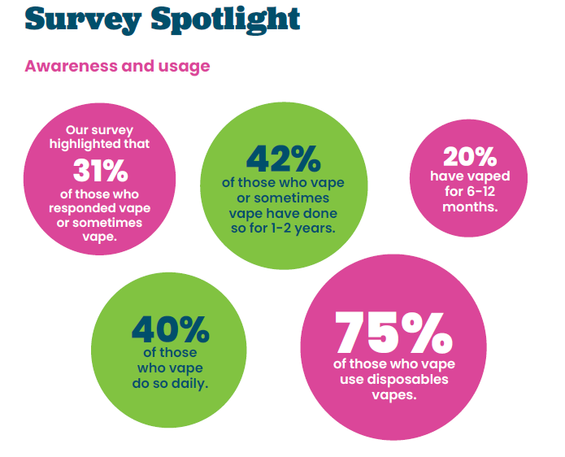
Young people vaping prevalence
Vaping Support - Healthwatch Blackpool
Notes:
While the Public Health messaging has been clear that legal vapes should be viewed as and used as a short term quitting aide to assist with smoking cessation, unfortunately, despite never having smoked before, many young people have started to vape.
In 2023, we commissioned the team at Healthwatch Blackpool to produce our own Children and Young People’s Vaping Report.
Of the 3532 children and young people who participated in the survey, we found that 31%, which accounts for 1094 young people surveyed across Blackpool, vape or sometimes vape. Of those who vape or sometimes vape, 42% have vaped for 1-2 years and 20% of those have vaped for 6-12 months.
Another survey was carried out in Blackpool titled -Supporting the Health and Well-being of Young people in Blackpool (SHEU) in 2019 and what the report identified is -
47% of pupils, aged 12-15 years old, reported that they had used a vape. 17% said that they use an e-cigarette regularly (at least once a week). 32% of pupils said they tried vaping first (or have only tried vaping), before smoking cigarettes.
50% of students, aged 16-17 years old, reported that they had used an electronic cigarette/vape. 12% said that they use an e-cigarette regularly (at least once a week). 35% of pupils said they tried vaping first (or have only tried vaping), before smoking cigarettes.

Slide 4
Young people vaping prevalence
Single use disposable vapes are now the most popular product.
Sources of supply:
the most common source of supply for underage vapers is corner shops (47%)
Promotion of vapes
over half (56%) of 11-17 year olds reported being aware of e-cigarette promotion, most frequently in shops, or online (Tik Tok, then Instagram were the most frequently mentioned sources)
Use-of-e-cigarettes-among-young-people-in-Great-Britain-2022.pdf (ash.org.uk)
Notes:
In Blackpool we know, 75% of those who vape use disposables vapes.
Sources of supply
Despite it being illegal to sell vapes to under 18s, the most common source of supply for underage vapers is shops (47%)
In Blackpool, feedback was given by CYP stating they feel that vapes and e-cigarettes are easy to purchase and are rarely asked for ID and most commonly bought from the corner shop. In a recent round of test purchasing carried out by trading standards, there was a 100% fail rate across the 10 premises where a test purchase was conducted.
We know the interests of YP using vapes is due to the wide promotions that is directly marketed to children.
Promotion of vapes
Over half (56%) of 11-17 year olds reported being aware of e-cigarette promotion, most frequently in shops, or online (Tik Tok, then Instagram were the most frequently mentioned sources)
Feedback given on the CYP Vaping Report states that vapes are cheap and marketed at children, with flavours such as PRIME and branded vapes.
• Children and young people are seeing adverts and videos on TikTok.
The cause for concern from these statistics is vaping is becoming the norm among youth, its easily accessible and promoted directly to young people.

Slide 5
What is a vape and how do they work?
Notes:
So, what is a vape and how do they work?
Vapes work by using a battery to heat up liquid, which contains, propylene glycol, vegetable glycerine, flavourings and nicotine and turning it into vapour (so a bit like steam) and inhaled.
Puffing on the e-cigarette activates the battery powered device, which vapourises the liquid, and when this vapour is inhaled it is absorbed by the mouth and lungs and enters the blood stream.
Most devices will contain nicotine, however, there are nicotine free vapes available. Increasingly worrying is the emergence of vapes that contain THC and Spice.

Slide 6
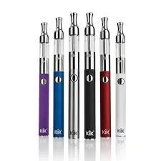
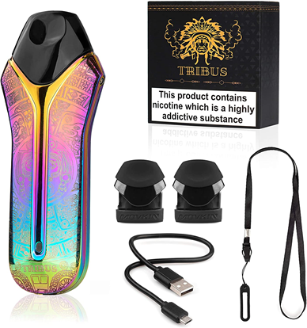
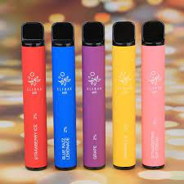
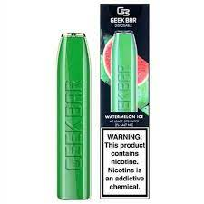
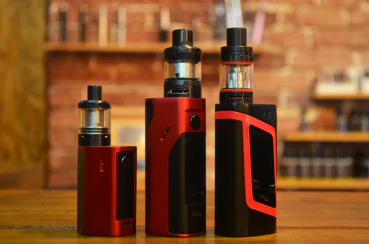
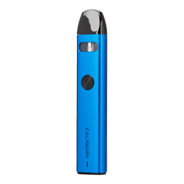
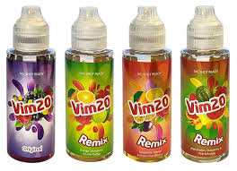
What do vapes look like?
Notes:
E-cigarettes come in a variety of types, shapes and sizes.
Vape bars – these are shaped like a highlighter pen and are usually disposable, but sometimes rechargeable and refillable with e-liquid capsules
Compact pod devices – these are shaped like a flash drive or pebble and can be disposable for rechargeable and refillable with e-liquid capsules
Vape pens – these devices contain a ‘tank’ that you can fill with an e-liquid of your choice with a replaceable coil and rechargeable battery
Cigalikes – these are designed to look like cigarettes and can be disposable or rechargeable.
E-liquids come in different nicotine strengths ranging from 0 mg/ml to 20 mg/ml and come in different flavours.
There are also more sophisticated customisable devices with variable power, but these are used more by people who have been vaping for a long time.

Slide 7
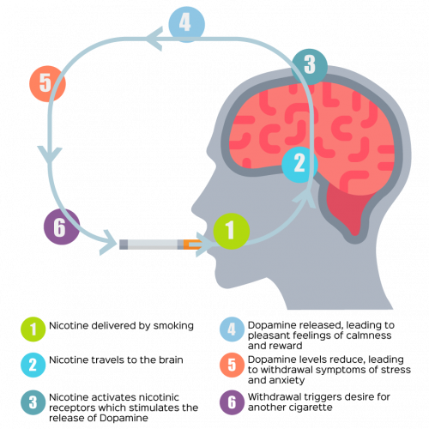
How nicotine affects the brain?
Notes:
Nicotine affects the brain in several ways:
It interferes with the blood-brain barrier function, raising the risk of brain edema and neuroinflammation.
It activates structures in the brain called receptors, which release dopamine, making you feel good.
It is harmful to developing brains and can disrupt the formation of brain circuits that control attention, learning, and susceptibility to addiction.
It increases the release of neurotransmitters in the brain, which help regulate mood and behavior.
It affects the area of the brain responsible for attention, memory, learning, and brain plasticity, which essentially means the brain has the ability to rewire itself and nicotine can disrupt the ability for the brain to do this and stop it from creating new connections.
These new connections include being able to recover from traumatic injuries, learning new skills, restoration of lost functions in your body and management of depression and anxiety.
Nicotine is a highly addictive stimulant. It is most popularly known for its use in tobacco products and vapes.
When nicotine binds to receptors in your brain, it communicates to neurotransmitters to be released that enable biological responses. These include dopamine and serotonin – that regulate pleasure, mood, emotion, and pain relief. The dopamine release, for instance, is what causes one to feel pleasure after smoking a cigarette or using a vape.
One thing to remember is nicotine by itself isn’t harmful. Smoking releases nicotine by burning tobacco. Burning tobacco creates many harmful toxins that can cause serious illnesses including cancer, lung disease, heart disease and stroke. Tobacco smoke contains more than 4,000 chemicals including carbon monoxide and tar, and a sticky soup of around 250 toxic chemicals (more than a quarter of which are known to be carcinogens). Vapes is less harmful than smoking due to it not having all the harmful toxins that burning tobacco produces.
Using nicotine can be complicated. In the short-term, smoking may feel good by creating feelings of pleasure and relaxation and it can also create social opportunities to connect with other people and provides a distraction from stressful situations. These are powerful drivers for continuing to vape or smoke.
However, because of the way nicotine works in the body, those feel-good chemicals don’t last long. Within just a few minutes, the effect of nicotine in the body wears off and can lead to a desire to smoke or vape again. This is nicotine withdrawal, and it includes:
cravings or urges to smoke or vape
feeling irritated or upset
feeling jumpy and restless
a hard time concentrating
changes in sleep and eating habits
And feeling anxious or depressed.
Over time, it takes frequent use of nicotine to create that same good feeling and deal with these symptoms of withdrawal. This is called nicotine dependence. Eventually, what started out as a pleasurable experience, vaping or smoking can lead to a nicotine addiction cycle that only addresses controlling withdrawal symptoms.
This cycle can make it feel like vaping or smoking relieves anxiety and depression, but the reality is that it only addresses withdrawal symptoms and makes the cycle continue.
Because of this complex cycle, many smokers falsely believe tobacco and vaping products can relieve stress or anxiety. The idea that these products curb the symptoms of nicotine withdrawal is often misinterpreted as a beneficial effect on mental health.
Due to nicotine's addictive nature, vaping and/or smoking can easily become a habit. An individual may develop a routine surrounding the act of it that looks like regular breaks or only smoking or vaping after meals, certain locations or under certain levels of stress. If someone is to overcome the addiction to nicotine, they will likely have to change the behaviors they associate with smoking or vaping as well as start a reduction regime of nicotine.
This makes it hard to stop using these products even when you know it’s bad for you.
That’s why we use stop smoking medications such as nicotine patches, gum, lozenges etc. Nicotine help smokers quit by replacing some of the nicotine they used to get from cigarettes and also by mimicking the hand-to-mouth action of smoking.
Nicotine replacement therapy such as gum and patches are licensed by the Medicines and Healthcare products Regulatory Agency for smoking cessation, not just by adults but also for children from age 12 upwards.
Nicotine vapes are not yet licensed as medicines but are proven effective and have become the most popular quitting aid for smokers in recent years.
Vapes containing nicotine are a useful aid to quitting as they deal with the cravings smokers get when they try to stop.
Research is still needed to learn more about how e-cigarettes effect health in the long term but there is enough evidence to advise that vaping is not for children. If you don’t smoke, don’t vape.
A PHE report from 2022 found that
Nearly half (43.0%) of the 11 to 18 year olds who were current and former vapers, reported always using vaping products that contained nicotine
And only 17.3% reported always using nicotine-free products.
Addiction is a form of learning, and young people can get addicted more easily than adults.
YP can do it to address other needs such as relief from boredom and to cope with anxiety and stress.
This is something that we are being told locally is happening with our Healthwatch CYP vape report!
Vaping alone tends to have smaller concentrations of nicotine than a cigarette and its important to monitor the dependency of nicotine being used in a vape.
Dependence on vaping appears lower than smoking for young people.

Slide 8
What are the risks of vaping in young people?
Vaping is less harmful than smoking in the short term but that does not mean it is harmless. We do not yet know what the risks might be in the longer term.
Nicotine is more risky for young people than for adults, as evidence suggests the developing brain is more sensitive to its addictive effects.
Notes:
We know that nicotine vaping is substantially less harmful than smoking – however, it is not risk-free. The reason being is, that they carry a small fraction of the risk of cigarettes. Because vapes don’t produce tar or carbon monoxide, which are two of the most harmful elements in tobacco smoke and they also don’t contain all those thousands of other chemicals that are found in tobacco that causes most of the harm. Here are some facts to tell to young people:
Vaping is a way for adults to stop smoking – not something for non-smokers, especially children and young people to try.
Vaping is substantially less harmful than smoking but that does not mean it is harmless.
Vaping exposes users to some toxins, and we do not yet know what the risks might be in the longer term.
Most vapes contain nicotine, which is an addictive substance that can be hard to stop using once you have started.
Nicotine is more risky for young people than for adults, as evidence suggests the developing brain is more sensitive to its addictive effects.
In the UK, it is against the law to sell nicotine vaping products to under-18s or for adults to buy them on their behalf.
Some disposable vapes on sale are illegal and do not meet UK safety regulations. They can contain high levels of harmful substances.
Nicotine exposure during adolescence can harm the parts of the brain that control attention, learning, mood, and impulse control. Youth might vape to deal with stress or anxiety, creating a cycle of nicotine dependence. But nicotine addiction can also be a source of stress. Some youth who use e-cigarettes or cigarettes also report symptoms of depression and anxiety. Nicotine withdrawal symptoms include irritability, restlessness, feeling anxious or depressed, trouble sleeping, problems concentrating, and craving nicotine.

Slide 9
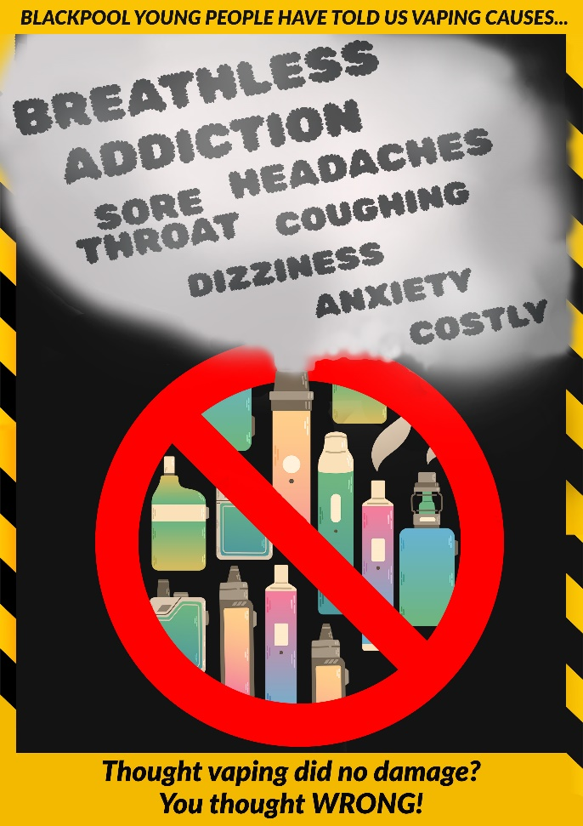
The appeal to vapes in young people
Curiosity
Peer pressure
It is less harmful than smoking in the short term, but not harm free
Cost
No smell
More discreet
There is limited evidence to say vaping is a gateway into smoking
Notes:
Young People say they vape for many reasons.
Curiosity is the big one, they see friends or family members vaping, and they are also drawn to the appealing flavours and colours in which they come in.
This is exactly how they are marketed………Appealing to YP with the various fruity flavours and different colour options
Peer pressure is another reason, as they want to fit in with their mates and they think it’s cool, and having that sense of belonging with a group is very important to YP
Vapes have a lower per-use cost than traditional tobacco cigarettes. You can buy a disposable one for £4 - £5 or they do deals on them.
It costs over £10 now for a packet of tobacco cigarettes!
Youths and adults find the lack of smoke appealing. With no smell, vapes reduce some of the stigma of smoking and it’s also more discreet.
Finally, youth have a perceived notion that vaping can support mental health, reduce stress levels and address low self-esteem as mentioned before. Vapes are used as a perceived coping mechanism to address these.
What is really concerning though is the rise of vaping amongst YP who would have never smoked otherwise, are taking up the habit.
Use of e-cigarettes remains largely confined to experimentation (trying once or twice).
Most (70%) current vapers have also tried smoking. For both experimental and current vapers who have tried smoking, it is more likely they tried smoking before vaping than the other way around.
Since 2021 the proportion of children currently vaping has been greater than those currently smoking (7.6% compared to 3.6% in 2023).
The largest concern remains the same nationally that CYP are using vapes even if they have never smoked.
It’s one thing if you convert from cigarette smoking to vaping.
It’s quite another thing to start up nicotine use with vaping.
At this moment in time there is NO strong evidence yet to say that vaping is a gateway into smoking.

Slide 10
The advice
Vaping is not for children. Whilst it can help adults to quit smoking, it isn’t risk-free. Those who don’t smoke should not vape and vaping should only occur as a short term quit aid.
Notes:
An important message to vape use is-

Slide 11
Key actions for schools to take
Confiscation of vapes and any associated paraphernalia
Safe storage & disposing of confiscated vapes
Inform parent of incident
Intervention worksheet to be completed
Intel information uploaded to Blackpool Council link -
Blackpool Council | Reporting illegal alcohol and tobacco sales
Notes:
We recognise schools and colleges can and do play an important role in the prevention and harm reduction efforts on many public health issues. Specific guidance around how schools should respond to cases of smoking and vaping amongst pupils are available on the PSHE website for both Primary and Secondary schools.

Slide 12
Brief intervention worksheet
Notes:
Best practice would be to have further conversations with the YP about vaping, so Public Health have developed this worksheet that a staff member can complete with that Young Person.
This worksheet will enable you to gather information, educate around the impacts on health and reduce the harm to that young person
On one side it gives information about Electronic cigarettes, nicotine and vaping and then on the back there is some information that you can gather to help with conversations.
Key questions to ask students:
What do they think about smoking…?
…and what do they think about vaping…?
…what is the difference?
Do they know people who smoke or vape?
Why do they think people smoke or vape?
Discuss the different reasons why children may smoke or vape – give examples such as wanting to fit in, curiosity, stress. Talk through effective ways to respond if they ever feel pressured to try either and practise responding together.
It may be useful for us as professionals to understand what is attractive about vaping and why YP are vaping (flavours, designs, devices etc).
Asking questions like:
“What do you enjoy about vaping?” or
“How does vaping make you feel?”
The answers to these questions highlight the Young Persons needs, and then those needs can be addressed in a healthier way.
Give the health facts to students around vaping. Reinforce the law to students that it is illegal to sell or give a vaping product to someone under 18, and that it is prohibited to vape on school property or grounds 24/7. Ensure the students are aware of your school’s policy, rules and procedures regarding tobacco, alcohol and other drugs.
Schools can support students by making the law clear, the facts known, and the decision theirs. Young people must be empowered to make informed decisions, by understanding that vaping is not harmless and is not for under 18s.
Educate students on vaping just as you would with other programmes that focus on reducing harm from the use tobacco, alcohol or drugs. Discuss how what we don’t know, is as important as what we do.
Conversations that empower students to come to their own conclusions help students feel respected and in control. Research together, ask these questions and listen to their answers.

Slide 13
Supporting pupils with action planning
Never start smoking In the first place!
Set a quit date.
Tell your friends you are going to quit.
Anticipate challenges to the upcoming quit attempt
Remove vape products from your environment.
Notes:
If you have concerns on pupils managing quitting vapes you can advise of some action planning the student can set goals to anticipate challenges they may face and create new behaviour changes.
Set a quit date. Keep a diary for a few days to help you prepare to quit. Becoming aware of your habit gives you more control and makes it easier to change. Do you use nicotine and/or vape products more when with other people or when you’re alone? Record how many puffs of a vape each day and when you vape.
Tell your friends you are going to quit. It is important to share your goal with people who are close to you. Surround yourself with people who do not vape and can support you.
Anticipate challenges to the upcoming quit attempt. List all the situations that might be challenging for you. Decide in advance what you will do when you feel tempted to vape. What are your reasons for quitting? Make a list to remind yourself.
Remove vaping products from your environment. Throw away any vaping paraphernalia or anything else that might tempt you to use them. Get rid of all reminders of nicotine and vape use. Avoid places and people you associate with nicotine and vape use.
The best advice is to contact our local stop smoking service to get advice and support.

Slide 14
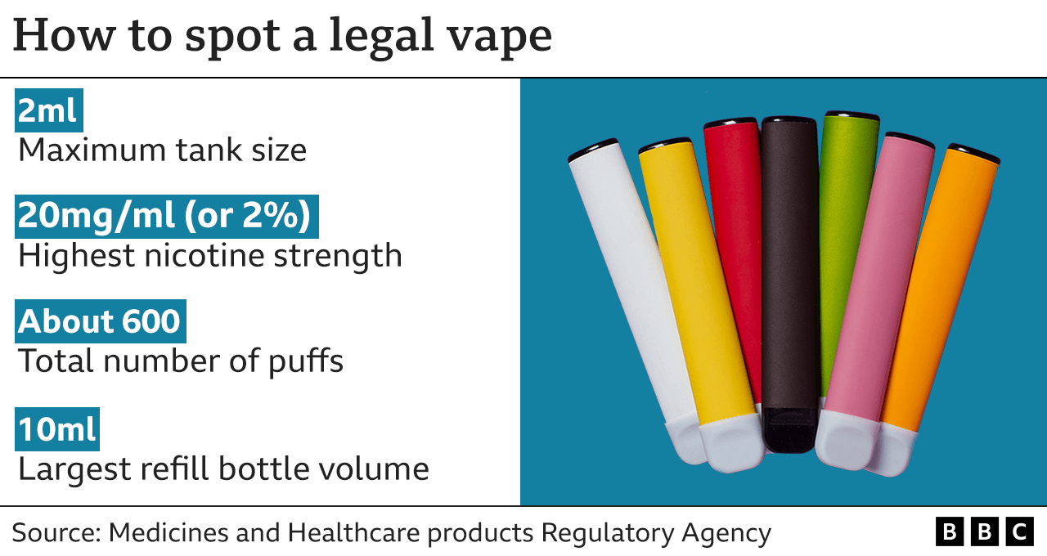
Identifying illicit vapes and regulation
Notes:
Nicotine containing e-cigarettes are age restricted products regulated by the Medicines and Healthcare products Regulatory Agency (MHRA).
Sales to under 18s are illegal. To be legally sold in the UK, nicotine containing e-cigarettes must also:
Contain 20 mg/ml or less of nicotine (equivalent to 2% or less)
Carry the health warning ‘This product contains nicotine which is a highly addictive substance.’
Be notified to the MHRA and listed on its website.
You must be 18 to buy a vape or any vaping products
It is illegal to sell vapes, or vape liquids, to anyone under the age of 18 and it is also illegal for someone over the age of 18 to buy any vaping products for anyone who is under the age of 18.
• Nationally – 1/3 sell to under 18s, ¼ non-compliant products
• Promoted to young people
Non compliant vapes include –
• Contain more than 20mg/ml (2%) of nicotine or have a tank size larger than 2ml
• Do not carry a health warning
• Prohibited ingredients – vitamins, stimulants ie caffeine, colourings
You may have also heard of ‘popcorn lung’, a serious but rare respiratory disease so-called because it was found in popcorn factory workers, who had been exposed to high levels of exposure to diacetyl, which was used to give popcorn a buttery flavour.
Some vapes were found to contain diacetyl but in very small quantities, not the large quantities associated with ‘popcorn lung’. However, as a safety precaution it has been banned from vapes in the UK as are other ingredients that pose a risk to human health
There is no law around where you can and can’t vape, but many places adopt the same rules as smoking, therefore you must go by venue policy.
Blackpool councils policy is to adopt the same rules as smoking

Slide 15
Cannabis and other illegal substances
Blood shot eyes
Dazed/dreamy demeanour
Short term memory loss
Faint/feeling sick
The giggles
The munchies
Dry mouth
Paranoia
Anxiety
Notes:
There has been an increase in young people using vapes and in particular experimenting with THC vaping.
Preliminary findings from the healthwatch survey found out that 30% of the young people who vape, have vaped (THC) oil.
THC is the chemical that gives the ‘high’ effect in cannabis. Cannabis is an illegal Class B drug.
Vaping THC will have similar effects to using cannabis.
However vaping THC as opposed to smoking cannabis allows a larger amount of THC to be inhaled very quickly, potentially causing overdosing/ adverse effects that require medical attention
The effects of vaping THC depends on the amount of THC/CBD in the vape, the YP’s mood, the environment and how often it is used.
A prohibited chemical found in THC vapes is vitamin E acetate which causes serious respiratory disease when vaped (known as ‘EVALI’). It’s used — safely — in nutritional supplements and skin creams. But it isn’t safe to inhale. Sticky and honey-like, it can hang around in the lungs interfering with how they function which causes the EVALI. Due to vitamin E acetate being an oily chemical, it is added to some THC vaping liquids to thicken or dilute them.
These are some possible short term effects that can be signs a YP has vaped THC oil.
Blood shot eyes - Dazed/dreamy demeanour - Short term memory loss - Faint/feeling sick - The giggles - The munchies - Dry mouth – Paranoia – Anxiety
Young people who use cannabis are at increased risk of child criminal exploitation (CCE), and to be groomed into County Lines operations

Slide 16
See it? Share it. Stop it.
Blackpool Council | Reporting illegal alcohol and tobacco sales
Trading Standards
tradingstandards@blackpool.gov.uk
Telephone: 01253 478375
Notes:
We are working very closely with public protection/licensing/enforcement colleagues in Blackpool to gather intel about the shops/petrol stations/mobile phone shops/ car boots/ market stalls etc who are selling to our under 18’s.
Test purchasing activity that has been carried out in Blackpool over the last couple of months, has seen a bigger failure rate than what we expected, so on the back of that we are asking people to gather any information they might get relating to the under age sales of E-Cigs.
The maximum penalty for selling a nicotine inhaling product to a person under 18 years is a fine of £2500. If convicted and further offences occur in a two-year period, Trading Standards can make an application to a Magistrates' Court for a restricted premises order and/or a restricted sales order.
Children under 18 should be asked where they got their vape (or cigarette) from and use the link to report any illicit vapes/cigarettes on the Blackpool website.
Any intel you get, it’s always best to report.
This is the link to the online Intel form for Blackpool Councils Trading standards team
There is also a phone number that you can call if you prefer
This intel will be gathered and then test purchasing with be influenced by this information

Slide 17
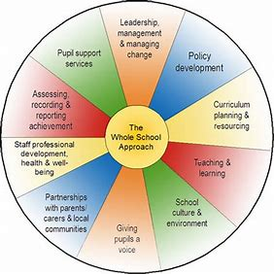
Incorporating vaping into a whole school approach
Vaping prevention can be incorporated into your whole school's approach to health and wellbeing, which includes personal, social, health and economic (PSHE) education and the wider curriculum, school policies, ethos and environment, and partnerships with parents and the local community.
Notes:
“A whole school approach is needed to address both smoking and vaping, making it part of the curriculum, highlighting the risks, and arming children with the facts so that they can make informed choices. It’s important to remember that the harms to health are significantly greater from smoking.”
Clear communication with your whole school community will support your whole school approach to smoking and vaping.
Communications should:
Clearly set out the school’s position on vaping and vaping devices within the school premises
Develop a whole-school smoke free policy in consultation with young people and staff is important.
Develop a policy that forms part of the wider healthy school strategy on wellbeing, sex and relationships education, drug education and behaviour.
Apply the policy to everyone using the premises (grounds as well as buildings), for any purpose, at any time.
Explain the rationale behind the school’s position; this is an opportunity to help parents, carers and families to:
• Understand that children and young people should not be vaping and that there are risks associated with underage vaping
• Know the minimum age for sale and supply of vaping devices. Particularly that selling or supplying vaping devices to under 18s is illegal, including parents/carers or older siblings buying vaping devices for a person under 18 as well as peer-to-peer sales
• Understand that smoking remains a significant health risk to those who smoke and those who are exposed to smoking and the support available to all to quit.
Children and young people should, by law, not have access to vaping devices and so vaping amongst this age group indicates illegal supply within the local community. When communicating with your school community, empower them to take an active stance against the illegal tobacco and vaping industry and illegal activity within their community by reporting sources of illegal sales.

Slide 18
Resources and training for staff
Vaping year 9 lesson pack (pshe-association.org.uk)
Talk to Frank on vapes. Talk to Frank provides clear, non-judgemental information on alcohol and drugs for young people. It has a 24 helpline on 0300 123 600.
Vapes | FRANK (talktofrank.com)
OHID School Zone resources. These are three flexible bitesize sessions with film content aimed at Y7 & 8. The sessions cover the impact of vaping and the effects of nicotine on young people
Mental wellbeing | Overview | PHE School Zone
Notes:
Our plan moving forward for the PSHE offer for schools will be that we are developing pre-recorded videos of awareness briefings, so that staff can upskill themselves at a time that suits them. The videos should help the staff gain more knowledge and understanding so that they can deliver assemblies and PSHE lessons with more confidence.
Along the side of this, there will be an offer of face to face sessions which will be more skills based.
There is lesson plans and resources available on the PSHE website for schools to use.
The most up-to-date vaping lessons are the PSHE Association for year 9 and Public Health England Key stage 3 lessons.
I also have added the Public Health Blackpool Council PSHE website for all update information on lesson plans and resources for schools.

Slide 19
Resources to support pupils, staff, families and carers to quit smoking
The resources below may be helpful for staff to support those around the child to stop smoking.
The NHS Better Health site provides information on vaping devices and e-liquids, side effects, and vaping in pregnancy.
Vaping myths and the facts - Better Health - NHS (www.nhs.uk)
The NHS Live Well site has information on vape safety and choosing the right vape for you.
Using e-cigarettes to stop smoking - NHS (www.nhs.uk)
Self- referral to our Blackpool Tobacco Addiction Service
Stop Smoking Services | Blackpool Teaching Hospitals NHS Foundation Trust (bfwh.nhs.uk)
Notes:
Links on PP for PDF

Slide 20
Referral Pathway
Blackpool Tobacco Addiction Service (BTAS)
FREE Helpline: 0808 1964324
(For professionals only - Direct number: 01253 956651
Notes:
When a conversation arises with a young person who is vaping or smoking, there are a number of services you can make them and their parent/carer aware of.
Encourage a referral into the specialist tobacco addiction service.
They will support any young person over the age 12 if they are smoking AND vaping.
Nicotine Replacement Therapy (NRT) is available for over 12s.
If the young person is just vaping, you can advise the pupil or parent/carer to contact the Blackpool Tobacco Addiction Service for guidance and support around stopping vaping.
The service has a direct number which you can use for the purpose of advice for school nurses/staff – Direct number: 01253 956651
Do not give this number to any YP or parent the number you promote with them is the freephone helpline number
There is also a self-referral form.

Slide 21
Blackpool Adolescent Service:
Under 18’s Request for Support (blackpool.gov.uk)
18 - 24 years www.blackpool.gov.uk/partnerrefer
www.blackpool.gov.uk/selfrefer
Horizon – Adult services – from dependence to freedom
To enter drug or alcohol treatment, people can self refer straight into Delphi or a support worker can refer in with consent from the cannabis user.
Tel: 01253 205157
horizonreferrals@delphimedical.co.uk
Notes:
Blackpool Adolescent Service provides free support for young people with drug, alcohol and sexual health issues.
The service is available to all young people aged 10 to 24. Interventions range from drug awareness, harm reduction as well as access to clinical prescribing services for substance abuse and clinical sexual health support.

Slide 22
Next Steps
Mental health and vaping lesson plan for key stage 3 being produced
Communications around vape awareness co-produced with young people, parents/carers and Healthwatch Blackpool
Tobacco pre-recorded information session
Notes:
The key takeaways are make sure to have empowered conversations with youth on vape use, use a whole school approach to to address both smoking and vaping, making it part of the curriculum, highlighting the risks, and arming children with the facts so that they can make informed choices, use the resources available to enhance your PSHE lessons, use safeguarding protocols to address vape use and access the brief intervention sheet and guidance for a step-by-step support when discussing vape use and confiscation and use the referral pathways to signpost the young person to the needed support.
Currently, we are in the process of creating a co-produced lesson plan on vaping and mental health for key stage 3 students that is off of the back of the Healthwatch CYP Vaping Report feedback, communications are being made around vape use co-produced with young people an Healthwatch Blackpool as well as a pre-recorded information session on tobacco.
Please keep an eye out on communications regarding these projects.

Slide 23
Further reading and helpful information
Stop Smoking Services | Blackpool Teaching Hospitals NHS Foundation Trust (bfwh.nhs.uk)
ASH-brief-for-local-authorities-on-youth-vaping.pdf
www.nhs.uk/better-health/quit-smoking/vaping-to-quit-smoking/
https://ash.org.uk/uploads/Use-of-e-cigarettes-among-young-people-in-Great-Britain-2022.pdf
Vapes | FRANK (talktofrank.com)
https://ash.org.uk/uploads/ASH-guidance-for-school-vaping-policies.pdf
https://www.gov.uk/government/publications/nicotine-vaping-in-england-2022-evidence-update
Children and young people’s vaping report - Blackpool - Healthwatch Blackpool
Vaping Support - Healthwatch Blackpool
Notes:
I hope this presentation has answered your questions and given you advice on how to support our young people make informed decisions around vape use.
Remember if you don’t smoke, don’t start to vape. Lets continue educating our young people and ourselves on the evidence surrounding vape use and support a smokefree generation!
If you need any further information or reading please use the links provided on this slide.
Thank you!
Zip file of all resources

