Slide 1
Public Health Briefing: Cannabis
This briefing has been created by the Blackpool Council Public Health team and is accurate as of May 2024.
Click the Blackpool Council image on the right of this slide to visit the Healthier Blackpool webpage. Click on the PSHE image to be directed to the PSHE section of the Healthier Blackpool website.
If you have any questions about anything in the slide, please contact publichealth@blackpool.gov.uk.

Slide 2
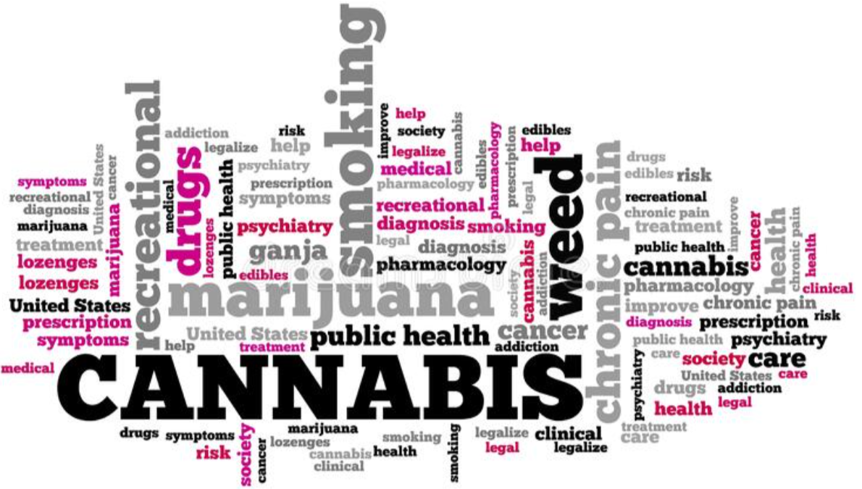
This briefing will cover:
Legalities.
What does cannabis look like and how it is taken/used.
Problems when cannabis is consumed within adolescence.
Signs to look out for
The impact of taking cannabis
Myth busting
Harm reduction.
Notes:
This briefing which aims to give information and advice to those supporting young people will focus on cannabis.
As well as reviewing the origins and background of cannabis, the briefing will also cover,
the legalities
what the drug looks like and how it is taken
the effects it has on the brain
the issues when the drug is consumed within Adolescence
signs to look out for
Harm reduction messaging. For those who may not know, harm reduction is looking at ways to help someone reduce or stop taking substances or give them the help and advice on how to be safe if they are to continue to use.
Finally, the briefing will explain how referrals can be made to the ADASH team.

Slide 3
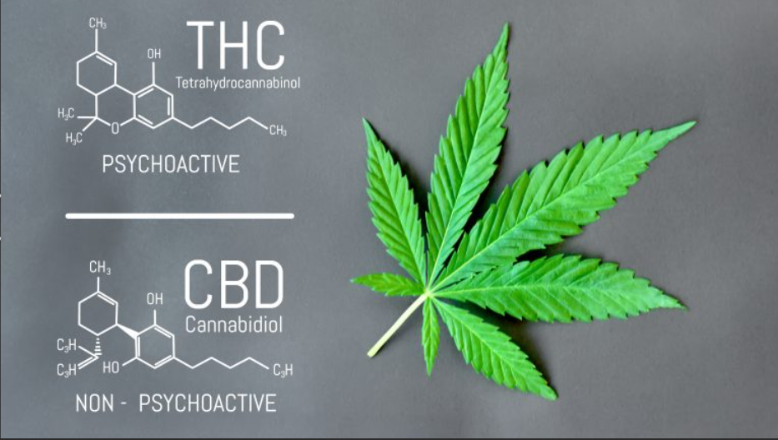
Cannabis
Notes:
Cannabis, also known as marijuana, hash, pot, weed and draw comes from the plants Cannabis Satvia and Cannabis Indica, which grows in the wild in any warm conditions.
Cannabis has been around for centuries. Historically, most UK cannabis was imported as resin, a brown/black compresses powder collected from the female plant. Now, most UK cannabis is produced here or in Europe. Cross breeding strains, known as Cannabis Hybrid, has led to the creation of hundreds of new strains, differing characteristics and appearances. These strains give varying effects for the user to experience. However, for the most part, users are unaware of what type of strain they are taking and believe they may be having one kind whereas they may be having another.
Cannabis contains a number of psychoactive compounds, the most significant ingredient being the tetrahydrocannabinols also known as THC. This is the element which changes the state of the mind and body and is responsible for much of the euphoria and hilarity associated with the drug. Cannabidinol (CBD) is the non-psychoactive chemical compound and appears to reduce some of the negative effects of THC. This can activate the serotonin receptor which helps alleviate symptoms such as anxiety, nausea, vomiting, and the perception of pain.

Slide 4
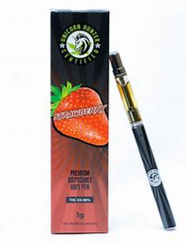
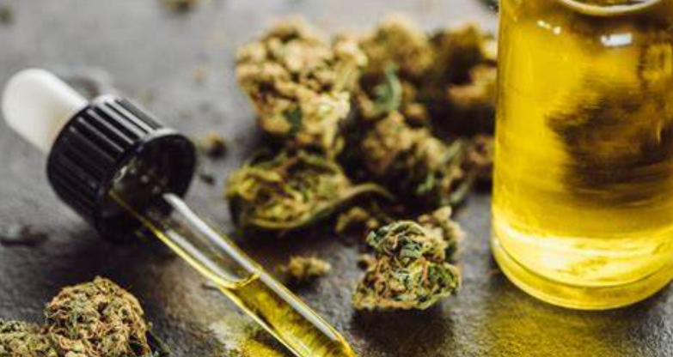
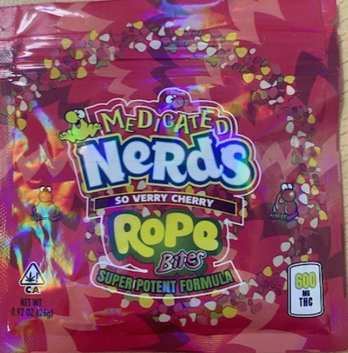
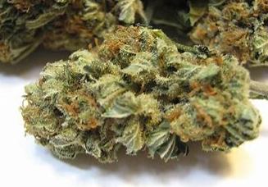
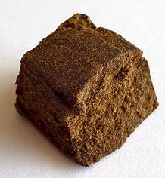
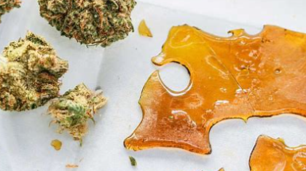
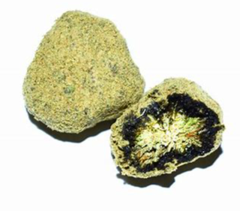
What does cannabis look like?
Cannabis oil
Edibles
THC vapes
Herbal/Skunk
Hash/Resin
Shatter
Moon rocks
Notes:
What does cannabis look like?
Cannabis comes in many different forms:
Herbal – This is the most common way to find cannabis. It is composed of the dried leaves and flowering parts of the female cannabis plant and resembles compressed dried herbs.
Skunk – Skunk is a strong form of herbal cannabis which consists of just of the buds. Much of the cannabis in use in the UK is home-grown either under grow lights or in greenhouse conditions using ‘hydroponic’ techniques (i.e., growing plants in nutrient-rich liquids rather than in soil). This produces a stronger, more potent form of the drug. In fact skunk is only one of 100 or so varieties of cannabis plant which have high levels of tetrahydrocannabinol (THC).
Hash or resin – A black or brown lump. Not seen as much locally. This is black due to being rolled by hand therefore contains skin and other bacteria from human hands.
Cannabis oil – Cannabis oil is a sticky, thick yellowy/brown liquid.
Shatter – Highly concentrated form made by stripping the THC out of the cannabis plant with butane gas, the result is a glass-like extract. It is broken up to be smoked and this is what is used in e-liquids and in vape pens.
Moon rocks are basically the “champagne” of the cannabis world. Some people even call them cannabis caviar. This is where skunk is rolled in the sticky crystals which cover the flower.
THC vapes – Cannabis containing vape products contain concentrated forms of the plant, which means THC levels are many times higher than in the highest-quality marijuana. That makes vaping them especially likely to cause negative side effects or long-term health problems.
Edibles – Cannabis Edibles are typically made with highly concentrated THC. The amount of THC in these products can vary greatly. They can look very similar to well-known sweets such as Haribo, Nerds, Smarties and chocolate bars. This particular image you can see was a package recently retrieved from a local Blackpool high school.

Slide 5
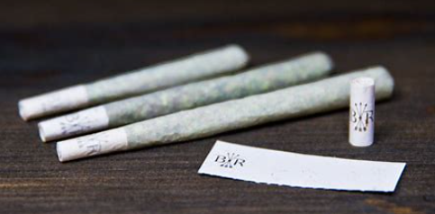
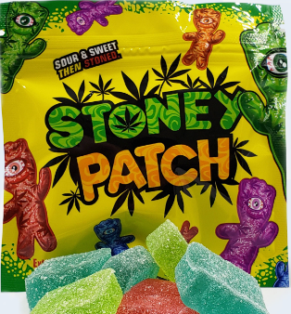
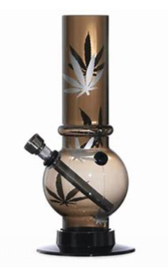
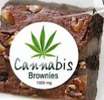
How is Cannabis taken?
Cannabis can be taken/used in a variety of ways including:
Smoking
Pipe/Bong
THC Vaping
Eating/drinking
Notes:
How is Cannabis taken/used?
Smoking – Probably the most common way to use herbal/skunk is to roll it up into a cigarette (joint or spliff) and smoke it. Sometimes tobacco is included in this method. Secondary problems when smoking tobacco are further addiction to nicotine, as well as increasing your risk of developing more than 50 serious health conditions such as cancer, coronary heart disease or a stroke.
Inhaling – Sometimes cannabis may be inhaled via a pipe or bong.
THC Vaping – Explained earlier – either by using specialised cannabis ‘vapours’ pens or by turning the cannabis into a liquid which can be used with a normal e-cigarette.
Eating/drinking – Cannabis may be baked into cookies, edible sweets or brownies, mixed with alcohol or brewed into a tea. Edibles are marketed for the younger generation, found in colourful packaging.
When eaten the effects take longer to start but often last longer too. Eating cannabis may result in a large dose being taken in one go, making it difficult to avoid unpleasant reactions.

Slide 6
Cannabis & The Law…
Cannabis is classified as a Class B drug in the United Kingdom.
There are various penalties relating to the use, dealing/distribution and production of cannabis.
Notes:
Cannabis and The law:
Cannabis is controlled as a class B drug under the Misuse of Drugs Act-This means it is illegal to cultivate, produce, supply or possess.
Maximum sentence for possession is 5 years and a fine.
Possession with intent to supply, maximum sentence is 14yrs and a fine.
Production and cultivation max sentence 14yrs and fine
There are three possible responses for officers to take where they believe they have found an individual in possession of a controlled drug for personal use.
Police now implement the use of Out of Court Disposals.
Controlled drugs are dealt with slightly differently now by Police.
Police Officers have options for dealing with simple possessions for personal use.
Police forces can implement the use of Out of Court Disposals. – words of advice – On the officers discretion
Out of court Disposals are for low-level offending which does not need prosecution at court and can be dealt with quickly and easily.
The use of Out of court disposals replace the old cannabis warning and penalty notice
The aim of them is to reduce the number of people who enter the criminal justice system if they admit their offence and it is low-risk enough to be suitable for one.
So for example If the offender is found in possession of a small amount of cannabis, consistent with personal use, and the offender admits the offence, the drug is confiscated and a record of the warning will be made on the Police’s local system CONNECT.
This information will stay on this system forever! And will show up on an enhanced CRB
No information will be put onto the PNC which is the Police National Computer.
1. Community Resolutions
A person found in possession of a controlled drug for the first time can be offered a Community Resolution.
To be eligible you must admit responsibility, which in effect will be an admission of possession.
More than one of these can be received, so long as at least 12 months have passed since the last time one was issued for the same or similar offence. Community Resolutions are intended to be given outside of the Police station, and so can be given on the street.
A Community Resolution does not form part of a criminal record, or count as a criminal conviction.
It gets logged on the local system which is CONNECT but it doesn’t get logged on the national system
However, it would be eligible to be disclosed as part of an enhanced DBS/CRB check.
2. Conditional Cautions
A person who has recently had a Community Resolution, or otherwise where one is not thought appropriate, may be offered a Conditional Caution.
To be eligible for a Conditional Caution there must be a realistic prospect of convicting you of the offence if it is charged, and you must also admit guilt for the offence and consent to being given a Conditional Caution.
Police forces will be responsible for the conditions imposed as part of a Conditional Caution. These conditions can also include making an apology and Diversion schemes. However, it can also require engagement with unpaid work, a fine, and other conditions. The purpose of the Conditional Caution should be to prevent reoffending, and the conditions should further that purpose, so it should be relevant to the use of drugs. It can also include a requirement to pay a financial penalty.
A failure to comply with the conditions is likely to lead to a prosecution for the original offence, though depending on the overall situation the Police can choose to treat the conditions as completed, or change the conditions.
While a Conditional Caution is a less severe outcome than a conviction, it does form part of your criminal record.
As you have to admit guilt to be eligible for a Conditional Caution you should always seek legal advice on your specific situation before doing this.
3. Charge/Summons
If a person has already had a Conditional Caution, or the Police do not consider an Out of Court Disposal to be appropriate, they may be charged, or released under investigation
If you are charged you will receive a Summons informing you what you have been charge with, and requiring you to attend a Hearing at the Magistrates Court at a future date. You can contact us for more advice on what to do if this happens.
On the 11th October 2018 the Government announced that medicinal cannabis is legal and that patients can be prescribed medicinal cannabis by specialist doctors.
Again I think this has caused lots of misconceptions around Cannabis and you usually will find that YP and Adults will use these comments and justify their own Cannabis use
What they are forgetting is that Medicinal Cannabis is not grown in someones loft or garage!

Slide 7
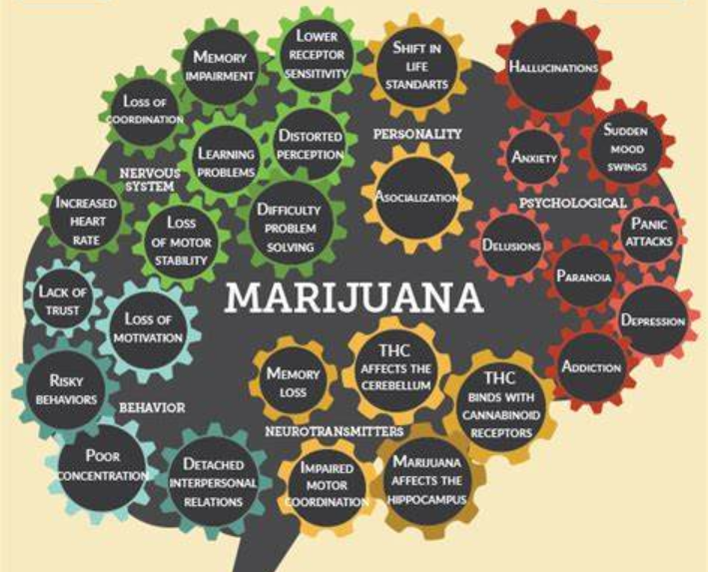
The effects of taking Cannabis
Cannabis has different short and long term side-effects and impacts people both physically and mentally.
How Cannabis is taken and the frequency of use are factors that can influence the impact that taking Cannabis can have on individuals.
Notes:
Cannabis | Drug Science
Cannabis and mental health - for young people | Royal College of Psychiatrists (rcpsych.ac.uk)
Cannabis is a depressant drug which slows down the activity of the central nervous system, including the heart rate, blood pressure and the brain. Users have explained various reactions when taking cannabis. Depending on the strain, depends on the “high” they experience. There are roughly four stages to the short term effects on the mind and body.
Within minutes, users feel elated or euphoric. They may start to talk more, laugh with increased sociability. Once this has started to wear off, users may feel a little agitated. Paranoia may begin to set in and users feel anxious with possible hallucinations. Once this has cleared, users feel relaxed, there may be alteration of time and perception and lack of motivation. Finally, users have a strong desire to eat more and continue to eat- hence the term “The Munchies.” Once sugar is consumed, the effects begin to weaken and normality sets in.
Long term effects of cannabis misuse can have lasting, detrimental consequences on the mind and body. Some users are at increased risk of respiratory diseases, including bronchitis, lung and mouth cancers. If you also smoke tobacco, this risk is increased. Smoking cessation is the process of quitting smoking. This can be done through various methods including nicotine replacement therapy, medications and behaviour counselling. Dependence – people who are dependent on cannabis need the drug to function in everyday life. Financial problems- cannabis can be expensive depending on the strain preferred. Feelings of social isolation – long-term smokers often report that they feel isolated and don’t mix with other people as much as they used to. Changes in motivation – people dependent on cannabis report it is hard to achieve their goals and regret wasted time and opportunities. Decreased concentration, memory and learning abilities. Very heavy cannabis use may affect fertility and THC can cross the placenta and pass into breast milk. Smoking cannabis can affect foetal growth and contribute to lower birth weight, which may place a baby’s health and well-being at risk. Cannabis induced psychosis – hearing voices or seeing things which are not real.

Slide 8
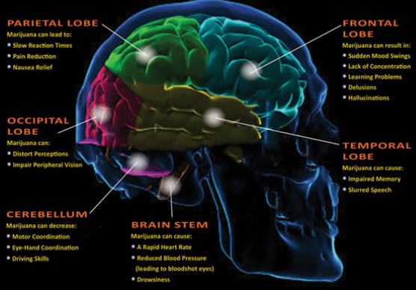
Consuming Cannabis in adolescence
Notes:
Consuming Cannabis in adolescence:
The law states, young people become an adult at 18. Whereas, scientifically, our bodies are not fully formed until we are 25 years of age. More so, the brain, and the prefrontal cortex and amygdala are still developing up to this age. These are the parts of the brain which control our thinking and emotions. So, moving forward, know, scientifically, young people within Adolescence are not necessarily purposely trying to do things wrong, just, have not formed the part of the brain which allows them to be an “adult” just yet.
Daily, we create new neurons when we have new experiences and memory of those experiences stick with us and shape who we are. When cannabis is consumed within Adolescence, it can become dangerous. There are permanent, physical changes being made. The Adolescent brain is no longer able to manage the new experiences to its entirety. Therefore, Adolescents find it even harder to think clearly, problem solve, they form problems with their memory and learning, have reduced coordination and struggle maintaining attention.

Slide 9
Challenging misconceptions…
Some young people say the following…
“Cannabis calms me down.” – Higher doses of THC mean the calming effect is reduced
“Cannabis helps me concentrate.” – It impairs the ability to think & focus
“I can’t get addicted to Cannabis.” – Cannabis can be addictive.
“Cannabis helps me sleep.” – It reduces REM in sleep.
Notes:
Cannabis helps me sleep – Cannabis actually disrupts the REM and the overall quality of the sleep becomes worse. Users will find they do not dream, and the side effects of not having full REM are moodiness, grogginess, lethargy and anxiety.
Cannabis calms me down – There may be a short term positive as cannabis is touted by some as a herb which relieves anxiety. Science, however, finds reality to be much more nuanced. The longer someone consumes cannabis, the worse long-term negatives effects become, inducing anxiety, cannabis induced psychosis and contributes to other mental health challenges.
Cannabis helps me concentrate – Cannabis is a drug known to induce the senses short term. Users have stated how they are more in tune to their surrounds. Again, a short term positive. What cannabis does to the developing brain in the long term, inhibits motivation, makes learning more difficult due to the inability to retain as much information.
I can’t get addicted to Cannabis- while only the minority will develop an addiction, people can without question become addicted to cannabis. Especially if they started using as an adolescent or if they use it frequently.
Being able to realign norms for young people is crucial so they have the correct information and hope to not start cannabis or deter the onset of consuming the drug.

Slide 10
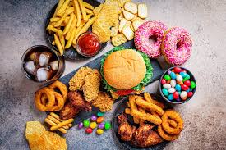
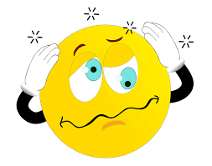
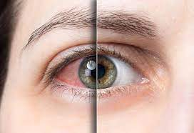
Signs to look out for
Some of the physical signs that a young person has consumed Cannabis are:
Red/bloodshot eyes
Dazed/dreamy demeanour
Giggles
Increased appetite
Sleeping more
Cannabis can also cause Paranoia, Dizziness and Anxiety.
Notes:
Most of the time spotting a cannabis user can be a pretty easy thing if you know what you’re looking for. The signs can be clear if you’re properly educated. While cannabis remains the most commonly used illicit drug in Blackpool for under 25’s it’s important to be able to spot a cannabis user, especially in the case of someone who is close to you. Unlike some of the other popular drugs, a cannabis habit is not that easy to hide. For starters it has a very strong and distinct smell to it that is hard to miss. Almost everybody is familiar with this smell. This would be a major indication that someone is using, if you happen to detect the smell from their presence. However, sometimes a user will tend to cover up the smell with perfume or aftershave, or wait until the smell dissipates before coming around people who don’t use.
Some Signs of Marijuana Use
Some signs of marijuana use include:
Bloodshot eyes or half closed eyes, or both - due to the THC - this lowers the blood pressure which dilates the blood vessels and increases blood flow throughout the body.
Decreased heart rate
Strongly increased appetite
Memory impairment
Trouble retaining information
Difficulty paying attention or solving problems
Paranoia
Anxiety
Giddy
Laughing for no reason
Foggy memory
Dizziness
Lowered inhibitions
Loss of train of thought during a conversation
Slow movement
Sleeping a lot
Marijuana paraphernalia such as bongs (pipes or water pipes), joint (hand rolled weed-filled cigarettes), rolling papers and blunts (weed-filled cigars)
Behavioural change
Financial problems

Slide 11
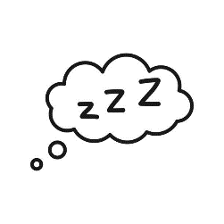
Harm Reduction Advice
Harm reduction advice/messaging is as follows:
Start low and go slow
Avoid mixing with other drugs or alcohol
Avoid using alone
Look after friends & do not share them as they are an illegal drug – this could be considered as supplying drugs if shared.
Call 999 in an emergency
Notes:
First things first… don’t start. Cannabis has a reputation to be a gateway drug which means it may lead onto trying other things.
Getting started, a user needs to ask a friend, relative, or self-refer to the ADASH practitioners to help them. Help starts by informing someone about their challenge. Talking about plans for change is the first step to find support.
Make a note of how much cannabis is consumed in the week. Then reduce this slowly over time. Thinking someone will be able to stop “cold turkey” has a low rate of success so it is important to reduce the amount day by day/week by week. If a young person smokes five joints a day, begin to take one away each day over a period of time and so on.
Reduce the amount used within each joint/bong. Reducing the volume of cannabis within a joint will over time decrease the bodies’ tolerance levels. Like anything, when trying to rewire your brain reducing it in a manageable way will be more successful.
Go low and slow with edibles – Impatient or naïve users might think they have not taken enough to feel the effects, and if they consume more they may experience unpleasantly strong psychoactive effects. When edible products have inconsistent levels of THC, even experienced users may find it difficult to control the amount consumed.
High risk situations are those in which people usually smoke cannabis. Certain people and places act as a trigger to cannabis use by increasing the cravings. Most cannabis smoking happens without planning or effort. This means that they must plan well ahead to make sure that they do not end up in a high risk situation. Write the high risk situations down as well as a reasonable strategy to avoid situation if it arises.
Do not mix cannabis with alcohol or other drugs.
It is always important when talking to young people about their goals and aspirations. In order for them to build discrepancy, can a young person see what their life would be like if they were not to be addicted to any substance and what it would be like if they were? So, discussing the pros and cons of smoking cannabis with an outlook on their life moving forward is a must.
Remind themselves why you want to change in the first place.

Slide 12
Blackpool Adolescent Services
There are a number of referral pathways for young people who may need support:
Under 18: Request for Support (blackpool.gov.uk)
18 – 24 self referral: www.blackpool.gov.uk/selfrefer
18 – 24: Partner Agency referral: www.blackpool.gov.uk/partnerrefer
Adults - Horizon – Adult services – from dependence to freedom
horizonreferrals@delphimedical.co.uk
Notes:
Blackpool Adolescent Service provides free support for young people with drug, alcohol and sexual health issues.
The service is available to all young people aged 10 to 24. Interventions range from drug awareness, harm reduction as well as access to clinical prescribing services for substance abuse and clinical sexual health support.
Horizon - To enter drug or alcohol treatment, people can self refer straight into Delphi or a support worker can refer in with consent from the cannabis user. Tel: 01253 205157
horizonreferrals@delphimedical.co.uk

Slide 13
Thank you.
E-mail: publichealth@blackpool.gov.uk
Website: www.healthierblackpool.co.uk

