Slide 1
Public Health Briefing: Cannabis Edibles
This briefing has been created by the Blackpool Council Public Health team and is accurate as of March 2024.
Click the Blackpool Council image on the right of this slide to visit the Healthier Blackpool webpage. Click on the PSHE image to be directed to the PSHE section of the Healthier Blackpool website.
If you have any questions about anything in the slide, please contact publichealth@blackpool.gov.uk.

Slide 2
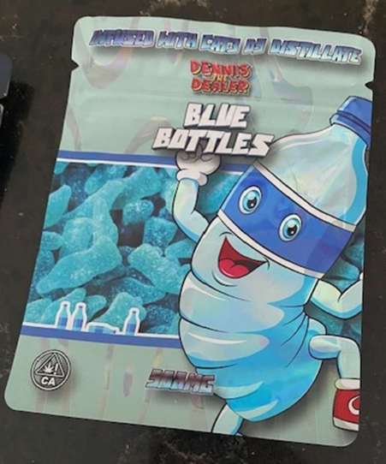
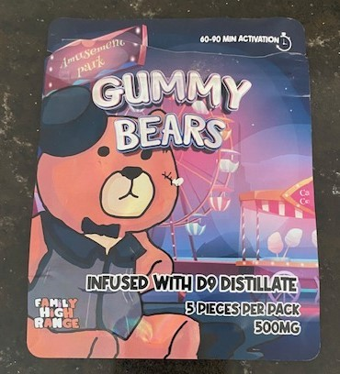
Cannabis/THC Edibles
This briefing will cover:
What Edibles are.
The associated risks of consuming edibles.
THC Vapes & guidance for schools & colleges
Signs to look out for that someone may have consumed edibles.
How edibles are being purchased.
Harm reduction messages.
Notes:
During this session you will find out:
What edibles are and what they may look like along with some of the associated risks.
You will be provided with some information around signs you might see if someone has taken an edible and how they are being purchased.
And we will also look at some harm reduction information along with brief interventions that can be cascaded to young people who are using edibles, or thinking about using to help them make an informed choice.

Slide 3
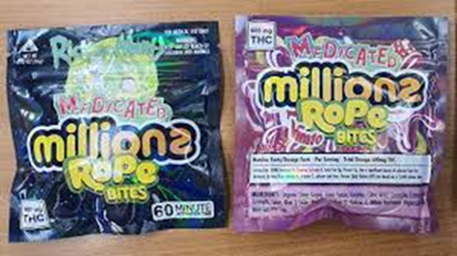
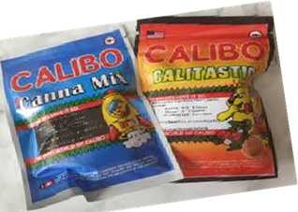
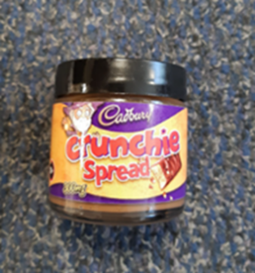
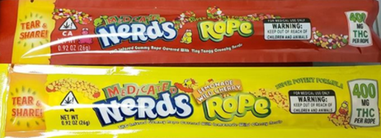
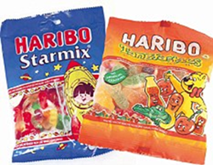
What are Edibles and what do they look like?
Notes:
This briefing is aimed at raising awareness and understanding of what cannabis edible drugs are and the effects they may have.
Cannabis contains lots of different chemicals or active ingredients known as cannabinoids.
2 of the main active ingredients are
Delta-9-Tetrahydrocannabinol (THC). – The psychoactive compound found in cannabis – The bit that gets you’ high/stoned!’
Makes you feel Pleasure, Euphoria and anxiety.
The more THC there is in cannabis, the greater the effect will be
CBD: Cannabidiol – Non-psychoactive component
CBD is the buffer against THC and can lessen the unwanted psychoactive effects of THC such as hallucinations, paranoia and anxiety.
This means that the effects of THC will be lower if there is more CBD in the plant.
The cannabis that we are seeing today is the 21st century cannabis, it is nothing like the historical cannabis that was circulating in the 60/70/80 and 90’s which means we are seeing plants that are grown specifically containing a high dose of THC and lower doses of CBD
People want to get stoned so the growers/suppliers and dealers advertise this!
THC is an illegal substance and CBD is a legal substance
There are many different forms of cannabis and this briefing has been put together in response to the increasing use of cannabis edibles amongst our YP in Blackpool.
What do edibles look like?
Many different food items can be infused with Cannabis, traditionally these have taken the form of cakes/brownies, but recently they have most commonly had the appearance of sweets, such as gummies/ sweets and chocolate
Often these edibles will be in packaging which mimics legitimate sweets and so at first glance may not give any cause for concern, and so they will often avoid suspicion/detection.
They often have a THC marking on the packaging like in the images.
This is to highlight the fact they contain cannabis and will give the psychoactive effects of cannabis when consumed.

Slide 4
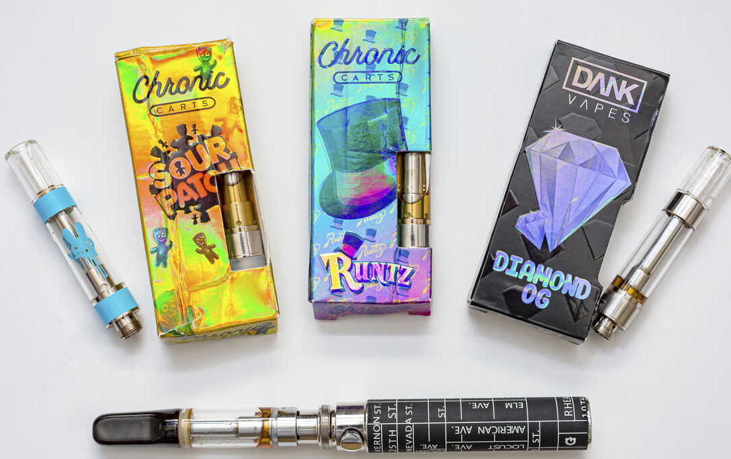
THC Vapes – New guidance for schools & colleges
If you are in possession of a vape you have taken from a young person that has caused a medical emergency, please call 101 to arrange to have this collected and tested by Lancashire Constabulary.
Notes:
As well as concerns around cannabis edibles, there has been an increase in young people using vapes and in particular experimenting with THC vaping. THC is the chemical that gives the ‘high’ effect in cannabis.
Vaping THC will have similar effects to using cannabis. However vaping THC as opposed to smoking cannabis allows a larger amount of THC to be inhaled very quickly, potentially causing overdosing/adverse effects that can result in young people requiring medical attention.
If the vape which has caused the young person to be unwell, has been confiscated and is able to be kept in a safe place, it can be collected for testing. There is an increasing emphasis on testing vapes linked to adverse reactions due to adulterated vapes containing synthetic cannabis (Spice) and THC.
Only vapes that may have caused an ill health incident can be tested, we cannot test all confiscated vapes. It is also important to highlight here that adverse reactions can be caused by vapes that only contain nicotine due to the strength.
To arrange for testing, secure the vape and ring 101 for collection by the Police.

Slide 5
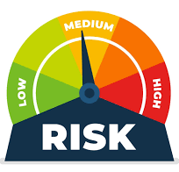
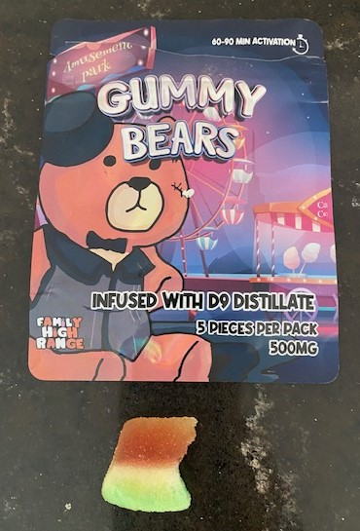
Associated risks of consuming Edibles
Some of the associated risks of consuming edibles include:
The strength of the Edible.
The increased chance of overdosing.
More THC reaches the brain (90%)
Effects take longer to kick-in but last longer
Uncertainty around the content
Notes:
Some of the risk associated with Edibles are the strength of them
A typical Cannabis joint would allow for inhalation of approx. 12mg of THC.
Using a bong would allow for inhalation of approx. 13mg of THC.
Using a vape would allow for inhalation of approx. 17mg of THC.
For a beginner with very low tolerance, unpleasant effects experienced at around 5-10mg of THC.
For an experienced user unpleasant effects experienced at 25mg THC.
A heavy user with high tolerance could experience unpleasant effects anywhere between 40 and 80mg of THC.
Edible sweets are commonly supplied in 500-600mg packs as seen in this packet,
So for a beginner this means they could consume THC which is upto 50 x stronger or even for the experienced user 25 x stronger than their body is used to!
Making accidental over consumption highly likely, particularly in naïve users.
Another risk associated is the Increased chance of overdosing
This is because eating cannabis as oppose to smoking it takes longer to feel the effects of the drug.
It can usually take between 1–3 hrs for the drug to take effect when eaten, often causing users to consume more, believing the drug is not working.
Also when cannabis is eaten about 90% of the THC reaches the brain, producing a stronger high than when it’s smoked.
And then the added risk is that these products vary widely in their appearance, strength and content.
They may not always contain what you think or what you have been told.
Which means that it’s difficult to know what the ingredients are or how much of the unknown ingredients you will ingest if you eat them.
It is inadvisable to mix edibles with alcohol or other drugs.
The interactions between substances cannot always be easily predicted and unwanted effects may be more likely to occur.

Slide 6
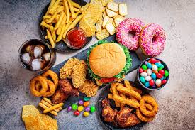
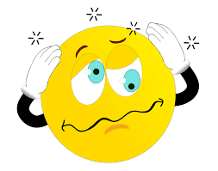
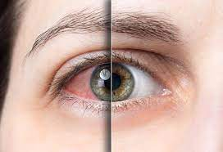
Signs to look out for
Some of the physical signs that a young person has consumed edibles are:
Red/bloodshot eyes
Dazed/dreamy demeanour
Giggles
Munchies
Cannabis can also cause Paranoia, Dizziness and Anxiety.
Notes:
There are several indicators that you might notice in a young person who has consumed edibles, but please remember it all depends on the contents of them, as to the signs you might notice – However if they contain THC these are some of the warning signs
Blood shot eyes: THC lowers blood pressure which dilates the blood vessels and increases blood flow throughout the body.
This causes the blood vessels in the eyes to expand, causing redness or bloodshot eyes.
Giggles: laughing is a reflex, just like sneezing and coughing.
When THC attaches itself to the receptors in your body it stimulates the laughing reflex, just like when you have a cold that stimulates the coughing reflex
Munchies: THC interacts with receptors in our brain that regulate emotions, pain and our sense of smell and taste,
THC stimulates and spikes your appetite even when you are full
Dry Mouth/cotton mouth: Contrary to popular belief, dry mouth is not caused by smoke drying out your mucous membranes and throat.

Slide 7
How are edibles bought?
Process for buying drugs through Social Media
Advertise
Connect
Pay
Notes:
As with any illicit substance, these drugs can be accessed via various means, either through friends, siblings or other family members
Or In the absence of any social supply network, edibles will largely be sourced online on the Social Networking sites, such as Tiktok – Instagram - Snapchat - Facebook
Seeing drugs advertised for sale on social media can normalise drug use
Social media has made it easier for young people to buy drugs. Dealers can be found in an accessible way through platforms and without young people
needing to have an existing drug user network.
Telegram messenger app - Telegram is an instant messaging tool that allows you to send and receive messages from your contacts even without sharing your phone number.
It also offers you end-to-end encryption so no one else can know what you’re talking about.
Due to its focus on user privacy and the fact it’s easier to access than the dark web, Telegram has become the go-to global messaging app for buying and selling drugs.
On Telegram drug buyers and sellers chat on invite-only “channels”,
Telegram is a lot easier to use and more convenient for buyers,” compared to the darknet/darkweb
How it works on social media
Advertise
Drug dealers advertise on social media platforms
These adverts are in disappearing, 24-hour stories, and in posts, which are promptly posted and removed.
Posts and stories are often accompanied by known code words and emojis that are used to market and sell illegal drugs on social media.
These code words and emojis are designed to evade detection by law enforcement and by the preset algorithms used by social media platforms.
Heroin: Brown heart, dragon
Cocaine: Snowflake, cloud with snow, snowman, diamond, eight ball, key, face with tongue out, blowfish)
Cannabis: Clover leaf & Cookie.
Connect
Prospective buyers contact drug dealers on social media apps in response to their advertisements
either using direct messaging or by commenting on a post.
Once contact is made, drug dealers and potential buyers often move to an encrypted communications app like WhatsApp and Telegram.
Drug dealers typically switch to these encrypted communications apps to arrange drug deals with prospective buyers.
Pay
Snaptrap iplayer link - https://www.bbc.co.uk/iplayer/episode/m001p4mk/bbc-wales-investigates-snaptrap-is-your-child-safe
Image on the slide is of a sticker that was recently found on Grovesnor street in Blackpool.

Slide 8
Harm Reduction Advice
Harm reduction advice/messaging is as follows:
Start low and go slow
Avoid mixing with other drugs or alcohol
Avoid using alone
Look after friends & do not share them as they are an illegal drug – this could be considered as supplying drugs if shared.
People could consume them in error due to their similarity to reputable sweets – store them safely
Call 999 in an emergency
Notes:
Start low. As the cannabinoids are in food or drink it’s difficult to know what those active ingredients are or how much of the active ingredients you have actually taken.
Go slow. Edibles take much longer to have an effect than smoked cannabis.
Wait at least an hour to check the effects before consuming more.
It can take a few hours to feel the full effects.
Look after friends, if they are sleeping or unconscious, put them in the recovery position. If in doubt, If you chose to take them, follow this advice: get help straight away.
Avoid mixing with alcohol or other drugs: The effects may be stronger and more unpredictable when eating rather than smoking cannabis.
Avoid using alone: Try to be with people that you know well and trust in a safe environment, especially if it’s your first time.
Look after friends, if they are sleeping or unconscious, put them in the recovery position. If in doubt, get help straight away.

Slide 9
Blackpool Adolescent Services
There are a number of referral pathways for young people who may need support:
Under 18: Request for Support (blackpool.gov.uk)
18 – 24 self referral: www.blackpool.gov.uk/selfrefer
18 – 24: Partner Agency referral: www.blackpool.gov.uk/partnerrefer
Adults - Horizon – Adult services – from dependence to freedom
horizonreferrals@delphimedical.co.uk
Notes:
Blackpool Adolescent Service provides free support for young people with drug, alcohol and sexual health issues.
The service is available to all young people aged 10 to 24. Interventions range from drug awareness, harm reduction as well as access to clinical prescribing services for substance abuse and clinical sexual health support.
Horizon - To enter drug or alcohol treatment, people can self refer straight into Delphi or a support worker can refer in with consent from the cannabis user. Tel: 01253 205157
horizonreferrals@delphimedical.co.uk

Slide 10
Thank you.
E-mail: publichealth@blackpool.gov.uk
Website: www.healthierblackpool.co.uk

