Slide 1
Public Health Briefing: Ketamine
This briefing has been created by the Blackpool Council Public Health team and is accurate as of March 2024.
Click the Blackpool Council image on the right of this slide to visit the Healthier Blackpool webpage. Click on the PSHE image to be directed to the PSHE section of the Healthier Blackpool website.
If you have any questions about anything in the slide, please contact publichealth@blackpool.gov.uk.
Notes:
This guidance has been created in collaboration with the Blackpool Council Public Health Team & colleagues from the ADASH team within Blackpool Adolescent Services.
The ADASH team focuses on Adolescent Alcohol, Drug and Sexual Health support and later in the briefing there is a slide that provides further information about the ADASH team and referrals to relevant services.
This presentation has been created to give you an overview of the drug Ketamine and is correct as of March 2024.

Slide 2
Ketamine
This briefing will cover:
What is Ketamine?
The legal implications.
The effects of taking Ketamine.
The associated risks of taking Ketamine.
Information about Ketamine Bladder Syndrome.
Harm Reduction advice.
Referral information to support services
Notes:
This brief guidance will cover:
What Ketamine is
Its legal status within the UK,
The effects it has on the body and the brain
The risks the drug has
As well as harm reduction messaging – Harm reduction is help or advice to reduce the amount someone takes or ways to help them manage their safety if they continue using.

Slide 3
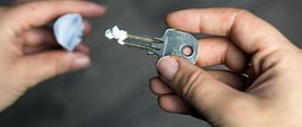
What is Ketamine?
Ketamine is a grainy, white powder which is snorted through the nose.
Ketamine is:
A hallucinogenic – it is mind altering.
A dissociative – feelings you disassociate from your body.
Analgesic – pain killer
Used in medicine and veterinary services for decades –known as ‘Ket’ or ‘Special K’ and associated with 16-24 year olds.
Young people have mentioned how it is cheap, used “after all the coke has gone”, “makes you very wavy” & “takes you into a K hole”.
Notes:
So, what is Ketamine?
Ketamine is a grainy, white powder. It is odourless and tasteless and can be added to beverages without being detected. This is usually taken through the nose through snorting or swallowed. Ketamine is a “dissociative anesthetic”. This interferes with signaling between the brain and the body, reduces awareness and sensitivity to pain but also inhibiting movement.
Ketamine is a dopamine releasing drug with immediate effects, usually lasting around 30 minutes to one hour. Dopamine is our “feel good” chemical and drugs such as Ketamine, trigger the release of dopamine and affects the brains reward system. Dopamine wants us keep doing what we are doing. It also teaches the brain to repeat the behaviour.
Young people may have heard Ketamine is a “horse tranquiliser” however this is not the sole case. It is used in veterinary services but as an anaesthetic just as its used in human anaesthesia. It is an anaesthetic (painkiller) and a psychedelic (mind altering drug) which means young people have more chance of causing themselves injury due to its effects not allowing them to experience pain. Mainly driven by 16-24 year olds, young people have said “Its cheap”, usually taken “After all the cokes gone!” and takes you into a “K Hole”.
This has the potential to be physically and psychologically addictive. Regular user build up tolerance and larger doses are needed to achieve the same affect.
Names for ketamine include Kenny, Vitamin K, Donkey, Dust, Wobble however locally to Blackpool the names used are “Ket” or “Special K”.

Slide 4
The legal implications
Ketamine is a Class B substance across the United Kingdom.
Possession carries up to a 5 year custodial sentence, a fine, or both.
Supplying Ketamine could result in a custodial sentence of up to 14 years.
Notes:
Ketamine is a class B substance in the UK. Therefore possession is up to five years in prison, a fine or both. Supply of ketamine is up to 14 years in prison.
Ketamine is not listed in drug related death statistics. However, pre Covid there are thought to be about 30 deaths a year where ketamine is implicated. Ketamine may have impaired judgement in other cases with other substances, particularly alcohol or other depressant drugs.
Ketamine is cheap and hugely available. It is around £20 a gram, however if bought in bulk this becomes cheaper. In comparison to cocaine, this is around £40 to £50 a gram.

Slide 5
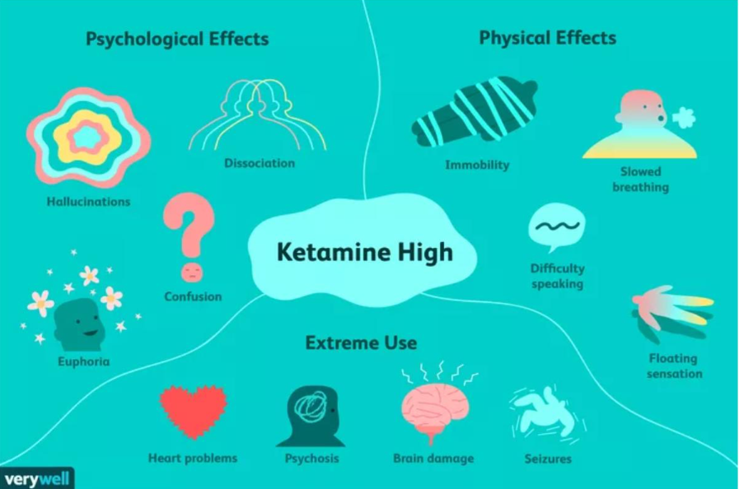
The side effects of taking Ketamine
Taking Ketamine could have a range of physical and
psychological effects.
Notes:
As you can see in the image, Ketamine can have damaging short term and long term effects.
At lower doses, users report feeling disorientated, with some hallucinogenic experiences such as distorted senses of the body and limbs feeling longer or shorter. Some people feel euphoric, Limbs may feel heavy and increased effort is required to move or speak,
At higher doses, hallucinations are much more pronounced. People describe an experience that has been Named "k-holing:“ A “K hole” is the feeling like your mind and body are “separated” . People can feel paralysed and find movement difficult or impossible. This can be frightening or overwhelming for people especially if they are unaware this may happen.
Young people have told us you are unable to feel your arms or legs and have no control over normal bodily movements.
Perceptions can become very altered with intensely altered awareness of sound and vision.
Effects are dependent on a persons size, weight, what they have eaten and whether or not they have taken anything else (i.e. drank alcohol or taken cocaine). Also, this depends on the quality of the drug.

Slide 6
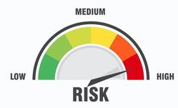
The associated risks of taking Ketamine
Associated risks include:
Nausea and loss of co-ordination
Accidental injury
Tolerance quickly builds
Physical and Psychological addiction
Severe cravings
Depression
PTSD
Anxiety
Notes:
This slide highlights a few more negative risks and the effects of the comedown which lasts for twelve hours after usage has stopped. It is important to note “ketamine bladder” which will be discussed next.
Some users feel nauseous and there is a risk of choking on vomit.
Ketamine does not suppress heart rate or breathing to a very great extent. So while people may become drowsy or possibly unconscious, the risks of this are lower than with other depressants.
The depressant effects of ketamine are exacerbated by taking it in combination with alcohol, opiates or benzodiazepines.
A bigger risk is that users can injure themselves while disorientated, and careful supervision of people who are heavily intoxicated is important. This is especially dangerous when Ketamine is combined with stimulants such as cocaine or amphetamines (as they are more mobile).
Some users can find the powerful hallucinogenic effects of ketamine very disorientating and find the experience very unpleasant.
There is a lack of definitive evidence relating to long term mental health, but as with other psychoactive substances, their use by people concerned about their mental health should be approached with caution.
Of great concern has being growing evidence that ketamine is linked to bladder damage.

Slide 7
Ketamine Bladder Syndrome
A concern relating to extensive use of Ketamine is the emergence of a medical condition called Ketamine Bladder Syndrome.
There are four stages and detecting this as quickly as possible is important in preventing it escalating beyond stages 1 & 2.
If you are noticing a young person is showing symptoms of a Urinary Tract Infection, it is important to explore with them if they are using Ketamine.
Notes:
Regular users of ketamine have presented to medical services with symptoms of bladder problems such as water infections, cystitis symptoms, abdominal pain and cramps.
In some people this has resulted in severe bladder damage and scarring to the bladder . These have included difficulty in holding urine, pain on urinating, blood in urine and bladder pain
Ketamine can cause permanent damage to your bladder. This has resulted in some people having catheters fitted and a small number of people have had complete cystectomies (removal of bladder).

Slide 8
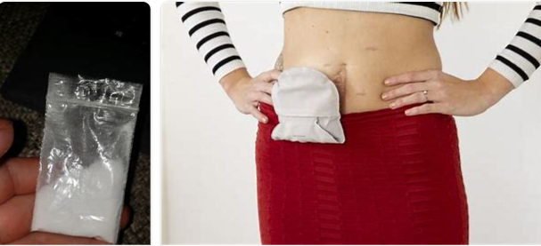
This small bag could result in a bag for life…
Notes:
Anyone who uses ketamine and experiences any problems relating to bladder health should seek medical help promptly!
What we are noticing is young people are coming to us at the latter stages of the ketamine use. Whereas we need more people noticing the signs earlier to intervene before irreversible damage.
Because Ketamine is an emerging trend for Blackpool young people , ketamine misuse is not always visible in primary care.
While GPs may only rarely be confronted with acute ketamine toxicity, they should be aware of the subtler signs of chronic misuse as discussed in previous slide.
A thorough history-taking, with special emphasis on ketamine misuse, is crucial in young patients presenting with depression, memory loss, or chronic urinary problems.
We have young people in the service who are now using incontinence pads with the potential to have to have their bladder removed and an ostomy bag put in place.
Hence, This small bag could lead to a bag for life…

Slide 9
Harm Reduction Advice
The best way to reduce harm is always not to start!
However, harm reduction for those using Ketamine includes:
Start low & go slow
Avoid mixing Ketamine with other drugs and alcohol
If someone taking Ketamine starts to feel nauseous, put them in the recovery position to reduce the risk of choking.
Drink plenty of water!
Notes:
So, how can we reduce the harm. First things first… don’t take Ketamine!
Realign norms -Only 3.2% of 16 – 24 year olds have tried it. Which means 96.8% of this age group have not!
Some harm reduction ideas are listed on the slide. Here are a few more.
Drinking plenty of water including up to 12/24 hours after last ketamine use due to metabolites still being in the bladder which cause irritation/damage. the day after will dilute the urine- the drug stays in the system for 12 hours plus
Don't sit in the bath or use near water as you have the potential to drown
Don’t use with stimulants –this makes you more mobile and users can injure themselves while disorientated
Don’t use on a full stomach or with alcohol – ketamine increases your risk of vomiting and whilst under the influence they may be unable to move.
Try to keep use as infrequent as possible. Give yourself breaks from using if you can to avoid developing tolerance and dependency.
If you are going to use ensure you have a sober friend – recently young people have died as friends UI have been unable to help.

Slide 10
Referral into specialist drug treatment services
Continuous use of Ketamine and dependency could result in devastating and life changing consequences. Within two years on average, it could cause irreversible physical damage.
Therefore, it is imperative that young people are supported to access specialist services to help as early as possible.
The service will look to support young people with their use of drugs but also explore behaviours and underlying causes associated with drug use.
Notes:
Continuous use of Ketamine and dependency can cause a devastating life changing impact on a young person
Within a relatively short period of time (average within 2 years) this can cause severe, often irreversible physical damage
It is important to encourage and support the YP to access specialist help as early as possible in their use of Ketamine
The services will look to support the YP not only with their drug use but behaviours and underlying causes/traumas associated with it.
https://www.blackpoolteachinghospitals.nhs.uk/services/urology

Slide 11
Blackpool Adolescent Services – ADASH Team
There are a number of referral pathways for young people who may need support:
Blackpool Families Rock: Request for Support (blackpool.gov.uk)
Young person self referral: www.blackpool.gov.uk/selfrefer
18 – 24: Partner Agency referral: www.blackpool.gov.uk/partnerrefer
Adults - Horizon – Adult services – from dependence to freedom
horizonreferrals@delphimedical.co.uk
Notes:
Blackpool Adolescent Service provides free support for young people with drug, alcohol and sexual health issues.
The service is available to all young people aged 10 to 24. Interventions range from drug awareness, harm reduction as well as access to clinical prescribing services for substance abuse and clinical sexual health support.
Horizon - To enter drug or alcohol treatment, people can self refer straight into Delphi or a support worker can refer in with consent from the cannabis user. Tel: 01253 205157
horizonreferrals@delphimedical.co.uk

Slide 12
Thank you.
E-mail: publichealth@blackpool.gov.uk
Website: www.healthierblackpool.co.uk

