Slide 1
Wellbeing Warriors
St John’s CoE Primary School, Blackpool

Slide 2
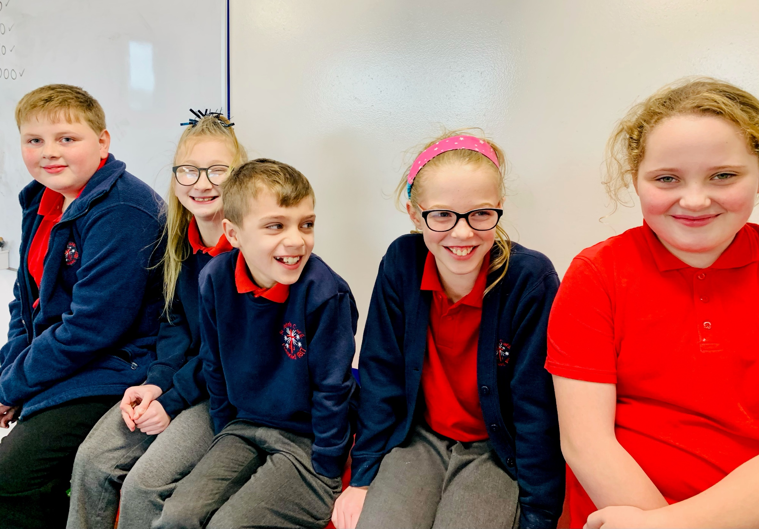

Slide 3
Who are they?
Their Role is a mix of:
Anti Bullying Ambassadors
Mental Health Champions
Peer Mentors
5 children – mix of Year 5 and Year 6
Not perfect role models
Lived Experience
‘Naturally’ resilient

Slide 4
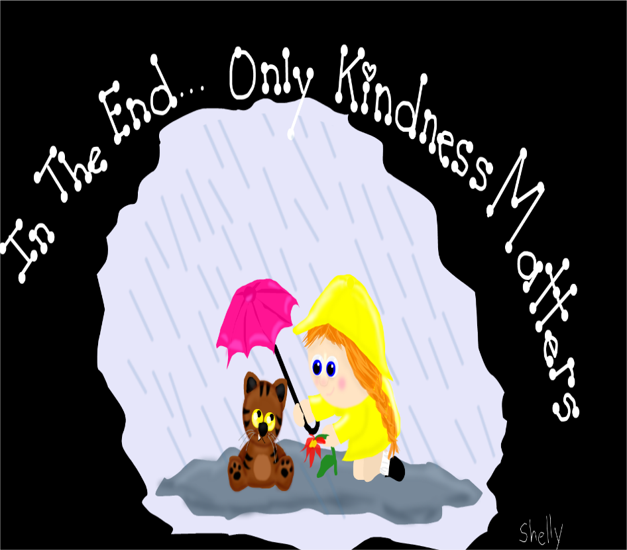
Anti Bullying Ambassadors
Intentionally wanted to get away from the negative connotations of the word ‘bullying’
Rebranded Anti Bullying policy to be ‘ Kindness Charter’ . It was coproduced by WW in a child friendly format
Recently achieved Silver Award for Anti Bullying work in school

Slide 5
Mental Health Champions
Offer practical ideas to feel better
Class Assemblies
Posters in School
Indoor Lunch Club
Personal Experience- what makes me feel better.
Normalise feeling ‘wobbly’

Slide 6
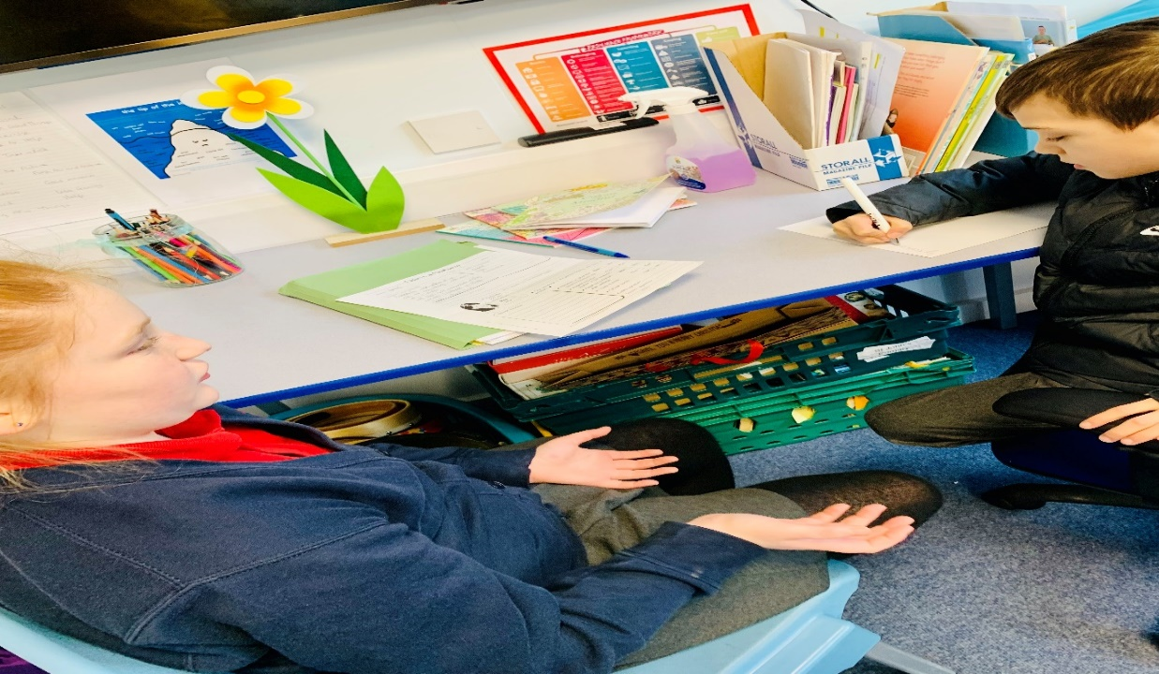
Peer Mentors
ROLE
Empowering Children to support children
Children ‘confide’ in their peers more comfortably
Children have skills to listen and support each other
Shared experiences / understand subcultures
Early intervention to help address minor issues before they turn into crisis situations
Immediate response
Signpost to adult when necessary

Slide 7
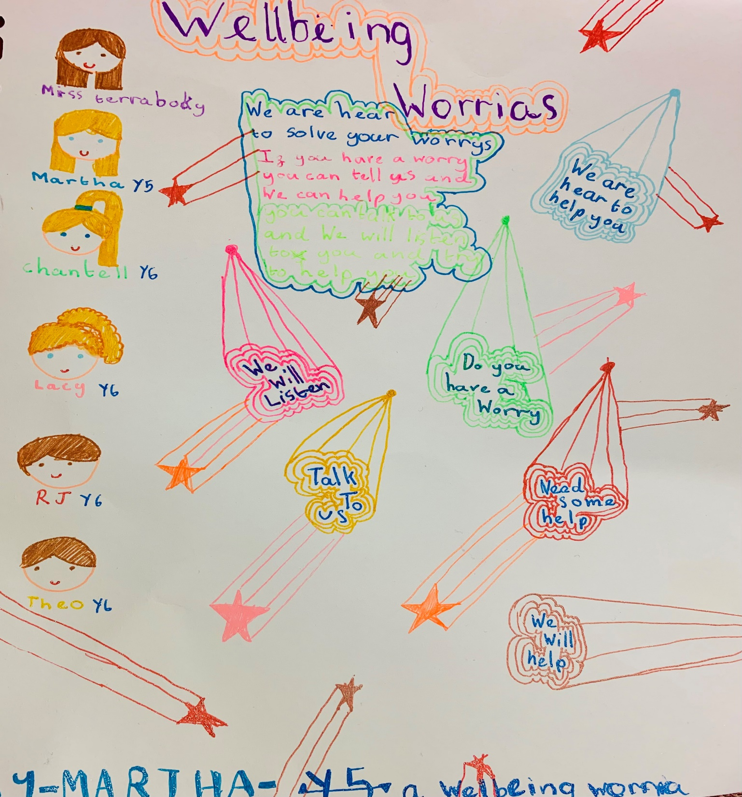
HOW?
Everyone knows who they are and what their role is
Marketing campaign to showcase role of WW
Whole School Assembly to introduce Warriors
Posters around school- toilet doors and corridors
Bookmarks for every child
Up to date dedicated Noticeboard
Termly Newspaper

Slide 8
Where?
Drop in clinic at Indoor Lunch Club
Note in Letterbox
Sit on Buddy Bench
On Playground or around school

Slide 9
Logistics
Weekly meetings with Mrs Tiribocchi
Talk about children they have helped
Practice role playing scenarios
Look at Resilient Moves

Slide 10
OUTCOMES
-no major disclosures made to WW but conversations have enabled staff to intervene when appropriate
-all children in school know they have someone to talk to
-an embedded ethos of ‘ we’re in it together attitude’ resulting in a caring and tight knit community
WW have become more confident in themselves, they have a great sense of responsibility and improved self esteem
-Everyday SuperHereos

Slide 11
