Slide 1
Reducing Parental Conflict Programme
Lynda Singleton
Early Help Locality Manager
Notes:
‹#›

Slide 2
What do we mean by parental conflict?
Conflict that occurs between parents/carers/co-parents that is frequent, intense and poorly resolved.
Notes:
‹#›

Slide 3

A note about Domestic Abuse
Parental conflict can be reflected in a wide range of behaviours, from constructive (helpful) to destructive (harmful) behaviours. Harmful behaviours in a relationship which are frequent, intense and poorly resolved can lead to a lack of respect and a lack of resolution. Behaviours such as shouting, becoming withdrawn or slamming doors can be viewed as destructive.
Parental relationship distress is different from domestic abuse. This is because there is not an imbalance of power, neither parent seeks to control the other, and neither parent is fearful of the other.
Notes:
‹#›

Slide 4
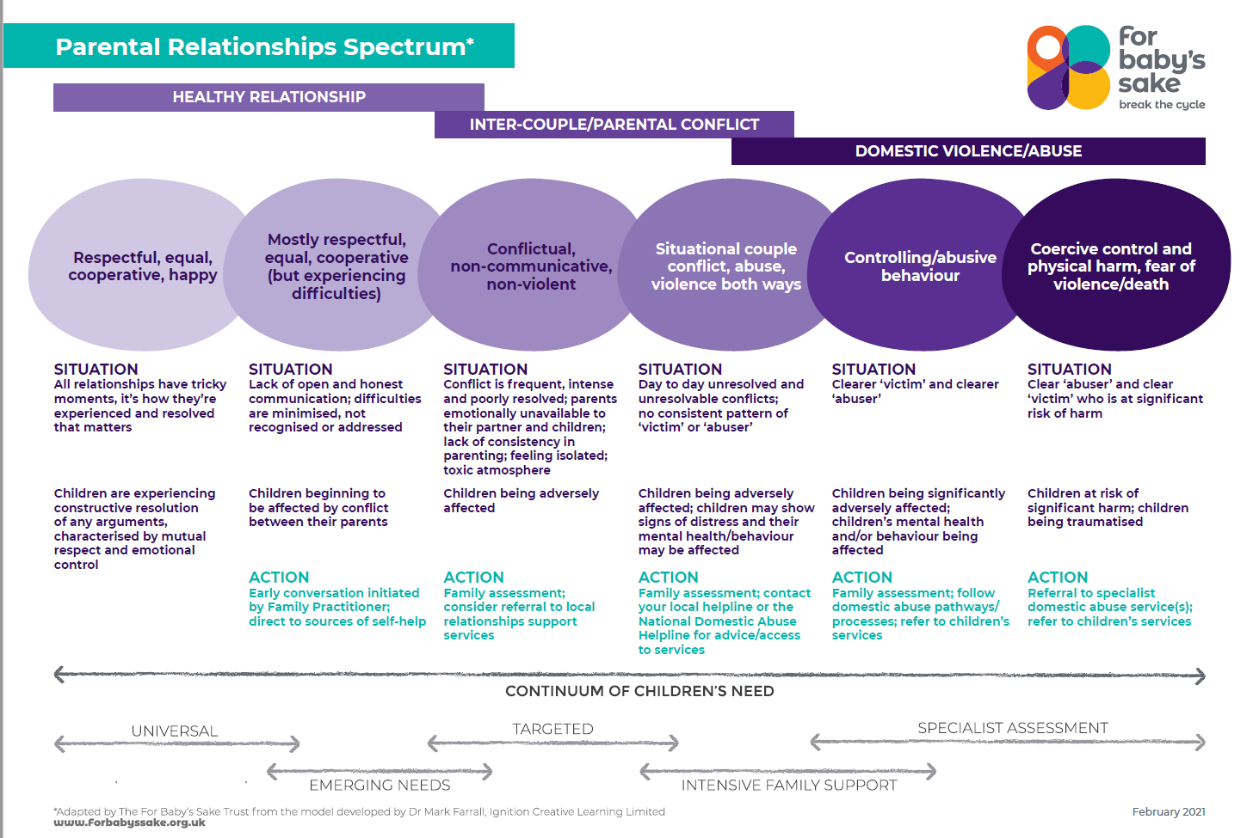
Parental Relationship Spectrum
Notes:
‹#›

Slide 5
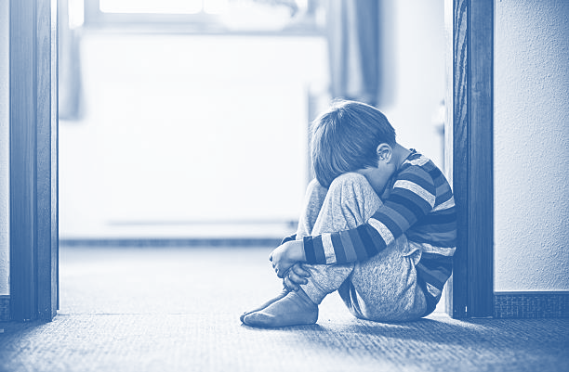
Estimated need
1,249,820
Notes:
‹#›

Slide 6

The impact of parental conflict on child outcomes
Physical health problems
Poor mental health and psychological wellbeing
Poor academic performance
Risky health behaviour
Low employability and poor economic outcomes
Emotional and behavioural problems
Social and interpersonal relationship problems
Sleep problems
Notes:
‹#›

Slide 7
Evidence: Gordon Harold
Parental conflict impacts on a child’s outcomes whether parents are together or separated
Parental conflict across the spectrum from ‘silence to violence’ is potentially damaging
Offering evidence-based support with parenting is likely to be ineffective where there is conflict between parents
Growing group of proven interventions to reduce parental conflict and improve children’s outcomes
Evidence suggests that parental conflict may have more of a negative impact on the father-child relationship that the mother-children relationship
www.eif.org.uk/report/what-works-to-enhance-interparental-relationships-and-improve-outcomes-for-children
Notes:
‹#›

Slide 8
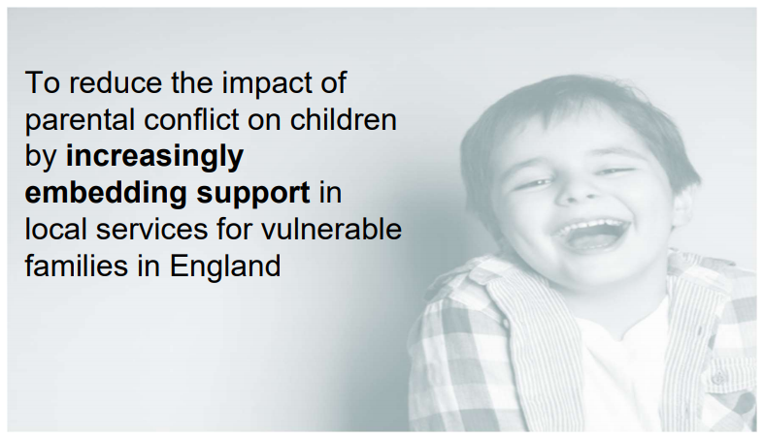
Reducing Parental Conflict National Programme Vision and Purpose
Notes:
‹#›

Slide 9
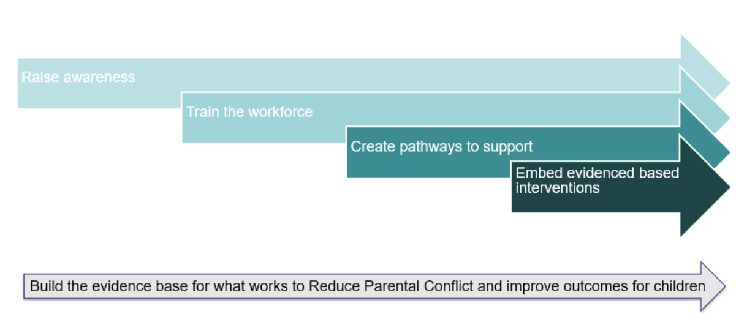
Programme aims
Notes:
‹#›

Slide 10
What is happening in Blackpool?
Reducing Parental Conflict awareness briefings
E-learning on iPool
The PAN-Lancashire Relationship Toolkit Training
The PAN-Lancashire Structured Support Sessions Practitioner Training
Healthy Relationships parenting programme
Digital offer
Notes:
‹#›

Slide 11
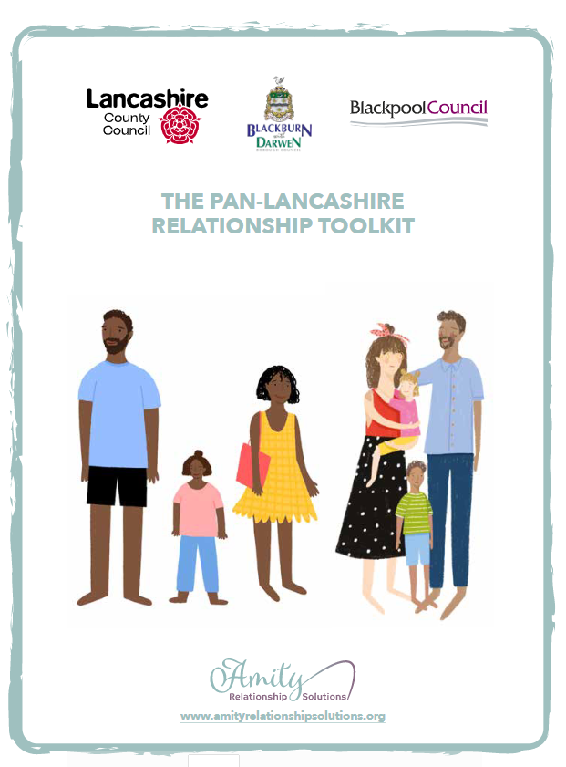
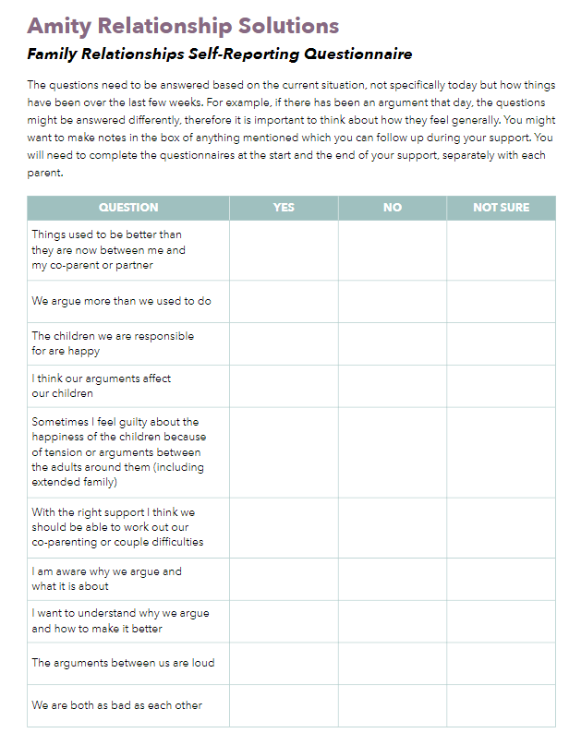
Toolkit for all practitioners
Notes:
‹#›

Slide 12
Next steps….
Access to e-learning training modules
Toolkit Training
Structured Support Session Training
Notes:
‹#›

