Slide 1
Holiday Activities and Food Programme
(HAF)

Slide 2
Background
School holidays can be a particular pressure point for some families because of increased costs such as food, childcare and reduced incomes.
For some children that can lead to a holiday experience gap, and for children from disadvantaged families they may be:
less likely to access organised out-of-school activities
more likely to experience ‘unhealthy holidays’ in terms of nutrition and physical health (holiday hunger)
more likely to experience social isolation
Children here in Blackpool face particular high levels of poverty, with 38.56% of children living in income deprived households so are particularly vulnerable to “holiday hunger” and its issues during the school holidays . With c7500 pupils known to be eligible for free school meals across both primary and secondary schools in our town there is a growing need to support these children by offering holiday activity and food programmes.

Slide 3
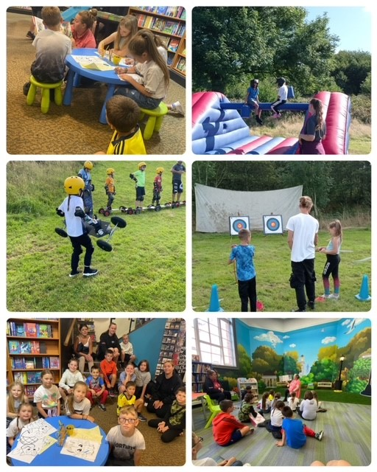
What is HAF?
The Blackpool Holiday Activity and Food programme (HAF) is a government funded programme for children who are in receipt of benefits-related free school meals (Reception to Year 11)
We work with local providers to provide a wide range of activities, health and nutrition information and free healthy meals each day to the participants
Our providers are contracted to an Open Flexible Framework created to purchase places and programmes to create a consortium of Service Providers that meet the Department for Education (DfE) and Blackpool Councils’ requirements for the HAF Programme This Open Framework enables new Providers to tender so that we can benefit from new entrants to the market.

Slide 4
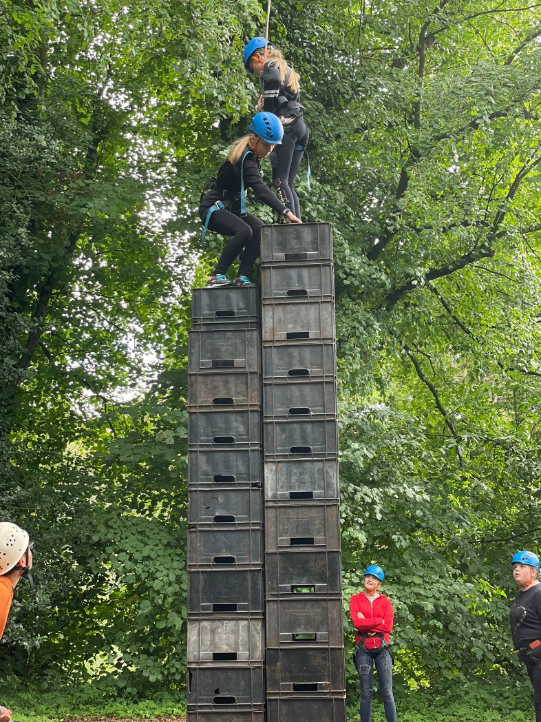
A HAF programme commissioned under the open Framework must meet the DfE requirements, which means:
A minimum of a four-hour session for each of four days during the Easter school holidays.
A minimum of a four session for each of four days a week for four weeks during the summer school holidays.
A minimum of a four-hour session for each of four days during the Christmas school holidays.
Every four hour session must include a meal, preferably hot, that is healthy and nutritious and meets School Food Standards.
N.B Whist the Department for Education funding only covers the HAF Programme for the Easter, Christmas & Summer holidays, Blackpool Council are also funding the remaining school holidays to support the overwhelming need in the town meaning our provision covers 11 weeks of the school holidays per year

Slide 5
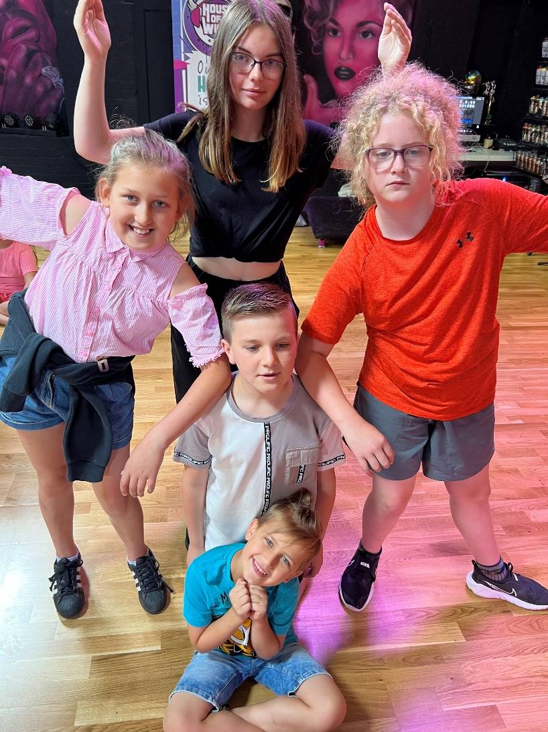
Who's involved?
We are working with local schools, voluntary and community organisations to deliver the HAF programme to eligible pupils across Blackpool.
Our current providers:-
@ The Grange
Magic Club
Blackpool Boys & Girls Club
Blackpool Football Club Community Trust
Active Blackpool
Park Rangers
House of Wingz
Boat House Youth
Dealmaker Ltd – Dish Up Recipe Boxes
My email: Annie.Tyas@blackpool.gov.uk

Slide 6
The Details
Places on the HAF scheme are available free of charge to children from Reception to Year 11 who receive benefits-related free school meals.
Each local programme provides delicious, healthy meals, allows them to get active, experience/learn new things, make friends and have fun
We want to regularly engage with a wide network of community-based organisations from across the town including existing holiday care providers, schools, sports, music groups and creative providers and any others who would be interested in taking part.
We are interested in proposals from providers who can deliver within one or more of areas of the town and from providers who would be interested in ‘scaling up’ their current provision, to meet the needs of a wider cohort of children and families within Blackpool.

Slide 7
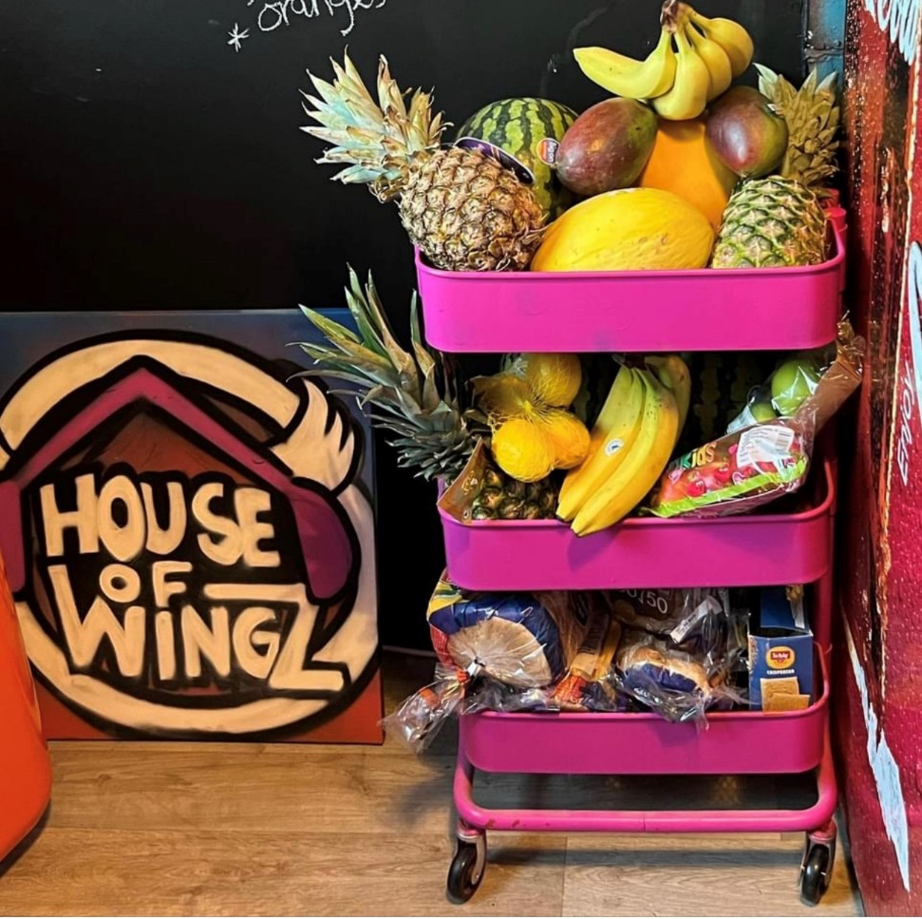
The Department for Education HAF programme aims for participating children and young people are:
To eat more healthily over the school holidays
To be more active during the school holidays
To take part in engaging and enriching activities which support the development of resilience, character, and wellbeing along with their wider education attainment
To be safe and not to be socially isolated
To have greater knowledge of health nutrition
To be more engaged with school and other local services

Slide 8
The local authorities’ additional aims for the HAF Programme are:
Our ultimate aim is to provide 1000 places across Blackpool to children and young people each day, throughout the 11 weeks. In addition to the 1000 places the partnership will aim to deliver a more targeted programme for SEND children and young people who are not able to attend a universal holiday due to complex nature of their disability
provide a spread of provision that matches the distribution of eligible children and young people across the town..
to have outstanding signposting support for participating children and their families
to strengthen partnership working within local areas
to increase prosperity by encouraging recruitment of local workers

Slide 9
Our Summer 22 HAF
This Summer we supported over 1400 eligible children offering families a safe environment to be active, educated, entertained through enrichment activities and the added provision of healthy meals.
Videos from:-
@ The Grange whose fantastic young people also wrote & performed their video’s soundtrack
Boathouse Youth whose video includes interviews with their amazing participants & staff demonstrating the difference HAF has made.
House of Wingz – whose Summer HAF culminated in a live performance event at the Old Electric for friends and family.

Slide 10
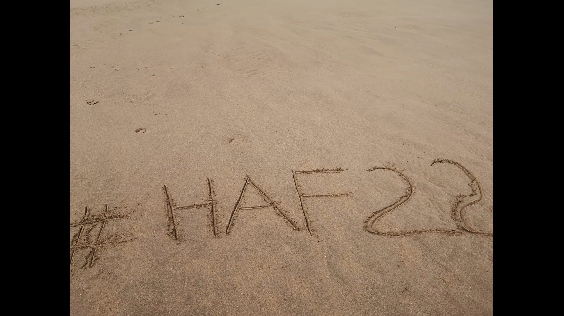

Slide 11
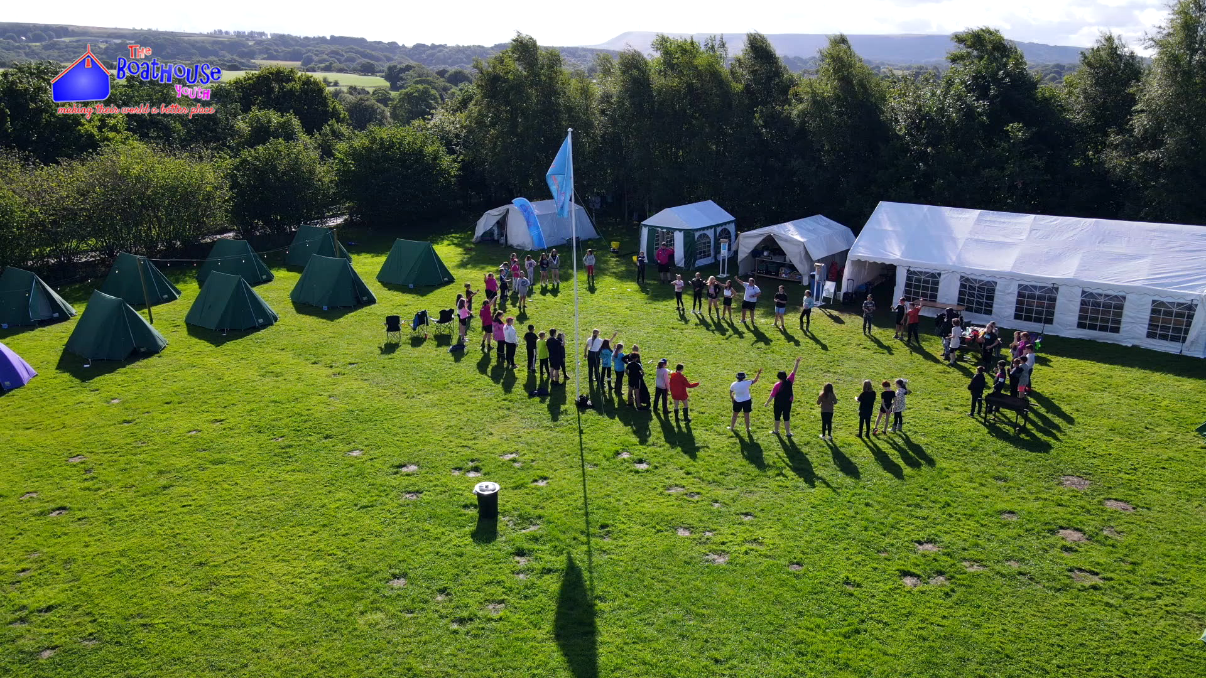

Slide 12


Slide 13
