Slide 1
Lancashire Prevent update
Imogen Lyth – Prevent Delivery Officer

Slide 2
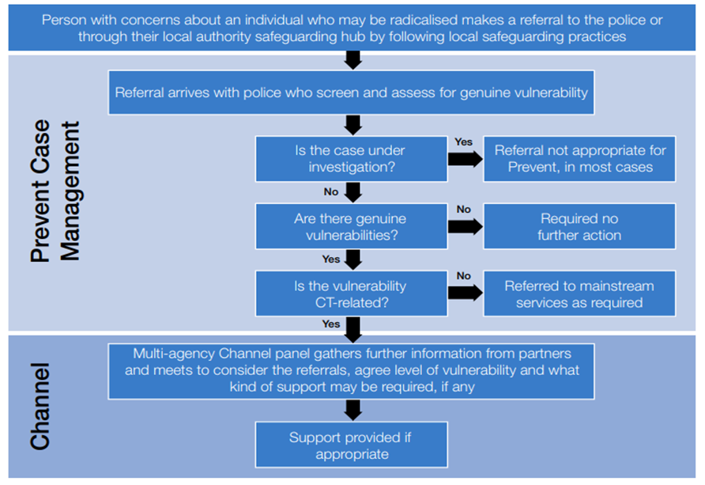
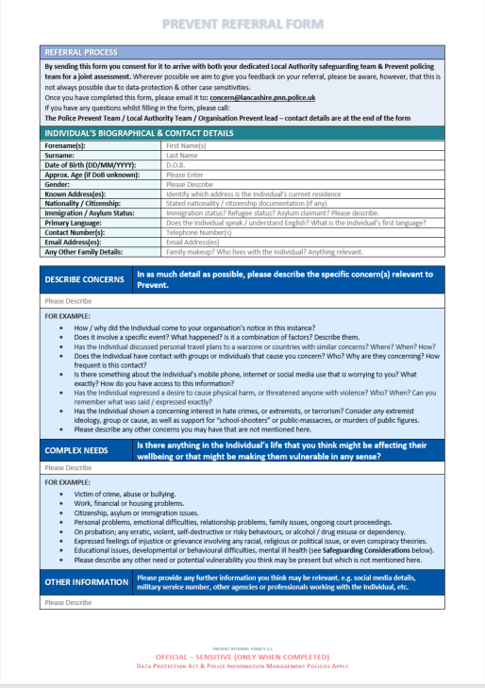
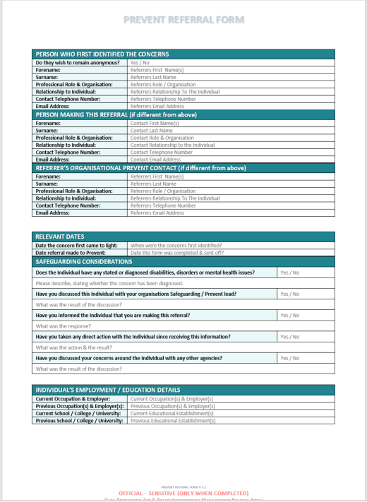
REFERRAL PROCESS
Complete the Prevent referral form and send to:
Concern@lancashire.police.uk
Notes:
Slide 30: Notes for trainer: Read
Concerns can be identified by any organisation for any form of extremism and at any age.
In the first instance we recommended that practitioners have a conversation with the individual they are concerned about, providing it is safe to do so.
Upon identifying a risk or a concern about the vulnerability of an individual in relation to radicalisation, the organisations safeguarding processes must be followed and the Prevent Lead / Safeguarding Team informed.
This can then be reported to Prevent by completing a Prevent Referral form and sending it to concern@lancashire.police.uk.
Please send all referrals to this address. This is the only address that is monitored 24/7
The Police will undertake preliminary investigations and assess the level of threat and risk posed by the individual and / or their family.
Not all cases will require further action however; there are occasions when risk may be perceived to be immediate, where the information must be reported immediately to the police who will then coordinate with the relevant local authority in taking the most appropriate action to ensure the safety of the child/adult at risk.
Where the individual is not high risk or has not fallen within the criminal space, the case will thn come to the Channel Team (Channel information on next slide).
Note: Referral to Channel is non- criminal.
When filling out a referral form it is extremely important to include as much detail as possible as lack of information may delay the support than can be provided. In particular personal details, and if referring a minor then contact details of the parents /guardian.
We are seeing an increase in referrals – partly down to greater awareness and training and confidence in the programme and what it aims to achieve. Whilst young people still make up the most number of cases, locally this year we have seen more adults referred.
We are now seeing referrals come in from HE/FE, Health, Social care etc. Referrals from the community, friends and family are low both locally and nationally which is one of the reasons the police have developed the Act Early website.
We will look at Channel in more detail in the next couple of slides

Slide 3
CHANNEL
Channel is a multi-agency approach to identify and provide support to individuals who are at risk of being drawn into terrorism or susceptible to radicalisation.
Terrorism vulnerability vs terrorism risk
Informed and explicit consent to voluntary engage with the programme
Information sharing is based on legal gateways and data sharing legislation
The Lancashire Channel panel includes professionals from a host of organisations including social care, police, Mental health, other health Education, Probation , early help & wellbeing etc.
Identify individuals at risk
Assess the nature and extent of that risk
Develop the most appropriate support plan for the individuals concerned
Notes:
Notes for trainer: Read
Channel forms a key part of Prevent. The process adopts a multi-agency approach to identify and provide early support to individuals who are at risk of being drawn into any form of terrorism or supporting terrorist organisations, regardless of age, faith, ethnicity or background. Individuals can receive support before their vulnerabilities are exploited by those who want them to embrace terrorism, and before they become involved in criminal terrorist-related activity.
There is no fixed profile of a terrorist, so there is no defined threshold to determine whether an individual is at risk of being drawn into terrorism. However, signs that extremist views are being adopted are used to assess whether the offer of early support should be made.
The administration and management of the process now lies with the Local Authority. The majority of cases are handled by the Channel Co-ordinators who will also plan and monitor any interventions, commission sessions and liaise with existing support agencies
A clear distinction should be made between individuals who present with a ‘terrorism vulnerability’ requiring Channel support and those who pose a ‘terrorism risk’ requiring management by the police. The process for undertaking assessments of risk and vulnerability informs this determination and is kept under review. Should there be an escalation of risk, the police may remove a case from Channel if appropriate.
Channel Duty Guidance was revised in November 2020
It works best when individuals and their families engage and are supported consistently by specified authorities.
- Consent is sought from the individual (or their representative) before support is accessed
If consent is not given or withdrawn at any time, they are exited from the programme. The police who own the CT risk may choose to undertake additional activity.
Lancashire Channel Panel – one panel for the county with representatives from the three upper tier authorities – LCC, BwD and Blackpool who meet on a monthly basis
We are part of a national pilot which saw the Local Authority take the lead in case management of channel cases – a team is hosted by BwDBC to cover both the Lancashire and Cumbria Channel panels.
The main elements of the process:
Identify - Unlike mainstream safeguarding for adults and children, there is no threshold to make a Prevent referral. Anyone can make a referral for an individual to access assessment and specialist support.
Assesses the nature and extent of the potential risk to an individual:
There may be cases that require a safeguarding response in conjunction with Channel so information is shared to ensure these processes and any interventions are aligned.
Channel team gather all relevant information from variety of agencies and then completed a vulnerability assessment
Cases are discussed at the Channel Panel where members make decisions on the most appropriate support package for the individual (tailored to the needs. )
This will be a combination of ideological and holistic interventions i.e. sessions with intervention providers i.e. religious scholars or former extremist, help with education, training or employment skills, mental health support etc.
Cases which are not adopted will still have some element of signposting / additional support through mainstream services.
Channel is NOT about prosecuting or stigmatising individuals who have been referred. It operates in non-criminal space and does not criminalise individuals.

Slide 4
Notes:
Our Prevent Education Offer for 22-23 academic year
This is what we offer directly to schools (and also Young Adults eg Princes Trust)
We recommend schools should have Staff Prevent Awareness Training once every 2 years and in between they should attend some of our Education Webinars, or complete the Home Office Prevent Training.
All of our services are FREE of charge

Slide 5
Notes:
Webinar’s for practitioners working in education settings
6 more planned
Again – free of charge
The content of this is the same that is delivered to staff face-to-face training (but prevent changes regularly which is why we recommend yearly training in one form or another)

Slide 6
Train The Trainer
A Train The Trainer session to equip individuals with the knowledge and resources to deliver effective Prevent training.
Ideal for DSL’s in schools
Planned an event for Blackpool School - event is Tuesday 17th and Wednesday 18th January 2023 at The Solaris Centre Blackpool
Tickets free of charge – available here;
https://www.eventbrite.co.uk/e/prevent-train-the-trainer-workshop-education-tickets-405143805027
Notes:
A Train The Trainer session to equip individuals with the knowledge and resources to deliver effective Prevent training.
This workshop provides an opportunity for practitioners to develop further knowledge around Prevent and acquire the most up to date resources developed by the Lancashire Prevent team.
By the end of the session participants will be equipped with the knowledge and tools to deliver Prevent effectively within their organisations.
The workshops will be delivered over a day and a half and will include interactive elements so that participants can ask questions, share their ideas and work through training case studies.
Following the training participants will gain access to all of the train the trainer resources developed by the Lancashire Prevent team and will be required to feedback to us once they have completed some training within their organisations.
We will also hold Prevent Champion’s Network events – aiming for people to attend one of these per year – this will be an opportunity for us to provide you willrecent updates, new resources and for you to share your experiences of delivering the Prevent training.

Slide 7
Contact details
All Prevent Referrals:
🖂 concern@lancashire.police.uk
For support, advice, training and all other enquiries relating to Prevent or Channel, please contact the Lancashire Prevent Team:
🕿 01254 585260
Prevent.team@blackburn.gov.uk
🖳 https://www.lancashirepreventpartnership.org.uk
Channel advice and guidance
🖂 Prevent.team@blackburn.gov.uk
Lancashire Police Prevent Team 🕿 101 and ask for the Prevent team. If urgent call 999. If you spot any stickers, graffiti or leaflets take a picture or report the location to stickering@Lancashire.police.uk. Please also CC your organisation’s Prevent Lead.

