Slide 1

Vaping
Year 9

Slide 2
Using this PowerPoint
The slides in this presentation are divided into two sections:
Teacher slides (purple) – provide key information regarding lesson preparation
Student slides (white) – provide a visual focus point for pupils during the lesson and delivery notes for teachers about the activities. Click ‘notes’ to view these.
Ensure that you select ‘Use Presenter View’ under the ‘Slide Show’ tab – this will allow you to preview the teaching notes on your monitor while the main presentation is displayed on a screen/smartboard.

Slide 3



Challenge and Support
The lesson includes suggestions for challenge and support activities, to help you differentiate appropriately for your class.
Challenge activities deepen and extend the learning for those who need more challenge or who finish the activity quickly.
Support activities are adapted to be more accessible for those who need it.
Look for these icons on the pupil slides. See delivery notes for details of the activities.
Challenge
Support

Slide 4
Context
This lesson has been designed by the PSHE Association to follow on from the drug education lessons for Year 9, developed for Public Health England. The existing suite of materials will be updated and relaunched in 2023.
This lesson explores the consequences of vaping and the influences that might impact young people’s behaviour relating to vaping.
This lesson is not designed to be taught in isolation, but should always form part of a planned, developmental PSHE education programme.
Please read the teacher guidance and evidence briefing accompanying the key stage 1-4 lessons, for more information about creating a safe learning environment, safeguarding, and the evidence base for the pedagogical approach to these lessons.

Slide 5
Students learn about different influences and consequences that might affect decisions relating to vaping
Pupils will be able to:
assess the potential impact of influences and marketing on young people’s behaviour related to vaping
explain the consequences of vaping, including the environmental cost
analyse ways to challenge influences and misconceptions about vaping
© PSHE Association 2023

Slide 6
Resources required
  Box or envelope for anonymous questions
  Students’ baseline mind-map activity from lesson 1 of our Year 9 drug education lesson pack
  Resource 1: Timeline [1 per pair]
  Resource 1a: Timeline - support [1 per student requiring support]
  Resource 1b: Teacher answers [1 per class]
  Resource 2: Card sort [1 per pair or small group]
  Resource 3: Challenging misconceptions [1 per student requiring support]
Duration
This has been designed to be taught as a
60-minute PSHE education lesson

Slide 7
Lesson summary
Activity | Description | Timing
Baseline assessment | Students demonstrate their prior understanding about vaping by responding to an overheard conversation. | 10 mins
Introduction | Introduce the learning objective and learning outcomes and revisit ground rules. | 5 mins
Influences and impact | Pairs review a timeline of a young person’s day and examine the influences and impact experienced at each stage. | 10 mins
Consequences of vaping | Students sort cards into environmental, legal, health, other consequences of vaping. | 10 mins
Challenging misconceptions | Students assess a range of strategies to challenge influences and misconceptions about vaping. | 15 mins
Endpoint assessment | Students revisit the mind-map baseline activity from lesson 1, adding new learning from this lesson to demonstrate progress. | 5 mins
Signpost support | Remind students how to access further advice, guidance and support related to substance issues. | 5 mins

Slide 8
Vaping
Year 9

Slide 9
Notes:
Revisit ground rules for PSHE lessons.

Slide 10
Overheard conversation
Tobi: I've heard they're safe
What do you think they are talking about?
What does the law say?
What might be the impact of disposing of them?
What other impacts might they have?
Jaz: Really? Don't you have to be 18 to buy them though?
Tobi: I don't know - people in our year have them... And I've seen loads of flavours online - there's bound to be one we'll like. Besides, they're disposable so we can just bin them if we don't like them. So, shall we give it a try?
Notes:
Teacher notes – baseline assessment (7 mins)
Ask students to read this ‘overheard conversation’ and answer the questions in their books. As this is a baseline assessment, do not provide further prompts or explanations at this point. Circulate the room while students are completing the activity, so you can gauge their current understanding and any common ideas or misconceptions and consider how to address these in the lesson. Once completed, take brief feedback from students.

Slide 11
To learn about different influences and consequences that might affect decisions relating to vaping.
  assess the potential impact of influences and marketing on young people’s behaviour related to vaping
  explain the consequences of vaping, including the environmental cost
  analyse ways to challenge influences and misconceptions about vaping
Notes:
Teacher Notes – Introduction - Learning objective and outcomes
Introduce the learning objective and outcomes and explain that today’s lesson will focus on the consequences of vaping and the influences that might impact young people’s behaviour relating to vaping.
Explain to students that ‘vapes’ are also known as e-cigarettes. Different types include vape pens, vape bars, pod devices, ‘mods’, and ‘cigalikes’; some are rechargeable, while others are disposable. They work by heating a liquid that can then be inhaled. The liquid typically contains nicotine, propylene glycol, vegetable glycerine, and flavourings, but not tobacco. They therefore do not produce tar or carbon monoxide (the damaging elements in tobacco smoke).

Slide 12
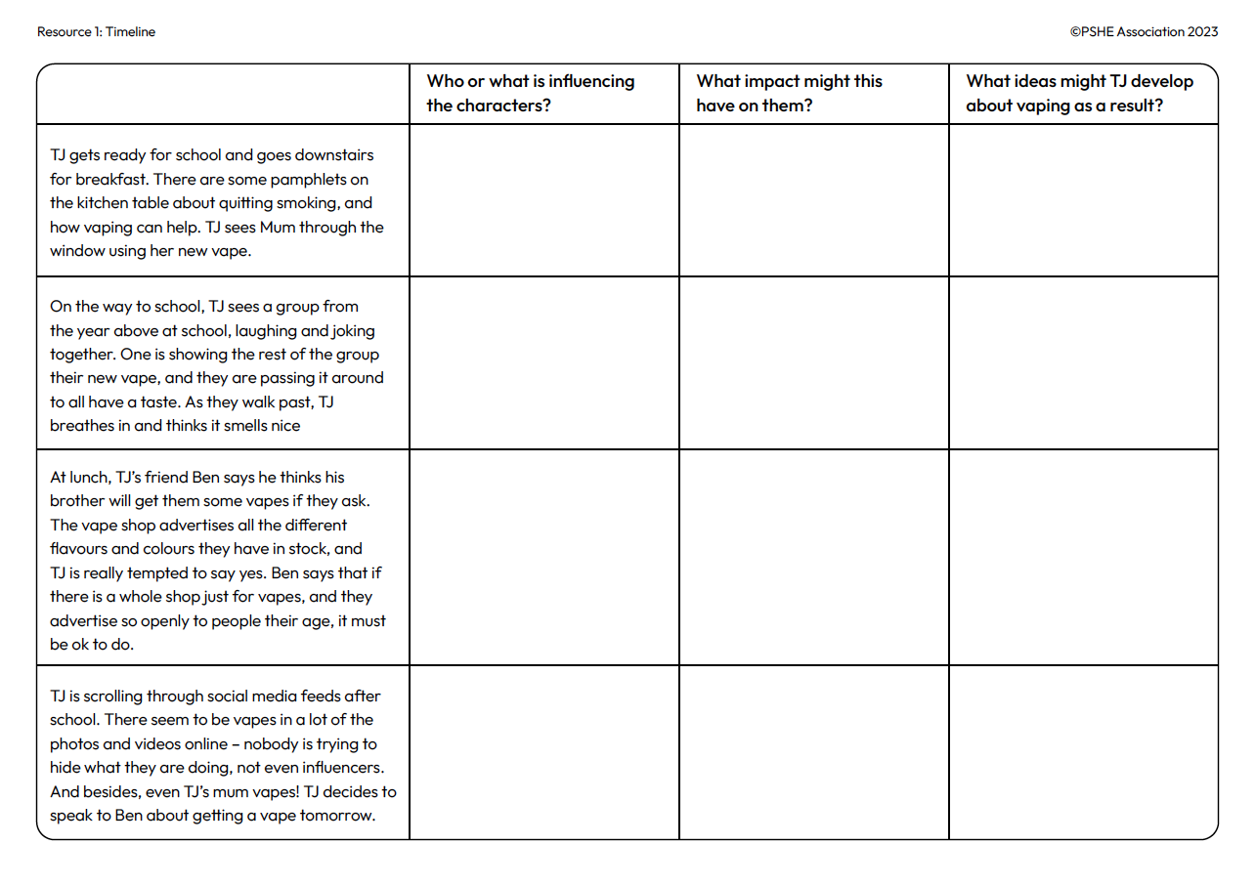


TJ: A day in the life
Read the timeline of TJ’s day and, in pairs, answer the questions on your handout.
Notes:
Teacher notes – Influences and impact (15 mins)
In pairs, give students Resource 1: Timeline, which outlines what a young person sees throughout the day related to vaping. Ask them to respond to the three questions about each stage.
Take feedback, using Resource 1b: Teacher answers to help guide discussions.
Support: Give students Resource 1a: Timeline – support.
Challenge: Ask students to evaluate what they think has the greatest influence on TJ and explain why, and then consider how and why this might be different to other characters in the timeline.

Slide 13
Consequences of vaping
Draw the four-square grid shown below. Then, sort the consequences cards by deciding which category each fact should come under.
Environmental impact | Health impact
Legal impact | Other impact
Notes:
Teacher notes – Consequences of vaping (10 mins – slides 13-17)
In pairs or small groups, ask students to sort the consequences cards from Resource 2: Card sort into the four-square grid shown on the PPT slide. Students should decide on the category each fact about vaping should come under: environmental impact, health impact, legal impact, other impact.
Take feedback, using slides 14-17 to guide discussions.
Support: If required, share some example answers with students:
Environmental - More than half of people who buy single-use vapes bin them and some of the biggest vaping brands do not take any specific steps to promote recycling.
Health - The long-term risks of vaping are unclear. While vaping is far less harmful than smoking (the risks from which are well-evidenced), it is not risk free.
Legal - It is not illegal to smoke or vape underage, but anyone who sells cigarettes or vapes to under-18s, or buys them on behalf of anyone under 18, is breaking the law.
Other - Vapes can help someone to quit smoking, by providing a replacement source of nicotine for those who want to quit smoking (although they are not recommended for non-smokers).
Challenge: Ask students to discuss which category is most likely to influence a young person’s decision to vape or not and why.

Slide 14
Consequences of vaping
Environmental impact
In the UK, two disposable vapes are thrown away every second. Over a year, this is enough lithium to make around 1,200 electric car batteries (lithium is needed for batteries, decreasing reliance on fossil fuels).
More than half of people who buy single-use vapes bin them and some of the biggest vaping brands do not take any specific steps to promote recycling.
In the UK, vapes require specialist recycling. If they aren’t recycled, the lithium-ion batteries can start fires when crushed in a waste truck or at a waste-processing plant.
Notes:
Teacher notes – Consequences of vaping – answers
Take feedback, using this slide to help guide discussions on the cards students have identified as having an environmental impact.

Slide 15
Consequences of vaping
Health impact
The long-term risks of vaping are unclear. While vaping is far less harmful than smoking (the risks from which are well-evidenced), it is not risk free.
Vaping can be addictive, mostly due to the presence of nicotine and the ease with which it can be taken and become part of someone’s daily routine.
The liquid and vapour in vapes contain some chemicals found in cigarette smoke (although at lower levels) that may be harmful.
Vaping still exposes users to some toxins. Nicotine is an addictive substance and evidence suggests it may be riskier for young people than adults.
Notes:
Teacher notes – Consequences of vaping – answers
Take feedback, using this slide to help guide discussions on the cards students have identified as having an impact on health.

Slide 16
Consequences of vaping
Legal impact
It is not illegal to smoke or vape underage, but anyone who sells cigarettes or vapes to under-18s, or buys them on behalf of anyone under 18, is breaking the law.
Vapes are an age-restricted product because there is potential for users to become addicted to nicotine-containing vapes, and because the long-term effects of vaping on health are unknown.
Notes:
Teacher notes – Consequences of vaping – answers
Take feedback, using this slide to help guide discussions on the cards students have identified as having a legal impact.

Slide 17
Consequences of vaping
Other impact
Vapes can help someone to quit smoking, by providing a replacement source of nicotine for those who want to quit smoking (although they are not recommended for non-smokers).
The vaping industry continues to grow (with some vaping companies backed by the tobacco industry) and is solely focused on making a profit.
Organisations are free to make their own policies about where people can vape. This may mean that someone has to separate from their friends/family and go to a designated area where they are allowed to vape.
Notes:
Teacher notes – Consequences of vaping – answers
Take feedback, using this slide to help guide discussions on the cards students have identified as having another type of impact.

Slide 18
Consequences of vaping: personal reflection
Privately reflect on what you think the most significant impact is.
Think about which consequences would be most likely to influence your own decisions about vaping…
Notes:
Teacher notes – Consequences of vaping
Then, ask students to reflect for themselves and evaluate what they think the most significant impact is, based on which they think would be most likely to influence their own decisions about vaping. As this is a personal reflection task, students are not required to share their answers with the rest of the class.

Slide 19
Challenging misconceptions
In small groups, look at TJ’s timeline again…
How might someone challenge negative influences and misconceptions related to vaping?
Brainstorm any strategies that you think TJ and TJ’s friends could use to manage influence, or anything they could say or do to challenge any misconceptions about vaping.
Hint: Think about the facts about vaping from the last activity!
Notes:
Teacher notes – Challenging misconceptions (10 mins – slides 19 and 20)
In small groups, ask students to return to the timeline in Resource 1 and discuss how someone might challenge negative influences and misconceptions related to vaping. On flipchart paper, they should brainstorm any strategies they think TJ and their friends could use to manage influence, or anything they could say or do to challenge any misconceptions about vaping, drawing on the facts from the previous activity.
Take feedback from each group, drawing out the following key learning in the discussion:
TJ’s misconceptions might include: vaping is a safe, social activity, because some other people from school do it; vaping is harmless for children because the packaging and smells seem to make it appeal to young people; vaping can’t be that bad for the environment because there’s not much information about needing to recycle vapes; vaping is the same as smoking cigarettes, so there’s no point in Mum switching to vapes from cigarettes; most young people try vaping at some point in their lives; if Ben gets some vapes, TJ has to try them.
However, while vaping can benefit someone who is trying to quit smoking, it has no other benefits. Vapes can provide a replacement source of nicotine for those who want to quit smoking but are not recommended for non-smokers. Disposable vapes do not contain as much nicotine as a packet of 20 cigarettes, but the National Institute for Health and Care and Excellence (NICE) recommends that vaping should be discouraged in children and young people who have never smoked.
Vaping companies are focused on making profits and will market products with this in mind, rather than raising awareness about the unknown health effects, long-term financial cost of vaping, or environmental impact.
Depending on the influence/pressure someone is experiencing about vaping, someone might say a polite but assertive ‘no thanks’ to offers of vaping; talk to friends/peers about their intention not to vape; agree to respect others’ decisions not to vape; access help and support if required. Remind students that sometimes people might be going along with others because of influences including peers, celebrities/influencers, social media, advertising, but it can just take one person to ‘break ranks’ for others to admit they feel the same about what is happening. They should also remember that the vast majority of young people do not vape – according to ASH, amongst 11- to 17-year-olds, only 3.1% vape more than once a week, and 3.9% vape less than once a week.
Support: Give students the writing frame in Resource 3 to help them identify TJ’s misconceptions and negative influences, and then consider how to overcome these.
Challenge: Ask students to assess which point they think most effectively challenges one or more misconceptions, and which they think is most effective to challenge negative influences.

Slide 20
Challenging misconceptions
Tobi: I've heard they're safe
Jaz: Really? Don't you have to be 18 to buy them though?
Tobi: I don't know - people in our year have them... And I've seen loads of flavours online - there's bound to be one we'll like. Besides, they're disposable so we can just bin them if we don't like them. So, shall we give it a try?
Think about what you have learnt in this lesson and write a response from Jaz, declining Tobi’s offer.
Notes:
Teacher notes – Challenging misconceptions (10 mins – slides 19 and 20)
Then, ask students to return to the overheard conversation from the start of the lesson and, working on their own, draw on what they have learnt in this lesson to write a response from Jaz, declining Tobi’s offer.

Slide 21
What have we learnt?
  Look back at your mind-map from lesson 1.
  Is there anything you want to add or change based on what you have learnt this lesson? (Can you show you’ve met the learning outcomes?)
  Make changes and add new learning to your mind-map in a different colour.
Notes:
Teacher Notes – Endpoint assessment (10 mins)
Return students’ baseline mind-map activity from lesson 1 of the existing suite of Year 9 lessons. Ask them to now revisit their ideas, change anything they want to and add anything new they can, based on what they have learnt this lesson. Students should use a different coloured pen to do this. As a prompt, remind them that the learning outcomes for the lesson concerned the potential impact of influences and marketing on young people’s behaviour related to vaping; the consequences of vaping, including the environmental cost; and ways to challenge influences and misconceptions about vaping.
This can be used to demonstrate progress and inform future teaching.

Slide 22
Further support
Speak to a tutor, head of year, school nurse, or other trusted member of staff in school.
Contact Childline: www.childline.org.uk
0800 1111
Contact the National Smokefree Helpline: 0300 123 1044
Further information is available via FRANK: www.talktofrank.com/get-help
I need your help with something . . .
Something's worrying me,
can I talk to you?
I have something that’s been bothering me . . .
Notes:
Teacher Notes – Signposting support (3 mins)
Remind students that they can access support at home, and both in school (through their form tutor, head of year, or school nurse) and out of school, through their GP, local and national organisations. Share the following websites and phone numbers with students:
Childline - www.childline.org.uk Phone: 0800 1111
FRANK - www.talktofrank.com/get-help Phone: 0300 1236600
National Smokefree Helpline: 0300 123 1044
They can find more information and advice about vaping at: www.talktofrank.com/drug/vapes.

Slide 23
Extension
Imagine that TJ’s friend Ben has decided to ask his brother to buy him a vape (even though TJ no longer wants one).
Write a response from Ben’s brother explaining why he won’t buy him a vape.
Notes:
Teacher notes – Extension activity
Ask students to imagine that TJ’s friend Ben has decided to ask his brother to buy him a vape (even though TJ no longer wants one) and write a response from Ben’s brother explaining why he won’t buy him a vape, drawing on their key learning from today’s lesson.

