Slide 1
Ensure you read the guidance before teaching the lesson
Teacher
slide
Fertility and pregnancy choices
KS4/5
Lesson 3: Pregnancy choices: abortion
Notes:
Download the accompanying resources from the PDF: https://www.pshe-association.org.uk/curriculum-and-resources/resources/fertility-and-pregnancy-choices

Slide 2
Teacher
slide
Using this PowerPoint
The slides in this presentation are divided into two sections:
Teacher slides (purple) – provide key information regarding lesson preparation
Pupil slides (white) – provide a visual focus point for pupils during the lesson and delivery notes for teachers about the activities. Click ‘notes’ to view these.
Ensure that you select ‘Use Presenter View’ under the ‘Slide Show’ tab – this will allow you to preview the teaching notes on your monitor while the main presentation is displayed on a screen/smartboard.
© PSHE Association 2021

Slide 3
Challenge and support
Teacher
slide
The lesson includes suggestions for challenge and support activities, to help you differentiate appropriately for your class.
Challenge activities deepen and extend the learning for those who need more challenge or who finish the activity quickly.
Support activities are adapted to be more accessible for those who need it.
Look for the logo on the pupil slides. See delivery notes for details of the activities.
Support
Challenge
© PSHE Association 2021

Slide 4
Context
Teacher
slide
This is the last of three lessons for key stage 4 and 5 students focusing on fertility and pregnancy choices. This lesson teaches students about the laws related to abortion, addresses myths and misconceptions and explores options for help and support.
Neither this, nor any of the other lessons, is designed to be taught in isolation, but should always form part of a planned, developmental PSHE education programme, as part of wider learning on families and parenting.
© PSHE Association 2021

Slide 5
Developing subject knowledge
Teacher
slide
Key information on content related to these lessons can be found in the Knowledge Organiser.
Advice on safe practice, ensuring inclusivity and other important information can be found in the Teacher Guidance.
© PSHE Association 2021
Notes:
The knowledge organiser, teacher guidance & accompanying resources are available from the PDF lesson pack: https://www.pshe-association.org.uk/curriculum-and-resources/resources/fertility-and-pregnancy-choices

Slide 6
Teacher
slide
Learning objective
To learn about the laws related to abortion and support available
Learning outcomes
Students will be able to:
identify key legal considerations in relation to abortion
explain why there are strongly held views on either side of the abortion debate
explain where and how to access medical services and emotional support
© PSHE Association 2021

Slide 7
Teacher
slide
Preparing to teach
Climate for learning
Make sure you have read the accompanying teacher guidance before teaching this lesson, which includes guidance on establishing ground rules, the limits of confidentiality, inclusion, communication and handling questions effectively.
Resources required
Box or envelope for anonymous questions
Resource 1: Forum post [1 per student]
Resource 2: Fact or fiction? [1 per pair]
Resource 2a: Fact or fiction? Alternative [1 per student requiring additional support]
Resource 2b: Fact or fiction? Teacher answers and notes
Resource 3: Help and support [1 per pair]
Resource 4: Support options [Optional]
Duration
This has been designed to be taught as a sixty minute PSHE education lesson
Further guidance
Members of the PSHE Association can access our website for further guidance www.pshe-association.org.uk
60
© PSHE Association 2021
Notes:
The accompanying resources are available from the PDF: https://www.pshe-association.org.uk/curriculum-and-resources/resources/fertility-and-pregnancy-choices

Slide 8
Teacher
slide
Lesson summary
Activity | Description | Timing
Introduction | Introduce learning objectives and outcomes and reinforce ground rules. | 5 MINS
2. Baseline assessment | Independently, students respond to a forum post by a young couple who want to have an abortion. | 10 MINS
3. Fact or fiction? | In pairs, students assess whether a variety of statements about abortion are true or false. | 15 MINS
4. Abortion influences | Brief explanation by teacher about the debates surrounding abortion. | 10 MINS
5. Help and support | Students review sources of help and support in relation to abortion. | 10 MINS
6. Reflection and endpoint assessment | Class return to forum post from the start of the lesson and provide advice based on their learning. | 5 MINS
7. Signpost support | Reinforce the options available for sources of support. | 5 MINS
© PSHE Association 2021

Slide 9
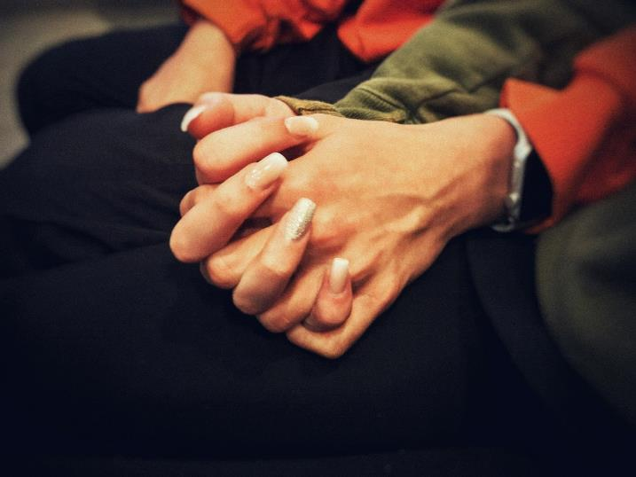
Lesson 3:
Pregnancy choices: abortion

Slide 10
Ground rules
[Add your class rules here]
Notes:
Teacher Notes
Negotiate or revisit ground rules for the lesson, particularly ground rules about respecting others’ views and commenting on what was said, not who said it.
Use this slide to display your class agreement / ground rules for PSHE education lessons. See Accompanying Teacher Guidance Notes (separate document).

Slide 11
We are learning about the laws related to abortion and support available
We will be able to:
identify key legal considerations in relation to abortion
explain why there are strongly held views on either side of the abortion debate
explain where and how to access medical services and emotional support
Notes:
Teacher Notes – Learning objective and outcomes
Introduce the learning objective and outcomes and explain that today’s lesson will explore the facts and laws relating to abortion (which is also known as termination) and the help and support available.

Slide 12
Forum post
Read the forum post on your handout.
Respond by completing the sentences in the boxes beneath.
Notes:
Teacher Notes - Baseline assessment (10 mins)
Ask students to read the post made by a young couple seeking an abortion in Resource 1: Forum post. Ask students to complete the sentences in the response boxes underneath, writing down everything they think or believe in relation to abortion. As this is a baseline assessment, they should work on their own, without any prompting or examples.
Circulate the room while students are completing the activity. This will allow you to gauge students’ current understanding and any common ideas or misconceptions, some of which will be addressed in the next activity. Once completed, make sure students have added their names and put these to one side, as these will be revisited at the end of the lesson.
*Download the accompanying resources from the PDF: https://www.pshe-association.org.uk/curriculum-and-resources/resources/fertility-and-pregnancy-choices

Slide 13
Fact or fiction?
In pairs, read the statements related to abortion in the Fact or fiction? table on your handout.
Then, assess and write down whether you think each statement is true or false.
Notes:
Teacher Notes – Fact or fiction (15 mins)
In pairs, ask students to complete Resource 2: Fact or fiction? analysing the validity of different statements and myths related to abortion. You could use a thumbs up/thumbs down approach to class feedback. After each statement, share the answers on the next slide and the supporting information, using Resource 2b: Fact or fiction? Teacher answers and notes.
Support: Ask students to complete a simplified version of the activity, using Resource 2a: Fact or fiction? Alternative.
Challenge: For any statement that students have judged to be ‘fiction’, ask them to add what the true statement should be in the ‘challenge’ column.

Slide 14
Fact or fiction? Answers
1. It is only possible to get an abortion if the GP agrees to make a referral.
2. Abortions should be carried out in the first 24 weeks of pregnancy.
3. Abortion can be accessed free from the NHS.
4. Two doctors must agree to the abortion.
5. The couple who have conceived must both agree to the abortion for it to be carried out.
Fiction
Fact
Fact
Fact
Fiction
Notes:
Teacher Notes – Fact or fiction (15 mins)
Use Resource 2b: Fact or fiction? Teacher answers and notes to support feedback.

Slide 15
Fact or fiction? Answers
6. Under 16 years old, parental permission must be given for an abortion to go ahead.
7. Abortion is a safe procedure.
8. Counselling must be provided before an abortion can go ahead
9. Having an abortion will not affect the chances of having a baby in the future
10. Taking emergency contraception, e.g. the morning-after pill, is a method of abortion.
Fiction
Fact
Fiction
Fact
Fiction
Notes:
Teacher Notes – Fact or fiction (15 mins)
Use Resource 2b: Fact or fiction? Teacher answers and notes to support feedback.

Slide 16
Abortion influences
What do you think might influence someone’s views about abortion?
Create a list of possible influences.
Some people support the practice of abortion and others oppose it, but everyone is entitled to their own opinions and should be allowed to make the decision that they feel is best for them.
Notes:
Teacher Notes – Abortion influences (10 mins)
Ask students to list what they think might influence someone’s views about abortion and take some feedback.
Opinions on abortion might be influenced by: someone’s family, friends, or peers; their personal values; their culture; their religion; the strength and/or nature of their relationship with their partner; their plans for the future; the legal status of abortion; the media.
Explain to students that some people support the practice of abortion and others oppose it. Often this is because both sides of the debate are representing competing beliefs (sometimes, but not always, linked to religious belief); about the rights of the foetus (often referred to as “pro-life”), e.g. the right to life; and the rights of the pregnant woman (or trans man) (often referred to as “pro-choice”) e.g. the right to choose what happens to their body. While it is a controversial and contentious issue, both sides believe they are supporting very important and valuable rights on either side. It is important to emphasise that everyone is entitled to their own opinions about these rights and should be allowed to make the decision that they feel is best for them.

Slide 17
Help and support
In pairs, complete the table in your Help and support handout, identifying possible people, groups, or organisations who may be able to provide the type of help and support stated.
The same person/group may be added more than once in different places!
Notes:
Teacher Notes – Help and support (10 mins)
In pairs, ask students to complete the table in Resource 3: Help and support, identifying possible people, groups, or organisations who may be able to provide the type of help and support stated. Explain that the same person/group may be added more than once in different places.
Take feedback, highlighting the sources of support on the next slide.
Support: Provide students with the sources of support suggestions in Resource 4: Support to help them complete the table.
Challenge: Ask students to identify who they think are the top three sources of support most beneficial to young people and explain their choices.

Slide 18
Sources of support: examples
Parents, family members or friends = listening, empathy, emotional support strategies
Someone’s partner = listening, empathy, emotional support strategies
Teachers or other trusted adults = listening, empathy, safeguarding, emotional support strategies
GPs and other medical professionals = medical advice, medical assessment, accurate, reliable, non-biased information, safeguarding, refer someone for an abortion
Counsellors = listening, empathy, therapeutic support
Advice lines, charities, specialist organisations = listening, empathy, emotional support strategies, reliable information (depending on the organisation)
Notes:
Teacher Notes – Help and support (10 mins)

Slide 19
Giving advice
Return to the forum post from the start of the lesson.
Create a new reply, giving advice to the couple based on what you have learnt this lesson.
Notes:
Teacher Notes – End-point assessment (5 mins)
Working on their own, ask students to return to the forum post from the start of the lesson. Ask them to create a new reply, giving advice to the couple based on what they have learnt this lesson.

Slide 20
Further support
Speak to a tutor, head of year, school nurse or other trusted member of staff in the school
Contact GP surgery or local sexual health clinic
Visit www.brook.org.uk/topics/pregnancy
Contact Childline www.childline.org.uk 0800 1111
Visit www.pshe-association.org.uk/curriculum-and-resources/resources/abortion-factsheet-frsh-rcog
Notes:
Teacher Notes – Signposting support (5 mins)
Ensure that students know where they can seek help and advice both now and in the future if they are concerned about unplanned pregnancy or abortion.

