Slide 2
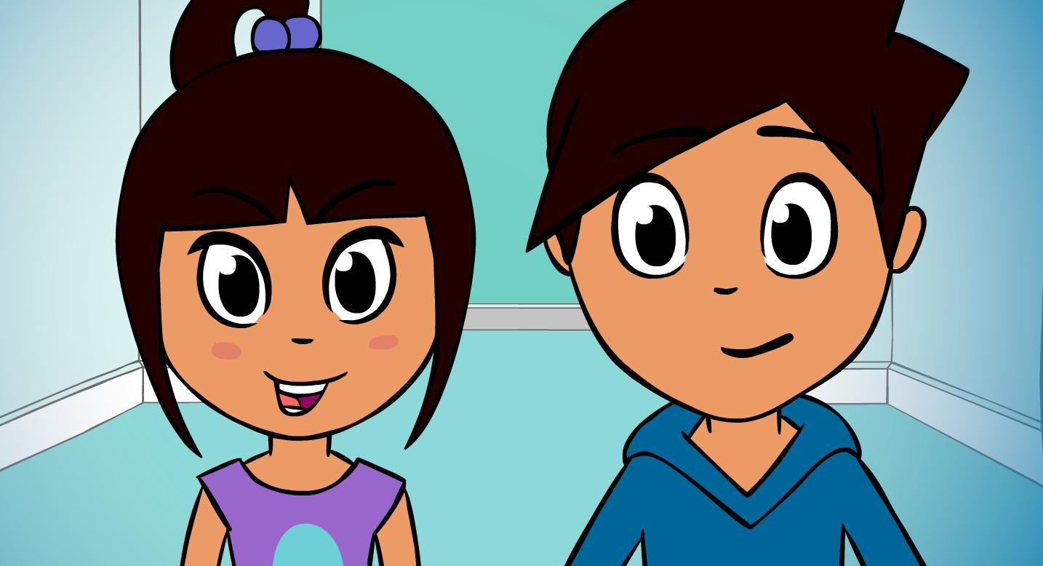
Meet Lee and Kim.

Slide 3
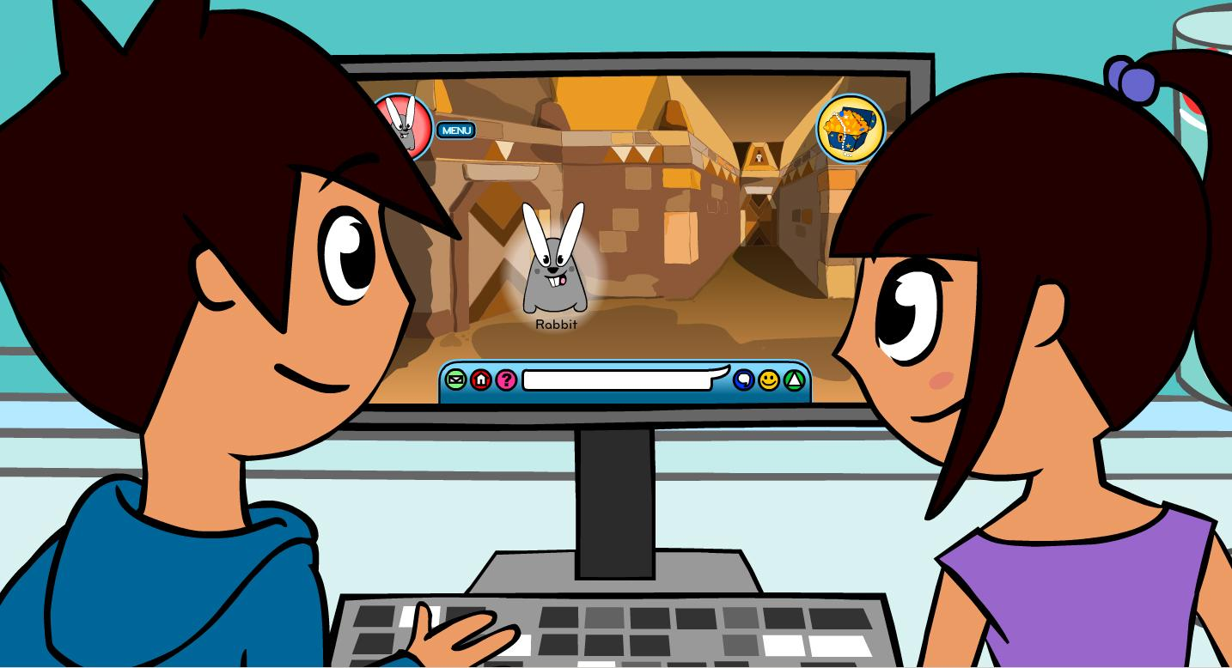
They both like to play on the computer. Lee likes to play a game called ‘Animal Magic’.

Slide 4
“Lee, show me what you have to do.” said Kim.
“The game is about finding treasure,” said Lee. “Everyone playing pretends to be an animal. I am that rabbit.”
“Cool,” says Kim. “That’s really exciting.”

Slide 5
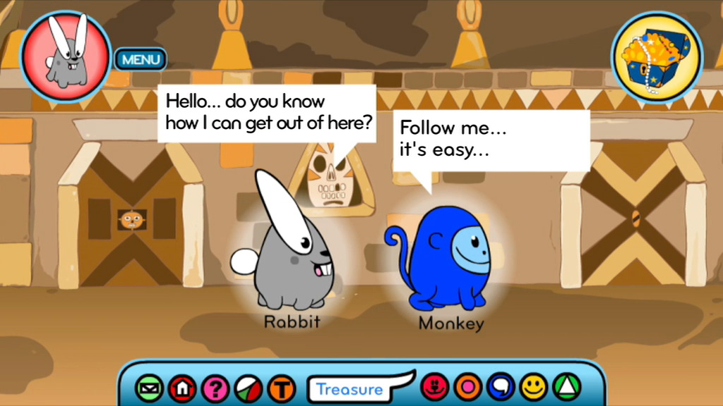
“I can talk to the other animals.” said Lee.
He typed a message on his computer.
It read, “Hello… do you know how I can get out of here?”
“Follow me…it’s easy,” replied Monkey.
“That’s a nice helpful monkey,” said Kim. “I like her.”

Slide 6
Outside was a lovely sandy beach. “This is nice,” said Kim. Lee’s rabbit met a tiger.
“Do you want to play?” Lee asked Tiger. But Tiger was very rude.
“You stink! Go away big ears!” Tiger shouted.
This made Lee and Kim really upset. “That’s so unkind,” said Lee. “We should always be nice, even when using the computer.”

Slide 7
A cuddly bear walked towards them. Cuddly Bear said, “Hello, are you looking for the treasure? I know where it is. Follow me!”

Slide 8
Lee followed Cuddly Bear into the forest.
“Where do you live?” Cuddly Bear asked Lee.
“England.” typed Lee.

Slide 9
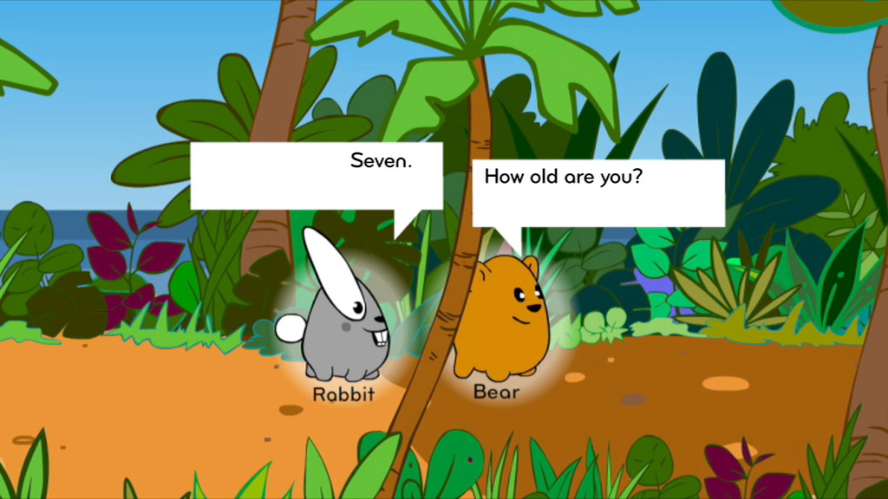
“How old are you?” said Cuddly Bear.
“Seven,” typed Lee.

Slide 10
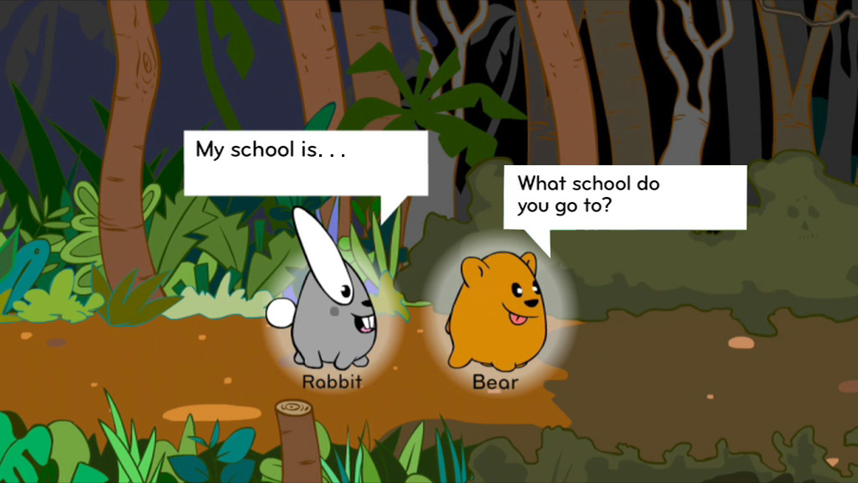
“Where do you go to school?” Cuddly Bear asked next.
“Why are they asking all these questions, Lee?” said Kim.

Slide 11
“I don’t like it. I’m getting butterflies in my tummy,” she said.
“Ssshhh,” said Lee. “They’re is taking us to the treasure. It’ll be fine.”

Slide 12
Lee was about to tell Cuddly Bear where his school was, when there was a flash of light. It was SID, the Super-Protector!
“Hold on there my friend. Not so fast!”
“Who are you?” they both cried.
“My name is SID,” he said. “It’s my job to make sure you stay safe.”

Slide 13
“But we’re not in any danger! It’s a really nice cuddly bear,” said the children.
“You don’t know that - they could be anyone,” said SID.

Slide 14
“You started to tell Cuddly Bear TOP SECRET stuff, like where you live and where you go to school,” said SID.

Slide 15
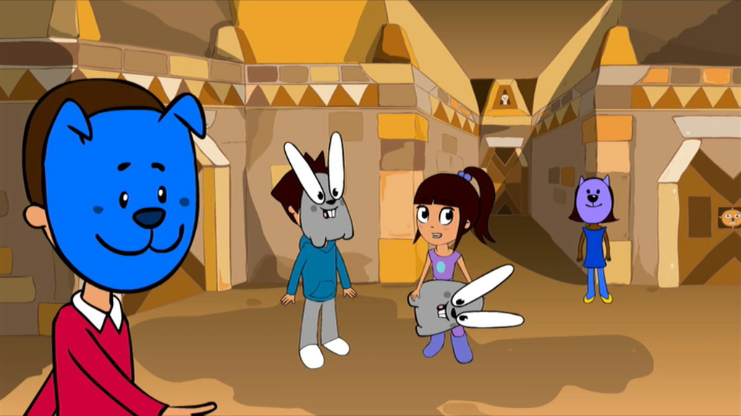
“In the game, you were just a boy behind a rabbit mask, Lee. You don’t know who the others could be.” said SID. “People you don’t know are strangers, they are not always who they say they are.” he said.

Slide 16
“Now do you see?” SID said. “You thought they were a nice cuddly bear, but they might not be nice at all. You shouldn’t go with someone you don’t trust.”

Slide 17
“I don’t want that to happen ever again!” said Kim.
“It won’t,” said SID. “I’ve got four fantastic ‘Top Tips’ to help you.”

Slide 18
“People you don’t know are strangers. They’re not always who they say they are. Bear shouldn’t have asked those questions. That’s secret stuff! You must always be very careful not go with people you don’t trust.”

Slide 19
“Remember the rude tiger, he was horrible wasn’t he? Be nice to people on the computer, like you would in the playground.”

Slide 20
“Be careful what you say to people you don’t know. Don’t give away top secret stuff like your name, where you live or where you go to school.”

Slide 21
“If you get butterflies in your tummy, remember to tell a grown-up you trust.”
“You mean someone like my mummy or daddy?” asked Kim.
“Yes, or your teacher,” replied SID.

Slide 22
SID gives Lee and Kim a badge each. “What’s this?” asked Lee.
“It means you are now a Super-Protector!” said SID.
Then, in a flash of light, SID disappeared.

Slide 23
Kim and Lee looked proudly at their badges.
“We’re Super-Protectors!” they cheered.

Slide 24
Watch SID’s song

