Slide 1
Learning about loss and bereavement
Lesson resource for Key Stage 1
Lesson 2 of 2
Developed in conjunction with Brighton & Hove City Council PSHE Team

Slide 2
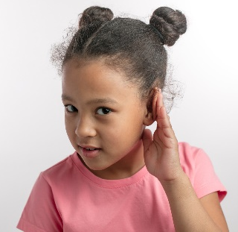
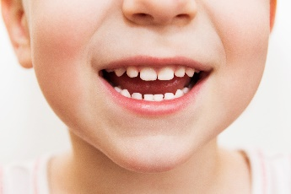
Lesson two: How can we learn well together?
Eyes for good looking
Ears for good listening
Brains for good thinking
Mouths for good talking
Hands and feet are still.
Anything else that would help us do our best learning?

Slide 3
Ground rules
Take turns to speak
Listen carefully to each other
We won’t share the names of our friends or family: say instead ‘Someone I know…’ or ‘My friend…’
You don’t have to answer
Talk to an adult if you feel worried.

Slide 4
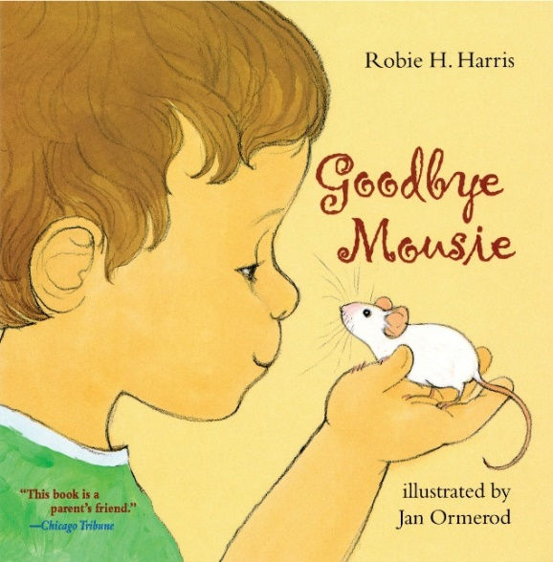
Today we are going to think about what can help when someone feels sad
What did we learn about in our last lesson?
What happened in the story?
However we feel in this lesson is OK. Remember feelings come and go.
It is also OK to ask questions and to ask for help.

Slide 5
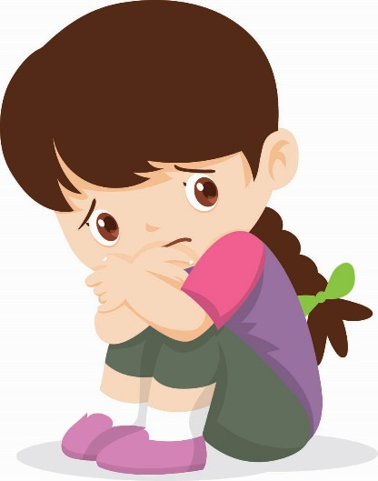
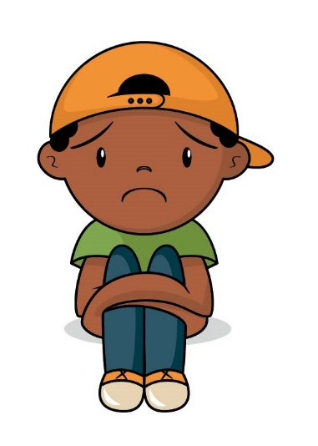
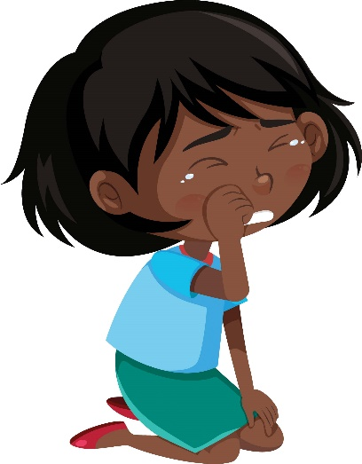
Let’s talk about supporting a friend
What would you do or say to a friend who was feeling sad?

Slide 6
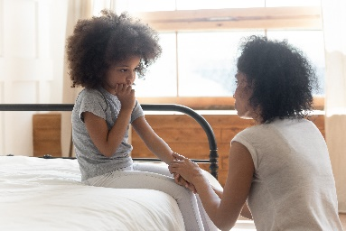
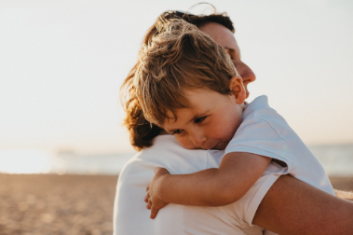
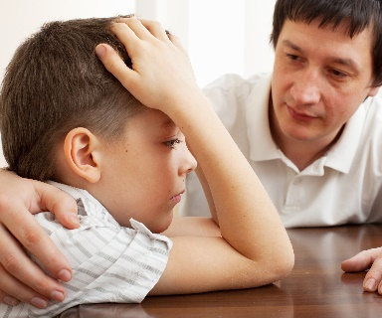
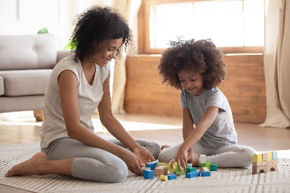
How can we comfort someone when they are sad?
In the story the grown ups try to help and comfort the child with his sad and cross feelings:
They gave him hugs and kisses
They stayed close to the child
They talked about what had happened
They said that they were sorry that Mousie had died
They said that they felt sad too

Slide 7
How can we comfort someone when they are sad?
What do you think comforted the child and helped the child to feel better?
What do you think would help or comfort you if you were feeling sad?
How could you comfort a friend at-a-distance?
Stand next to the photocard that you think would be most helpful.

Slide 8
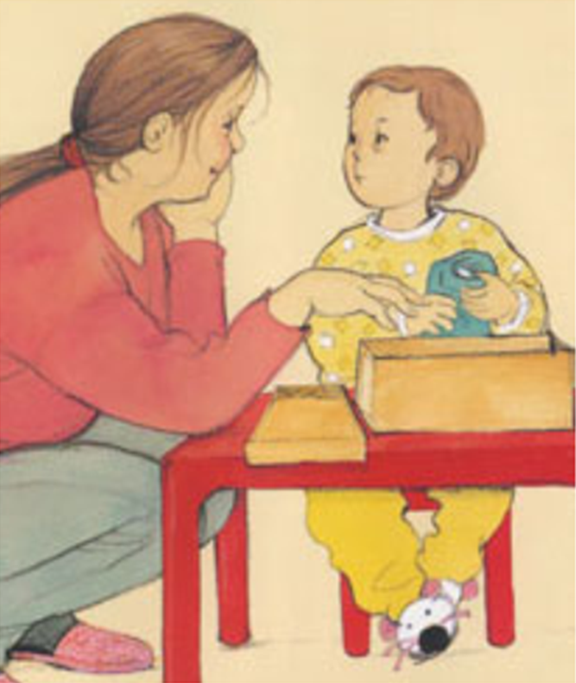
What did the family do to say goodbye to Mousie?

Slide 9
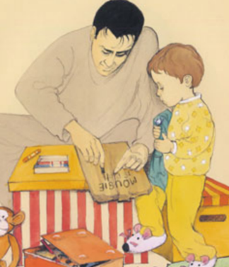
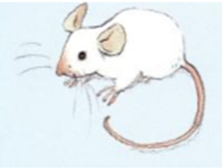
What did the family do to say goodbye to Mousie?
They wrapped up Mousie’s body in some cloth
They put Mousie in a box with some toys
The child decorated the box
They dug a hole and buried Mousie’s body in the ground
They made a sign so that they knew where Mousie was
They lit some sparklers
The child cried and said goodbye
Which two actions do you think helped the child the most? Can you think of any other ideas?
Discuss with your talk-partner.

Slide 10
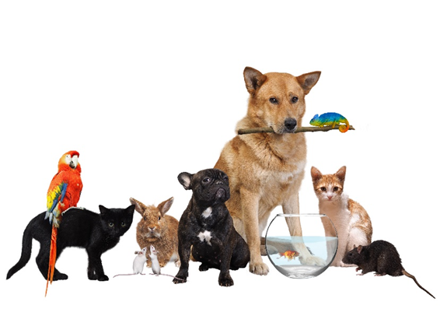
Ways to feel better after a pet dies
Sometimes when we miss a pet it can help to think of a special memory about that animal.
Think about the softness of the fur; or the funny whiskers; or the noise it makes; or how clever it is; or the games it plays.
Imagine how it would be to stroke, feed or play with this pet.
Share your idea with your talk-partner.

Slide 11
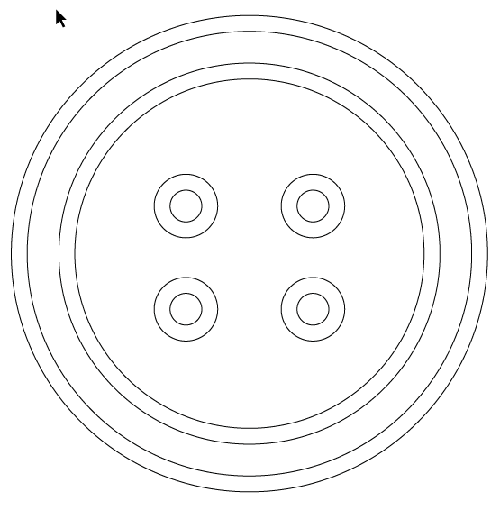
Sometimes making something can help us to remember a pet and this can help us to feel better
Colour in your button with shapes and colours that would show something special about a pet
Think about:
Colour of its fur or feathers or skin
Shape of its body
Colour of its eyes
The way it moves

Slide 12
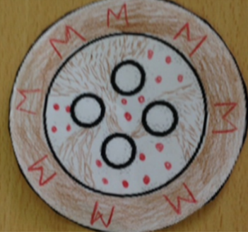
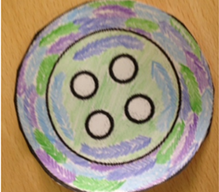
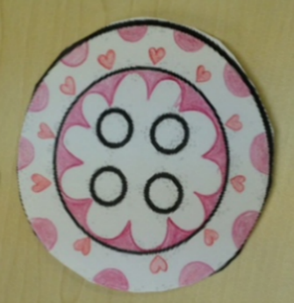
Here are some ideas to inspire you!
Colour ideas:
Green: for barks or squeaks
Yellow: for the funny way it plays or moves
Brown: for soft fur or smooth skin
Blue: for the calm feeling when it is cuddled
Red: for how happy it makes people

Slide 13
Can you help a friend?
Your friend’s hamster died last night. They tell you this has happened and they look a bit sad.
Can you think of something kind to say to them? What do you say to them?
They don’t know how to say goodbye to their pet hamster. What do you think they could do to say goodbye to their pet?

Slide 14
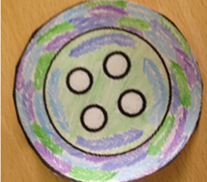
What have we learnt today?
What is a comforting action when someone feels sad?
I can comfort a friend by …
How can we say goodbye to a loved pet?
We can say goodbye to a pet by …
What can we do to remember a special pet…
We can …
Who would you ask to help if you felt sad?
I would ask …

Slide 15
It’s OK to ask for help
Who helped the child in the story?
If you are left with strong feelings or if you have a question, who could you talk to?
Who could you talk to in school?

Slide 16
Let’s do some more calming breathing to finish our lesson
Hold
Breathe in
Breathe out
Breathe out
Breathe in
Hold
Hold
Breathe in
Breathe out
Breathe out
Breathe in
Breathe in
Breathe out
Hold
Hold

